Slide 1
CPME/RRC Update
Steven Vyce, DPM, FACFAS, FNAP
RRC Chairman
CPME Council Member
Chairman and PD, Yale Dept of Podiatric Surgery

Slide 2
Disclosures
GEO-LLC member
CPME- Council Member and RRC chair
Yale Medical School- Asst Clinical Professor
Yale New Haven Hospital- Chairman and PD, Dept of Podiatric Surgery

Slide 3
Announcing new PD training!
CREC and RRC are hosting a
Program Directors/ Program Coordinators
educational training event in May 2025
See CPME.org for more details

Slide 4
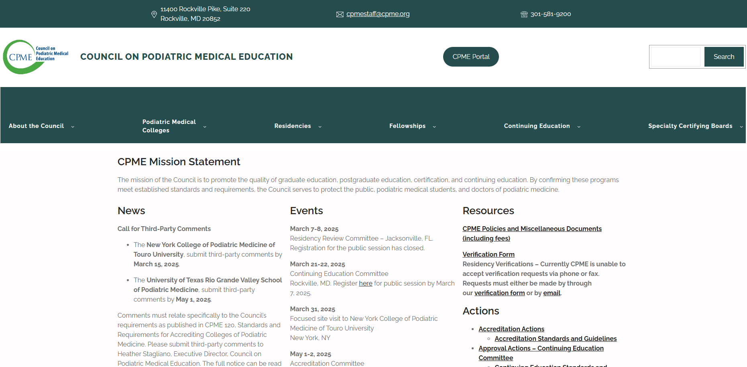
Updated Website @ https://www.CPME.org

Slide 6
New Substantive change forms on CPME.ORG

Slide 7
Logging Guidelines being rolled out on CPME.ORG

Slide 8
Procedure Notes (PN)
CPME 320 requires that the “Procedure Note”must support the chosen log category for ALL log entries and ALL categories.
PD review of the Procedure Note is the primary gauge of whether to verify log or not verify
The CLAD is NOT the primary gauge of the “appropriateness” of log entries
The Procedure Note:
Must never be left blank
Must be clear and we recommend it is concise
Must describe what is being logged even if it seems redundant to the category
Must never only say “refer to Op Note” or “refer to EMR note”
.

Slide 9
Wound Care from CPME320 update of 2023
DELETED Category 6.1 debridement of superficial ulcer or wound
MODIFIED Category 10.20 Previously: “wound care”
Now is : “wound care (non-podiatric)”
ADDED Category 11, Lower Extremity Wound Care
11.1 excisional debridement of ulcer or wound (e.g., neuropathic, arterial, traumatic, venous, thermal)
11.2 advanced wound care modalities (e.g., negative pressure wound therapy, cellular and/or tissue-based product, total contact casting, multi-layer compression therapy/Unna boot)
11.3 hyperbaric oxygen therapy

Slide 10
11.1 Wound care logging vs 3.8 I+D
11.1 = excisional debridement of ulcer or wound (e.g., neuropathic, arterial, traumatic, venous, thermal)
3.8 = incision and drainage/wide debridement of soft tissue infection
3.8 is intended for an incision and drainage (I+D) of an infection such as plantar space infection, necrotizing fasciitis, gas gangrene, etc.
3.8 is NOT used for excisional debridement of non-infected tissue, ulcer, eschar, decubitus wound etc….these would be category 11.1

Slide 11
Wound care- biologics
Debridement and application of biologic /tissue based grafts are always category 11.2 (never 3.8)
This includes the debridement prior to application

Slide 12
Delayed Wound Closure- is a 6.6
6.6 repair of simple laceration (no neurovascular, tendon, or bone/joint involvement); includes simple delayed wound closure

Slide 13
It may be a Wound Care Rotation- but is it a Medical Specialty Rotation?
For a wound care rotation to qualify as a medical subspecialty rotation, it must involve training and assessment by non-DPMs
This allows for logging in category: 10.20 wound care (non podiatric)
Programs certainly may have wound care rotations that only involve training by DPMs, but that type of rotation does not qualify as one of the two required “medical specialty” rotations, it is simply part of podiatric med/surg training.

Slide 14
Logging in Categories 9 and 10
6.2 The sponsoring institution shall require that the resident maintain web-based logs documenting clinical and didactic experiences related to the residency
Resident MUST log experiences to substantiate their rotations
Residents MUST log experiences in all non DPM rotations
Category 9-Surgical Specialties
Category 10- Medical Specialties

Slide 15
Proof of Completion of a Rotation
3 things we look for:
Properly completed evaluations for the rotation
Lists dates of rotation
Signed by evaluator, whose name + degree is printed legibly
Signed by Trainee and PD
Experiences logged for the non DPM rotation
Absence of large scale podiatric logs during that time
(we do check this and you can be cited for this)

Slide 16
Comprehensive H+Ps (CHPs) Are you sure it is not problem focused??
All CHPS must be something a CH+P can and should be done on
Think about billing and coding
E.g. could you code a 99214 for onychomycosis or heel decub visit?
No these are problem focused, so don’t use these for resident CHPs
CHPs for podiatry essentially should only be:
Admission H+P or similar initial consultation
Pre-op H+P
X Daily inpatient notes for podiatry patients generally do not need a CHP
X f/u office visits, ED consults for problem focused areas generally do not need a CHP
25 of 50 must be done with non DPMS
These should be for non-Podiatric issues

Slide 17
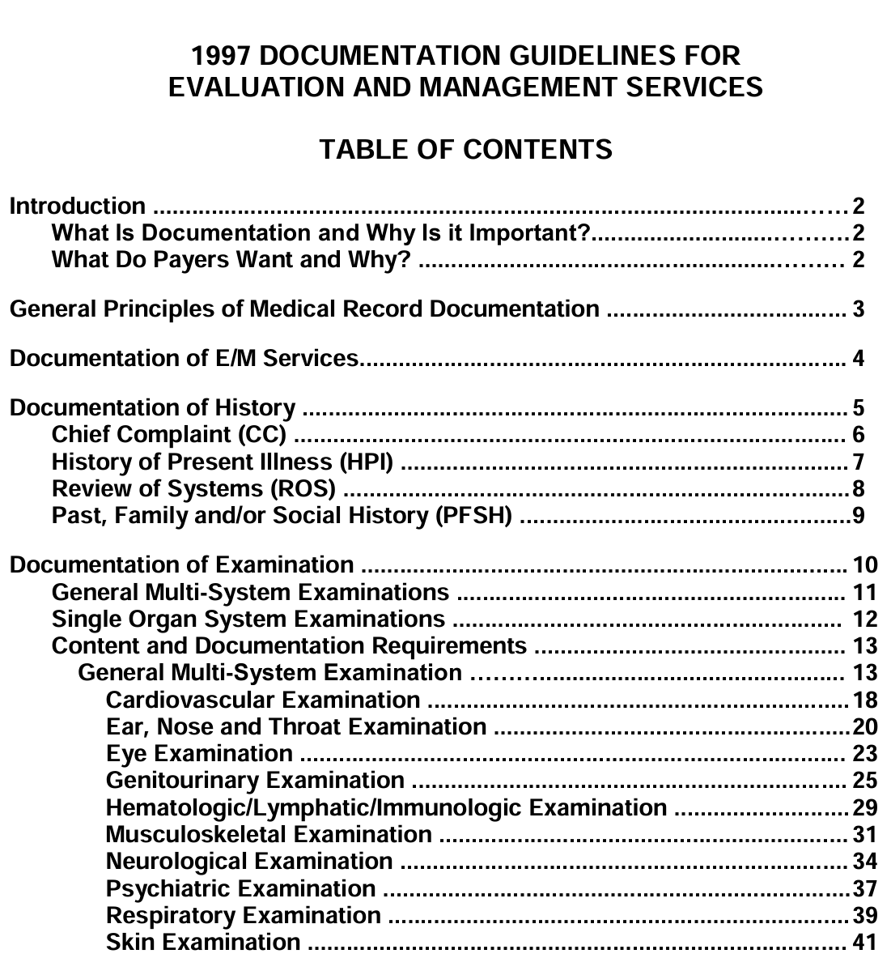
Comprehensive H+Ps
All must have a comprehensive history
All must have a full body physical

Slide 18
Biomechanical Examination (BME)
Need to be for a complaint or problem for which a BME will alter treatment ( can’t do it just to log a BME)
Need to have SOAP components to be a proper BME
A history of complaint is required
Residents should be taught to document their physical findings in the exam, and not document diagnoses in the PE section.
Physical findings in the BME then lead to diagnoses.
Finally, need to provide thought process connecting diagnosis to the treatment plan.

Slide 19
Thank you
Questions?

