Slide 1
CPME Document 310
The Pre-evaluation Report
These informal slides were intended to be delivered in a conversational format, with the presenter sharing practical examples relevant to each topic.

Slide 2
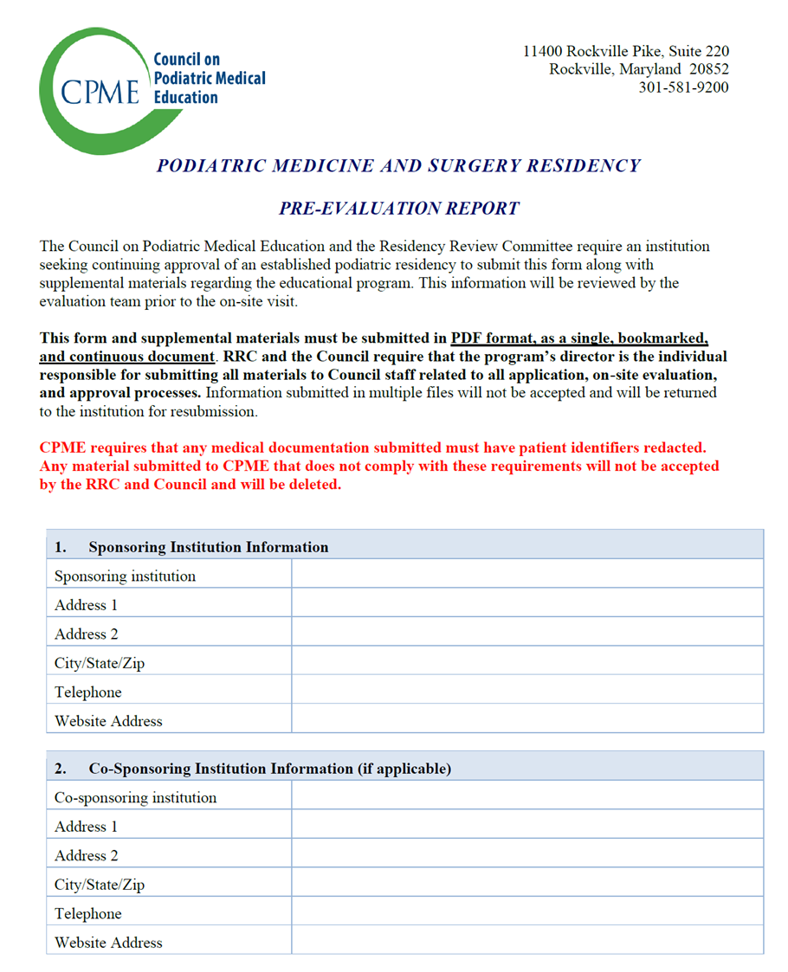
310: Pre-evaluation Report
The most important part of the on-site evaluation
“Make or break” paperwork
Simply a copy of records the program should have handy!
Make it easy for the team to understand your program

Slide 3
310: Pre-evaluation Report
Program Demographics
        Sponsoring and co-sponsoring institutions
        Hospital administration and program director contact information
  Supplemental Materials
Hospital accreditation materials
Affiliated sites
Resident contracts
Resident manual
5. Resident graduation certificate
6. Program Director CV
7. List of faculty
8. Resident rotation assessments
9. Resident semiannual evaluations
10. Program annual self-assessment

Slide 4
310: Pre-evaluation Report
Format for the 310 Submission
Submit in the format requested by CPME
Organization is key! Put everything in the order outlined in CPME 310
Bookmark everything!!
  Then sub-bookmark the bookmarks
Concise intro pages for each section (with a summary) are helpful
  List what is in that section
  Explain any missing materials
This process is the same for submitting progress reports
if you have areas of noncompliance.

Slide 5
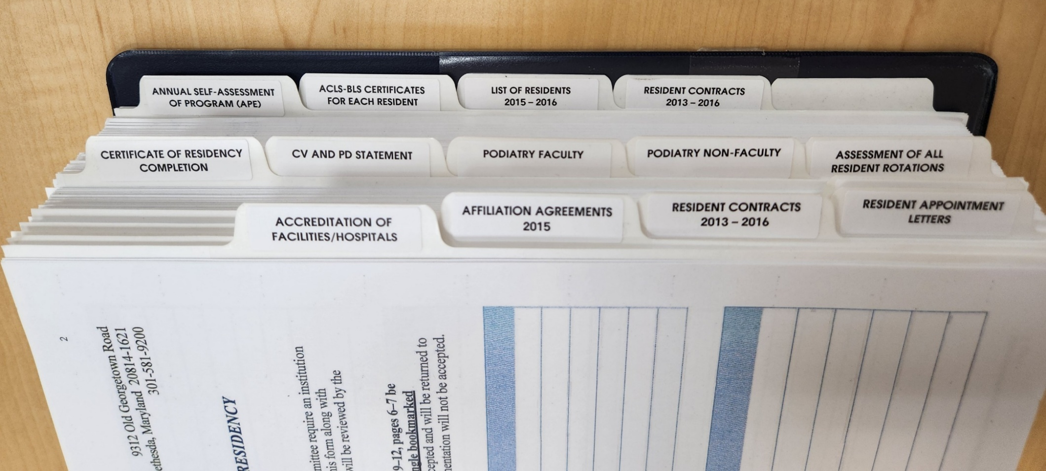
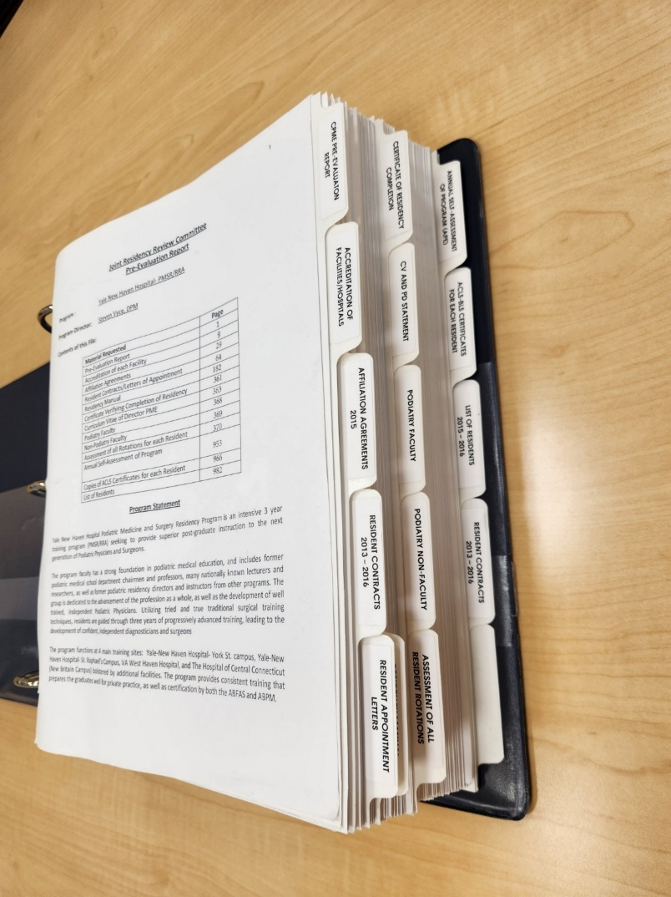
Traditional Audit Binder:
What the Bookmarked PDF is Based On

Slide 6
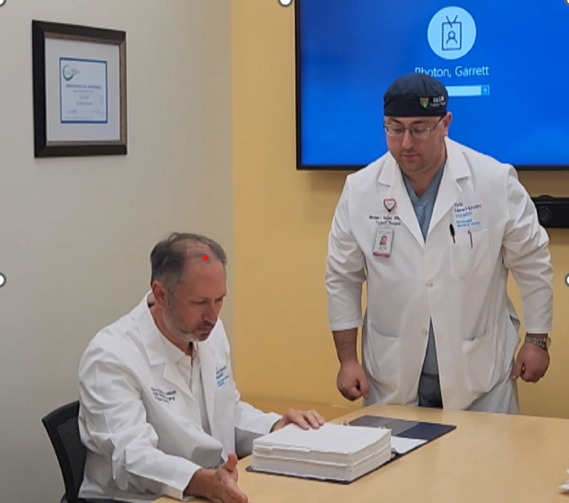
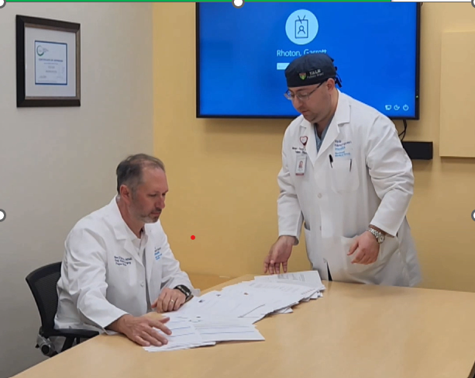
Which makes your program seem like it is meeting all criteria?
Two different scenarios: “Here are the pre-evaluation materials.”

Slide 7
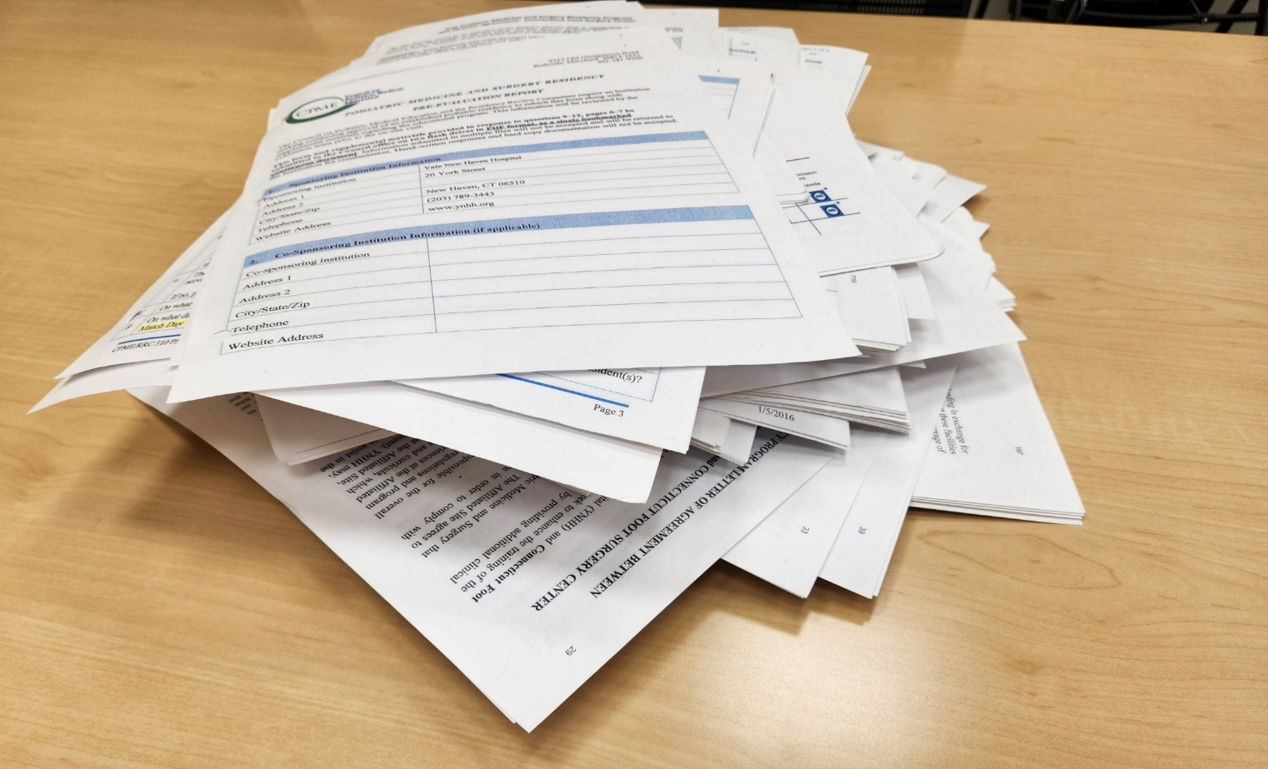
What Some 310 PDFs CPME Receives Resemble

Slide 8
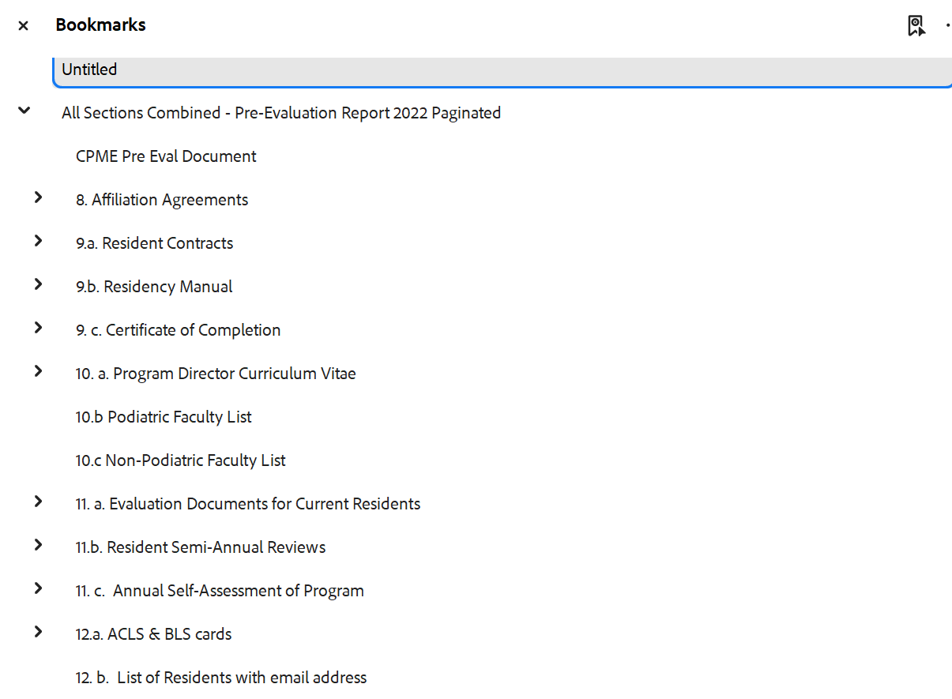
Required documents in 310 submission

Slide 9
Introduction Example
Our program is a 3/3/3 RRA program, sponsored by The Best Hospital (TBH).
Doctor Clark Kent is the Program Director and is a full-time employee of TBH. There are two assistant program directors, one in private practice (Dr. Jekyll) and one employed by the affiliated VA (Dr. Hyde).
The majority of nonpodiatric rotations occur at TBH, although dermatology and anesthesiology occur at the VA. The podiatric rotations are one month long and occur at TBH, the VA, or Community Hospital. Residents on podiatric rotations are responsible for inpatient care, ED consults, and inpatient outpatient surgeries that occur at the respective hospitals. TBH and the VA both have outpatient clinics as well, which is where the residents obtain their outpatient experience, including wound care and biomechanical exams. Residents assigned to TBH and Community Hospital also cover the affiliated surgical center when cases are available. Residents spend four half days per month at the private office of Dr. Jekyll while assigned to the Community Hospital rotation.

Slide 10
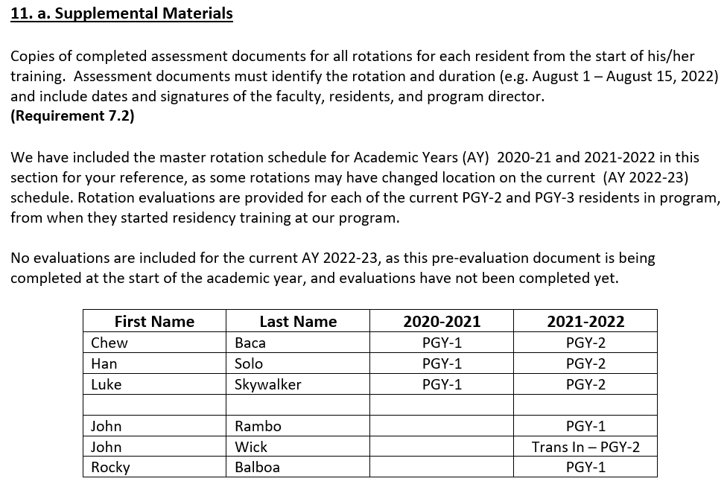
Section Headers
While not required, section headers are a good way to provide and organize information for the on-site team.

Slide 11
Section Headers
Notes:
Dr. John Wick transferred into the program at PGY-2 Level in 2022-2023. We have PGY-1 evaluations on file, but because they were not completed at our program, they are not included in this document. These are available upon request.
We use electronic evaluations via Med Hub online, Physical signatures of the resident and Program Director are not obtained, but an electronic record is made in Med Hub. CPME is aware how Med Hub operates and has approved this digital method.
The PD reviews, and an electronic log is created.
The resident reviews and clicks a statement stating it has been reviewed.
In addition, evaluations are printed for each semi-annual review meeting between the PD and resident. Then the resident and PD sign a statement indicating all evaluations done thus far have been reviewed.

Slide 12
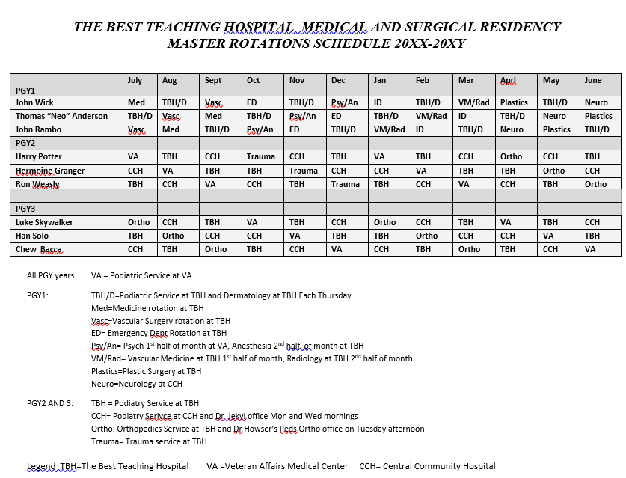
Rotation Schedule
Make sure it is easily understood.
Make sure there is a legend.
Make sure locations are included.

Slide 13
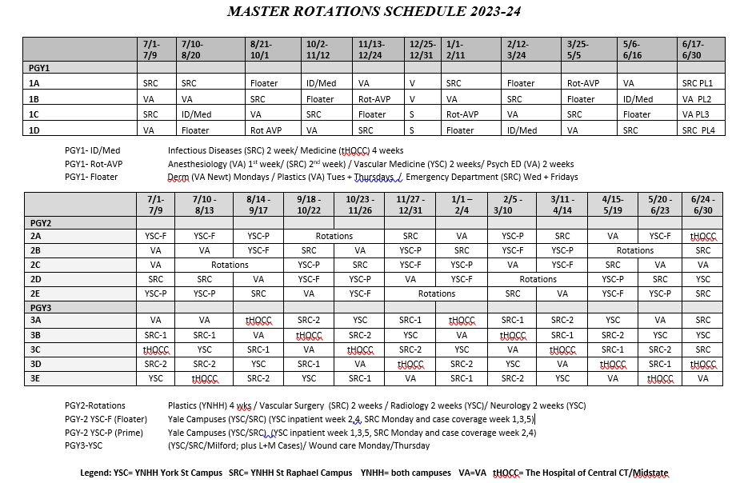
Rotation Schedule with Dates

Slide 14
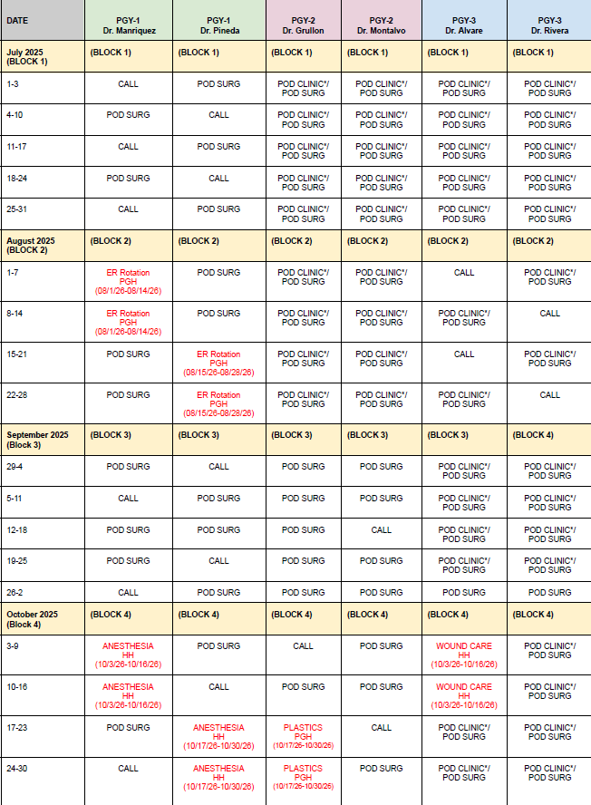

Slide 15
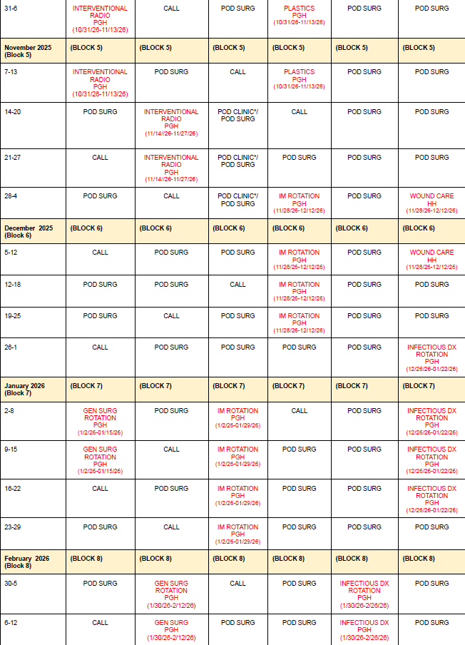

Slide 16
Accreditation Documents
All hospitals in the US must be accredited. Residency programs need to provide proof that the sponsoring and co-sponsoring institutions are accredited.
Make sure accreditation is CURRENT through the date of the site visit.
Examples of accreditors:
      The Joint Commission
      Center for Improvement in Healthcare Quality (CIHQ)
      National Committee for Quality Assurance (NCQA)
      Accreditation Association for Ambulatory HealthCare (AAAHC)
      American Accreditation HealthCare Commission/Utilization Review Accreditation Commission (AAHC/URAC)

Slide 17
Affiliated Training Sites: Agreements
  These include ALL SITES where residents receive training/interact with patients:
  Must have a written agreement for each training site.
  Must clearly define the roles and responsibilities of each facility.
  Must be reaffirmed every 10 years.
  Must delineate financial support.
  Must delineate RESIDENT liability coverage.
  Must be signed and dated by the chief administrative officer or designee of each site.
  Must designate a site coordinator in the affiliation agreement or in a separate document.
  Sending residents to a site without an agreement → probation.
      Hospitals and clinics
      Private practice offices
Surgery centers
Colleges of podiatric medicine

Slide 18
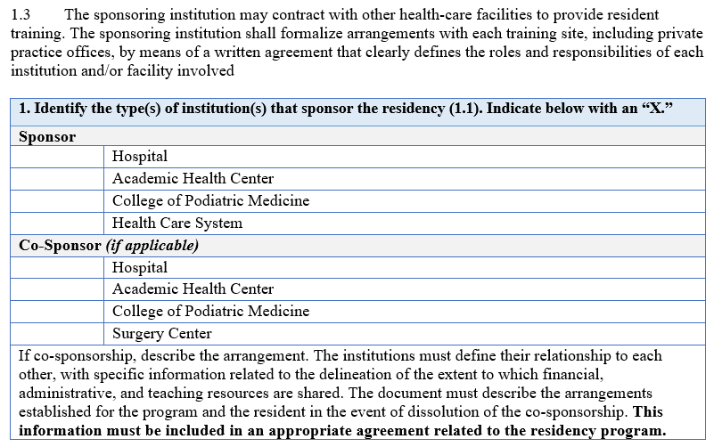
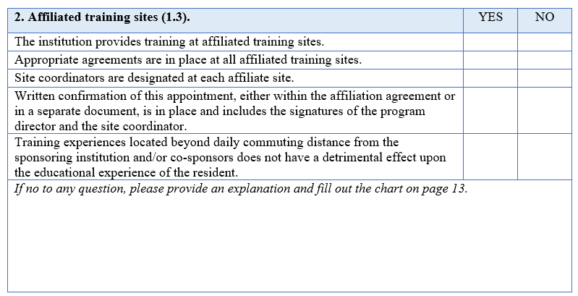
Checklist for Affiliation Agreements

Slide 19
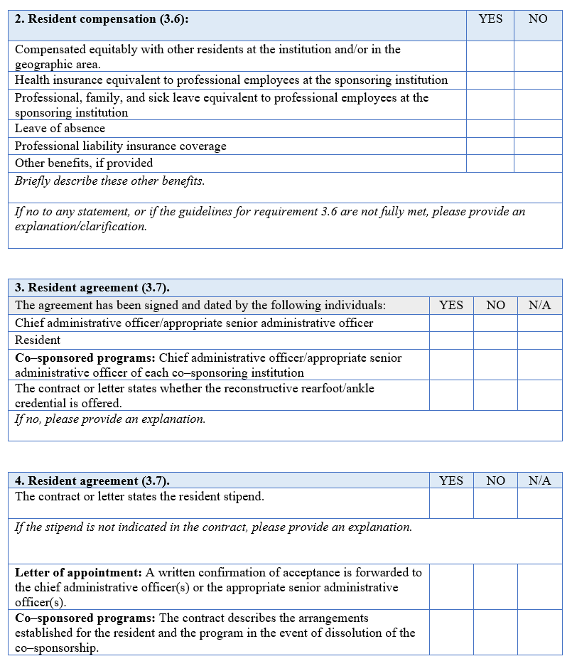
Checklist for Resident Contracts

Slide 20
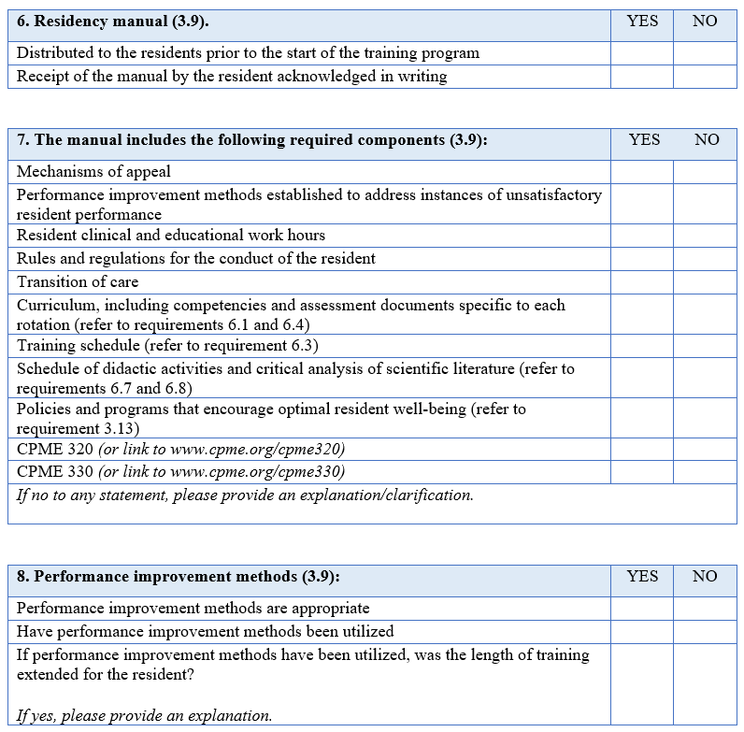
Checklist for Residency Manual

Slide 21
Links to CPME Documents
To assist Program Directors and to ensure publications always have the accurate URL for CPME documents, CPME asks that programs use the following links whenever referencing the CPME 320, the CPME 330, and the Residency Policies Document:
  www.cpme.org/cpme320
  www.cpme.org/cpme330
The site team will click on existing links in all locations (website/residency manual) to check URLs.

Slide 22
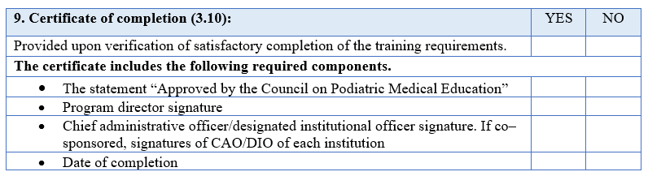
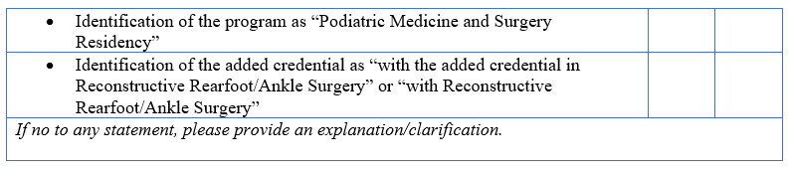
Checklist for Resident Certificate

Slide 23
Don’t Forget About Logs
Part of the program's pre-evaluation preparation is to make sure the PRR logs are accurate:
Properly clear the CLAD
Audit the BMEs
Audit the surgeries
Audit the H&Ps

