Slide 1
Affiliation Agreements
These informal slides were intended to be delivered in a conversational format, with the presenter sharing practical examples and emphasizing the key elements that contribute to a successful on-site evaluation.

Slide 2
What are Affiliation Agreements?
Affiliation agreements (sometimes called Program Letters of Agreement or PLAs) are agreements between the sponsoring institution and other health-care facilities to provide resident training.
  MUST have a written agreement for each training site where residents interact with patients, including:
Roles and responsibilities of each institution and/or facility MUST be clearly defined.
      Hospitals and clinics
      Private practice offices
Surgery centers
Colleges of podiatric medicine

Slide 3
Why are Affiliation Agreements/PLAs Important?
Protect the residents!
Ensure residents have professional and general liability insurance.
Residents MUST NOT participate in training at affiliated sites until the agreements are fully executed!

Slide 4
The Agreement MUST:
Be reaffirmed every 10 years;
Acknowledge the affiliation;
Delineate:
  Financial arrangements;
  Liability coverage; and
  Educational contributions of each training site.
Be signed by the CAO, DIO, or designee of each participating institution or facility;
  Include an effective date; and
  Be forwarded to the Program Director.

Slide 5
In Addition…
If the Program Director does not participate at the affiliated training site:
  A Site Coordinator MUST be designated.
  The Site Coordinator MUST hold a staff appointment.
  The Site Coordinator MUST be a faculty member actively involved in the program at the affiliated training site.
Written confirmation of this appointment is required:
  Either in the affiliation agreement or in a separate document;

Slide 6
Affiliation Agreements: Things to Consider
The expected daily commute to each sponsoring institution and affiliated training site MUST NOT have a detrimental effect upon the educational experience of the resident.
Training provided outside of the US (and its territories) may NOT be counted toward the requirements of any training resource.
Affiliation agreements are NOT needed for:
  Entities that are legally part of the sponsoring institution
  Entities the institution is no longer working with
NOTE: For VA hospitals, federal law supersedes the CPME 320. VA affiliation agreements are standard and non-negotiable.

Slide 7
Affiliations (1.1, 1.3)
How and When Affiliation Agreements
are Evaluated
Before the Visit:
    All affiliation agreements provided in the pre-evaluation documents are reviewed and checked against the checklist in the CPME 370
    Confirmation that all agreements are current (re-affirmed)
    Any missing agreements are identified
    When logs, assessments, and annual reports are reviewed, evaluators look for names of facilities and sites residents are visiting and make sure there are agreements for all of them
During the Visit:
    Follow up on questions and areas of potential noncompliance in the agreements
    Obtain and review any missing agreements

Slide 8
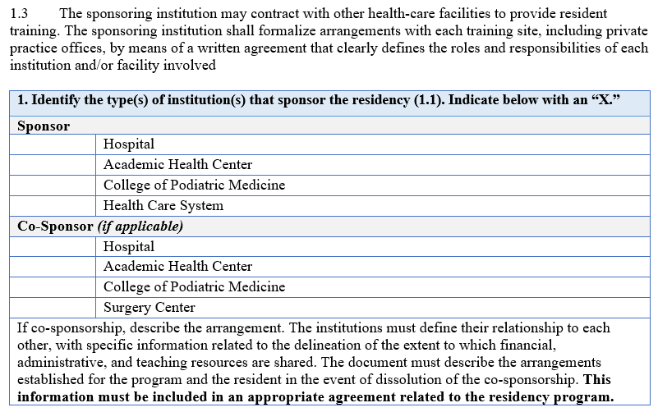
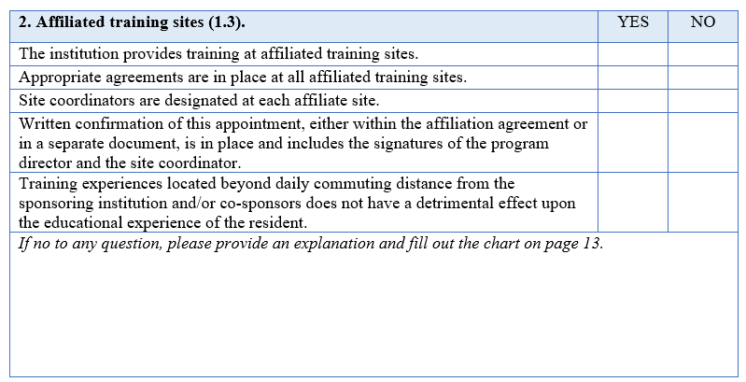
Checklist for Affiliation Agreements

Slide 9
Example of Affiliation
Agreement

Slide 10
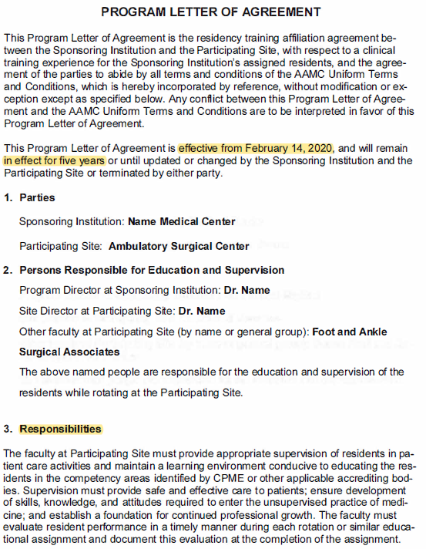

Slide 11
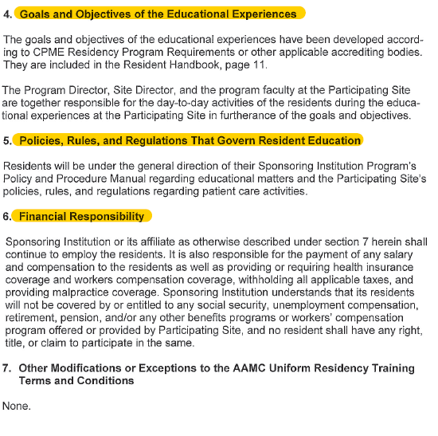

Slide 12
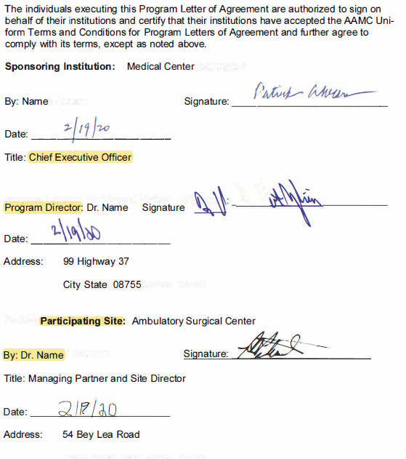

Slide 13
Letters of Appointment/Resident Contracts
Requirements 3.6 & 3.7
These informal slides were intended to be delivered in a conversational format, with the presenter sharing practical examples and emphasizing the key elements that contribute to a successful on-site evaluation.

Slide 14
Resident Contracts (3.6, 3.7)
The resident contract is a legal contract that spells out critical issues governing the resident’s employment.
Requirements 3.6 and 3.7 specify the basic information that must be in the resident contract and the benefits that must be afforded to the residents.
Contracts must be signed and dated by the hospital's CAO or DIO and the resident.

Slide 15
Requirements for Resident Contracts (3.6, 3.7)
  Contracts MUST indicate the type of certificate the resident will be awarded (PMSR or PMSR/RRA).
  Contracts MUST includes the amount of the resident stipend
      Stipends MUST be identical to those of equivalent PGY level residents at the institution.
      If there are no residents in other specialties, then stipends MUST be commensurate with common practice in the region.
      VA institutions will have their own standard salary tiers, which are not negotiable.
  Contracts MUST be signed and dated by the Chief Administrative Officer of the institution (or DIO) and the resident.

Slide 16
Resident Benefits and Compensation (3.6, 3.7)
  The institution SHALL provide the following benefits:
    Health insurance
    Professional, family, and sick leave
    Leave of absence
    Professional liability insurance coverage
    If the institution provides other benefits, they must be identified (e.g., meals, uniforms, vacation policy, housing provisions, payment of dues for membership in national, state, and local professional organizations, and disability insurance benefits)
Any information not explicitly spelled out in the resident contract must clearly reference another document that provides this information and the program must provide these referenced documents to the on-site team.

Slide 17
Requirement 3.6
The sponsoring institution SHALL ensure the resident is compensated equitably with and is afforded same benefits, rights, and privileges as other residents at the institution.
SHALL provide the following:
  Health insurance for the duration of the training program
  Professional, family, and sick leave
  Leave of absence
  Professional liability insurance coverage
  Other benefits if provided (meals, uniforms, vacation policy, housing provisions, payments of dues, and disability insurance)

Slide 18
Requirement 3.6 - continued
All of the benefits must be at least equivalent to those afforded to other professional employees at the sponsoring institution.
Leave of absence: MUST establish a policy addressing interruption / leave as well as continuation of pay and benefits as well as effect on meeting requirements for completion of training.
Liability insurance coverage: MUST cover all rotations at all training sites
  MUST provide protection against awards from claims reported or filed after completion of training
  MUST provide proof of coverage to the resident upon request

Slide 19
Requirement 3.7
Institution SHALL provide resident a written contract or letter of appointment.
MUST including the following:
  Be signed and dated by the CAO or DIO and the resident
  Type of certificate the resident will be awarded (more in a moment)
  The amount of the resident stipend
  Duration of the agreement
  Benefits provided
  The length of the program (if it is approved by CPME to exceed 36 months)

Slide 20
Program Identification on Contracts
Podiatric Medicine and Surgery Residency (PMSR) or
Podiatric Medicine and Surgery Residency with the added credential in Reconstructive Rearfoot/Ankle Surgery (PMSR/RRA) or
Podiatric Medicine and Surgery Residency with Reconstructive Rearfoot/Ankle Surgery (PMSR/RRA)

Slide 21
Requirement 3.7 (Resident Contract)
Additionally, the resident contract MUST be forwarded to:
  the CAO or DIO upon execution/completion
  the Program Director

Slide 22
Requirement 3.7 - Resident Contract, continued
  The stipend offered by the institution MUST NOT be contingent on the productivity of the individual resident.
  If co-sponsored program: the contract/letter MUST be signed and dated by the CAO or DIO of each co-sponsoring institutions and the resident and be forwarded to the Program Director.
  If residents sign contracts with multiple institutions, a letter of understanding between those institutions MUST be in place, identifying the Program Director as the final authority to oversee resident training at all sites.

Slide 23
How and When Resident Contracts are Evaluated
Before the Visit:
    Evaluators review all resident contracts provided in the pre-evaluation
    Identify any missing contracts
During the Visit:
    Follow up on questions and areas of potential noncompliance related to the contracts
    Obtain and review any missing contracts

Slide 24
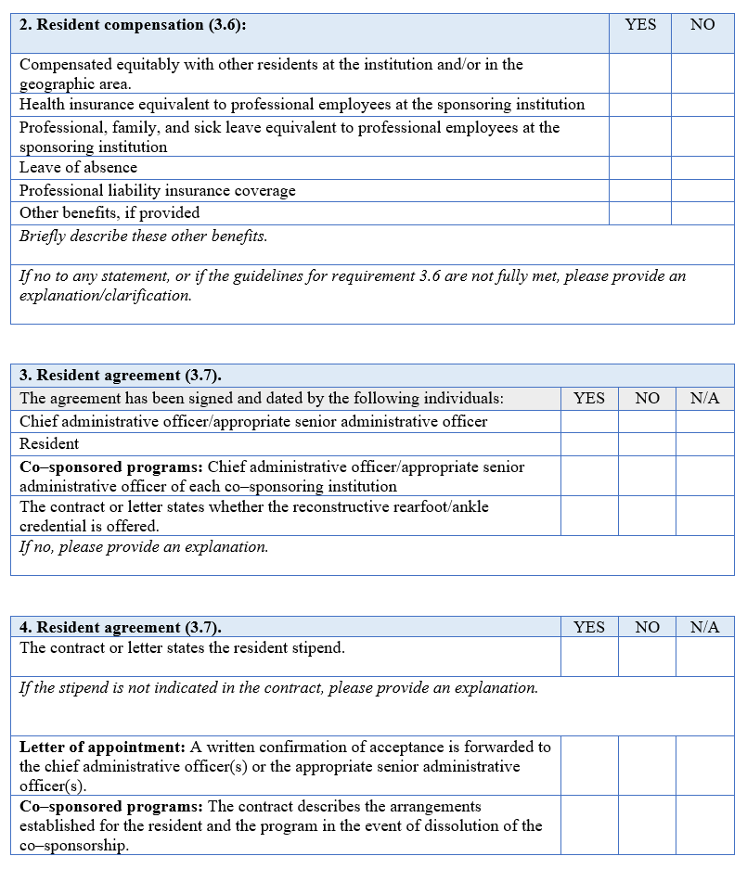
Checklist for Resident Contracts

Slide 25
Example of Letter of Appointment

Slide 26
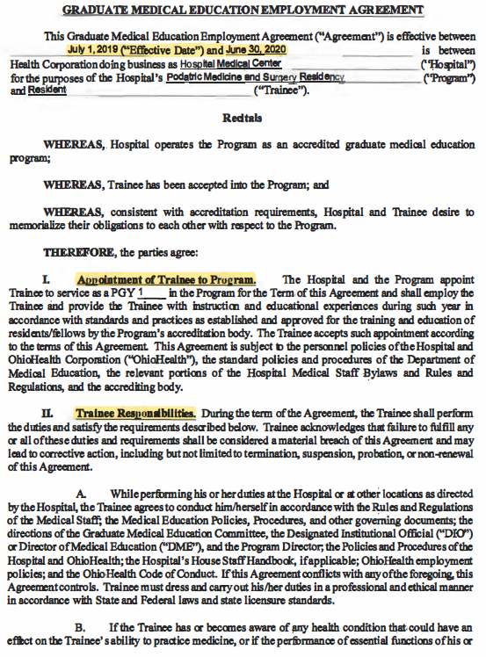

Slide 27
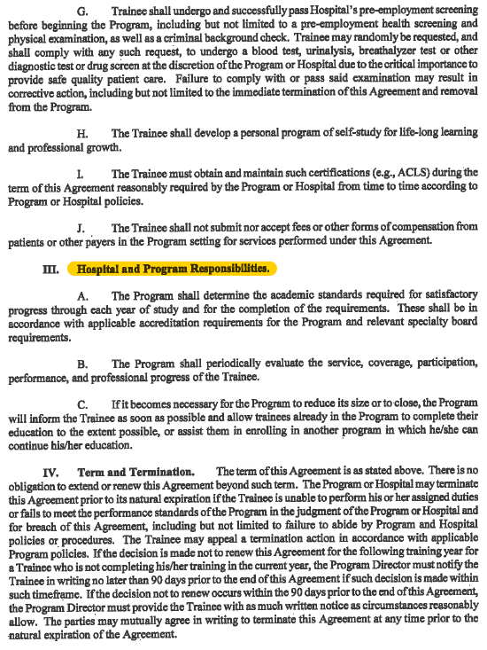

Slide 28
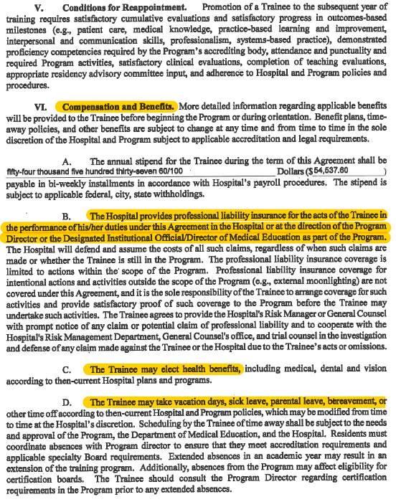

Slide 29
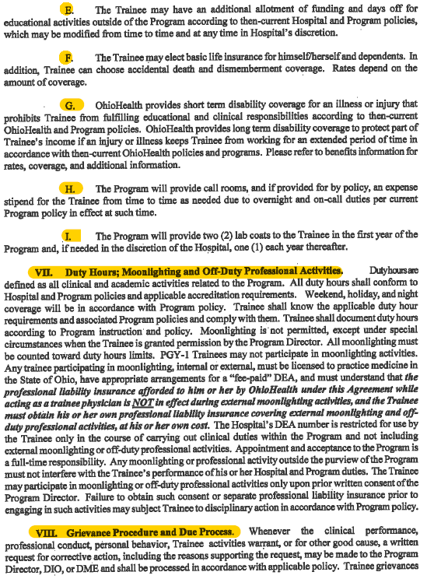

Slide 30
