Slide 1
Review of Key Residency Documents
These informal slides were intended to be delivered in a conversational format, with the presenter sharing practical examples relevant to each topic.

Slide 2
Key Documents
There are five important documents that are used in the residency approval process. You should refer to these documents if you have any questions during the on-site.
Key Documents
CPME 320
CPME 330
CPME 310
CPME 370
STANDARDS AND REQUIREMENTS FOR APPROVAL OF PODIATRIC MEDICINE AND SURGERY RESIDENCIES
PROCEDURES FOR APPROVAL OF PODIATRIC MEDICINE AND SURGERY RESIDENCIES
PRE-EVALUATION REPORT
EVALUATION TEAM REPORT
Used by residency programs, on-site evaluators, and the RRC/CPME
Used by residency programs, on-site evaluators, and the RRC/CPME
Related specifically to the on-site evaluation and are used by residency programs on-site evaluators and the RRC/CPME
Related specifically to the on-site evaluation and are used by residency programs on-site evaluators and the RRC/CPME
CPME 320 and 330 are used by residency programs, on-site evaluators, and the RRC/CPME.
CPME 310 and 370 are related specifically to the on-site evaluation and are used by residency programs, on-site evaluators, and the RRC/CPME

Slide 3
Key CPME Documents
  We will be going into more detail on each of these documents during this training. This module is a high-level overview of these five foundational documents.

Slide 4
CPME 320
Standards and Requirements for Approval of Podiatric Medicine and Surgery Residencies
  Specifies the standards and requirements that a sponsoring institution and the residency program must comply with to be accredited/
  maintain accreditation by CPME

Slide 5
CPME 320
Standards and Requirements for Approval of Podiatric Medicine and Surgery Residencies www.cpme.org/cpme320
  Includes institutional standards, program standards, and volume and diversity requirements.
  Use: www.cpme.org/cpme320 - it will always link to the most recent copy of the document.

Slide 6
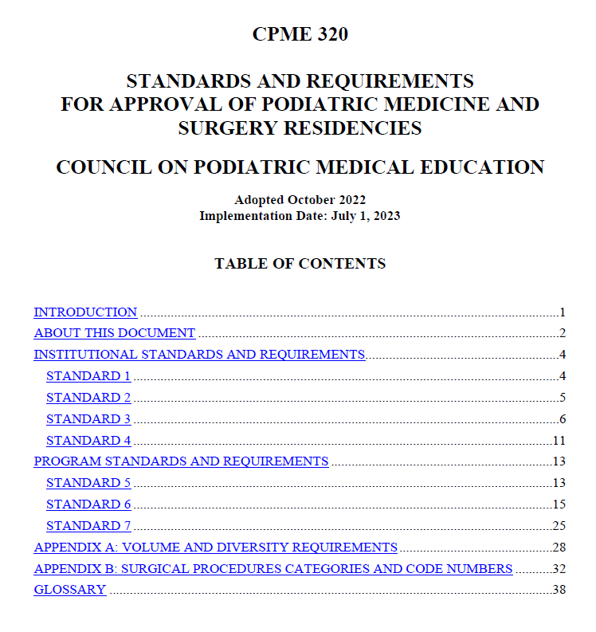

Slide 7
CPME 330
Procedures for Approval of Podiatric Medicine and Surgery Residencies www.cpme.org/cpme330
  Outlines important procedures related to CPME approval
  Outlines the timing and processes of the on-site evaluation and subsequent steps
  Outlines additional processes and procedures related to communication between residency programs and CPME

Slide 8
CPME 330 www.cpme.org/cpme330
Application for Provisional Approval of a New Residency Program
Re-evaluation and Continuing Evaluation and Approval of an Existing Residency Program
Categories of Approval and Approval Period
Authorization of Increases in or Reclassification of Residency Positions*
Resident Transfer*
Program Transfer/Change in Sponsorship*
*forms have been developed for these procedures (available on www.cpme.org)

Slide 9
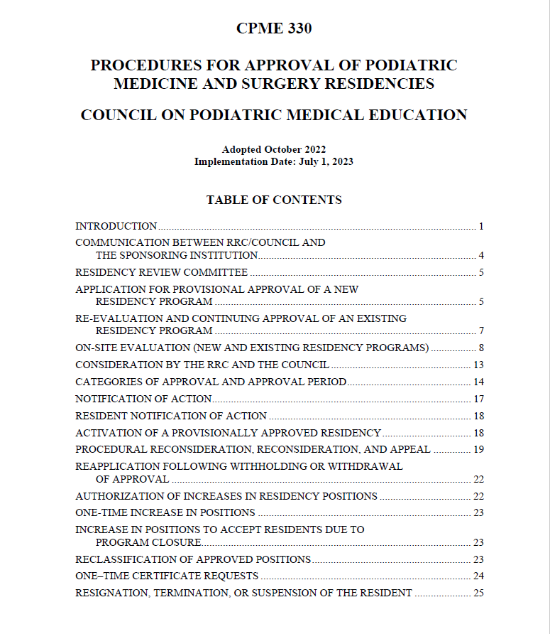
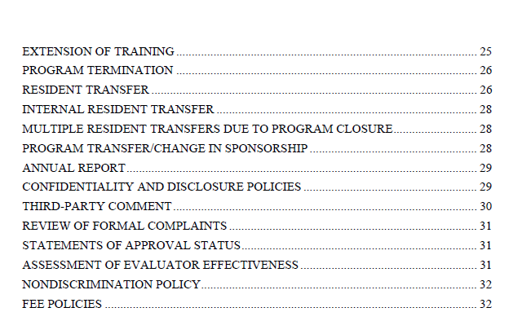

Slide 10
CPME 310
Pre-evaluation Report
  The CPME 310 is the form used by the residency program to submit required demographic and explanatory information for review by the evaluation team prior to the on-site visit.
  It also includes a list of supplemental materials to be submitted with the form.

Slide 11
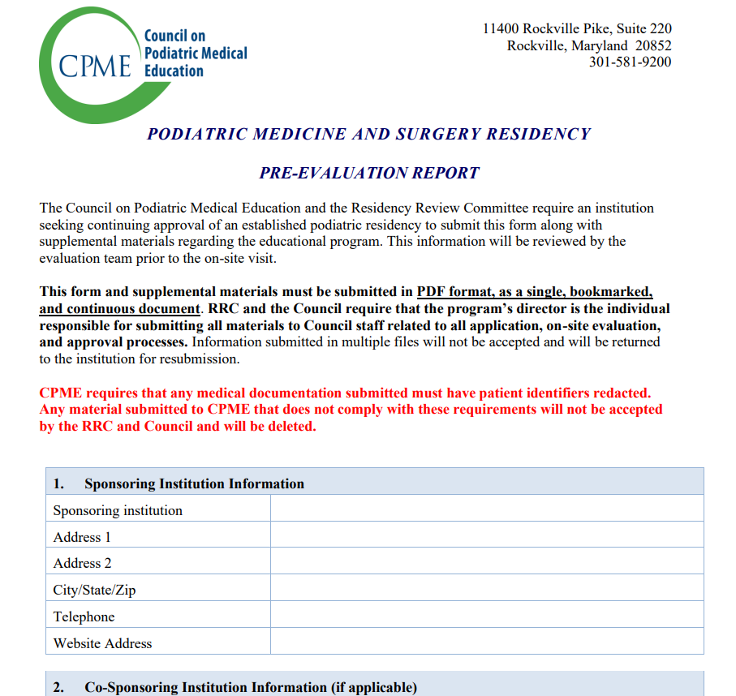

Slide 12
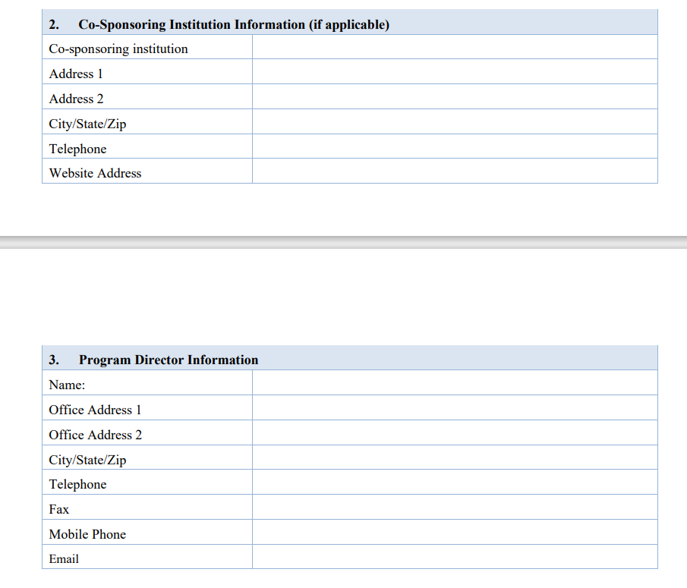
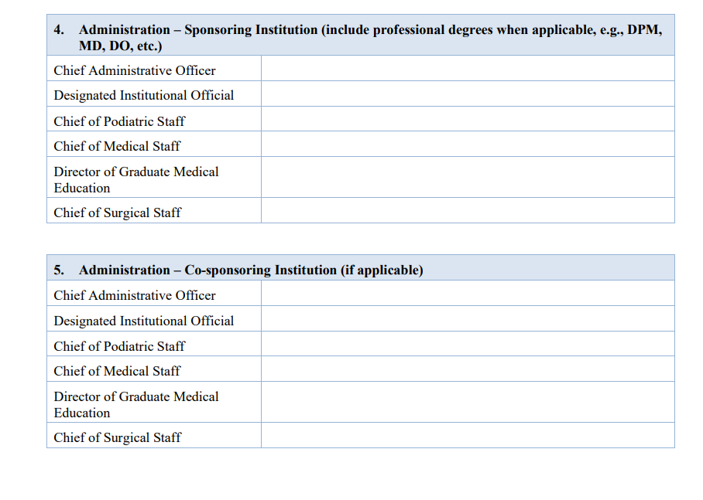
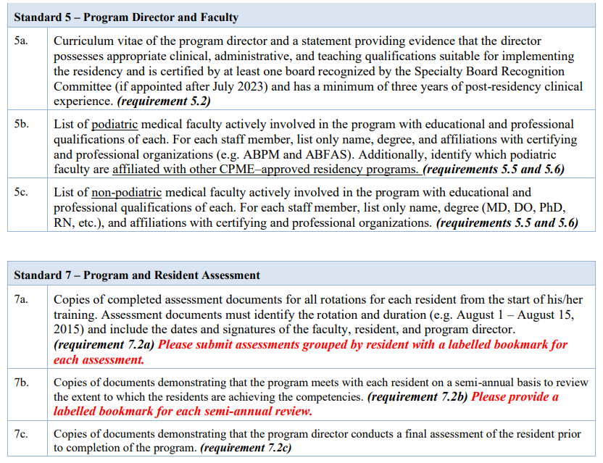

Slide 13
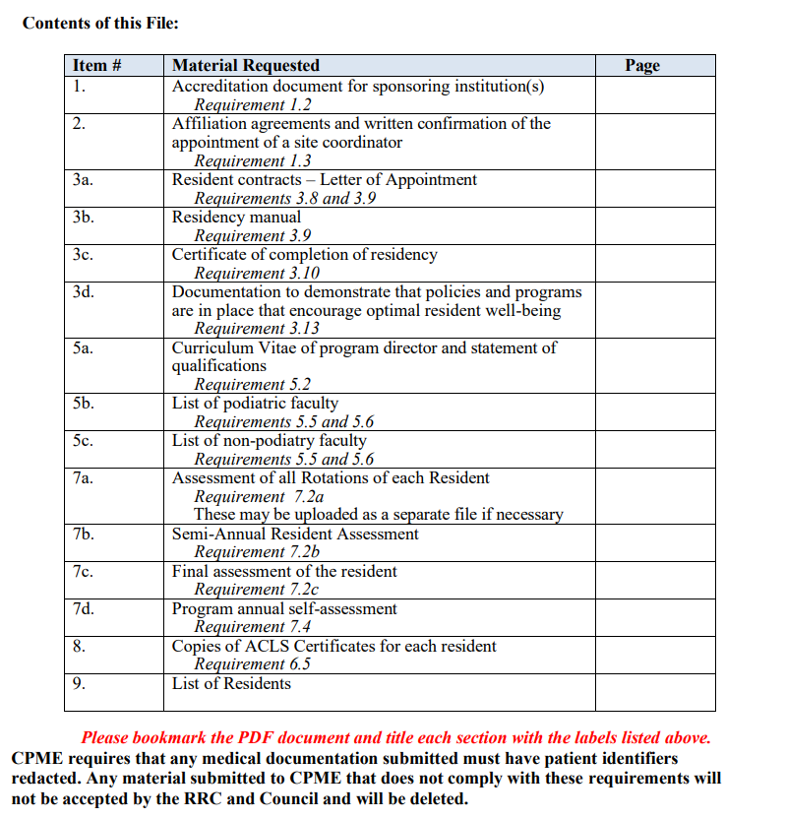

Slide 14
CPME 370
Evaluation Team Report
  The CPME 370 is a form used to report the findings of the on-site evaluation team, including potential areas of noncompliance.
  This form can be used as an “open book test” for program directors!

Slide 15
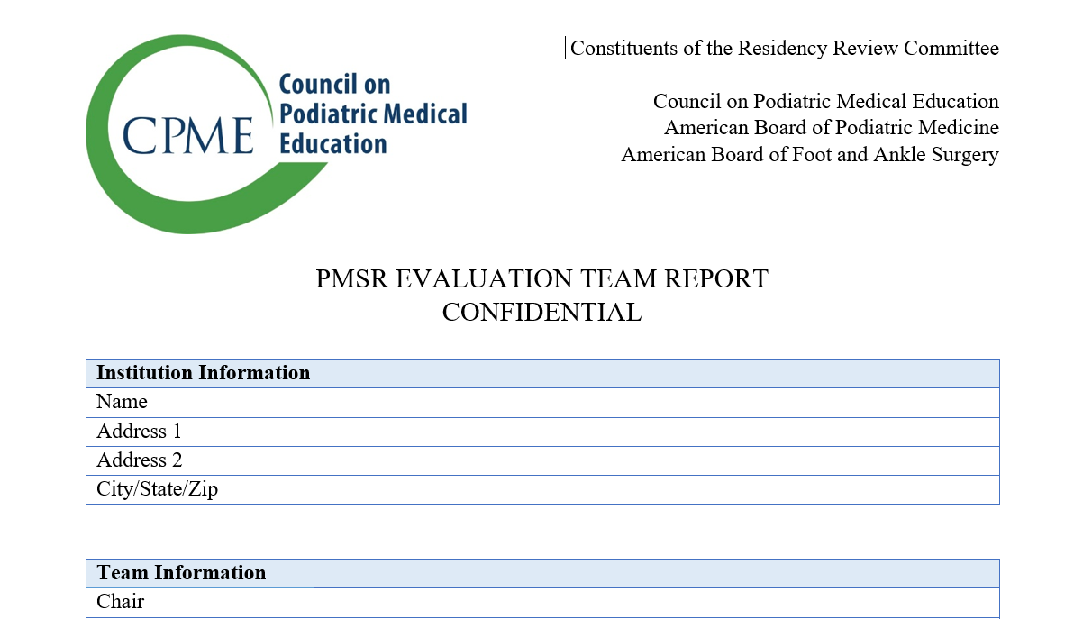
CPME 370 – Evaluation Team Report
The CPME 370, Evaluation Team Report for Podiatric Medicine and Surgery Residencies, is the evaluation team report completed by the on-site evaluation team.
Program directors should familiarize themselves with this document, as it outlines every requirement in CPME 320 and documents a program’s compliance with each item.
This form includes every item that will be asked of and reviewed with the program during the on-site evaluation.

Slide 16
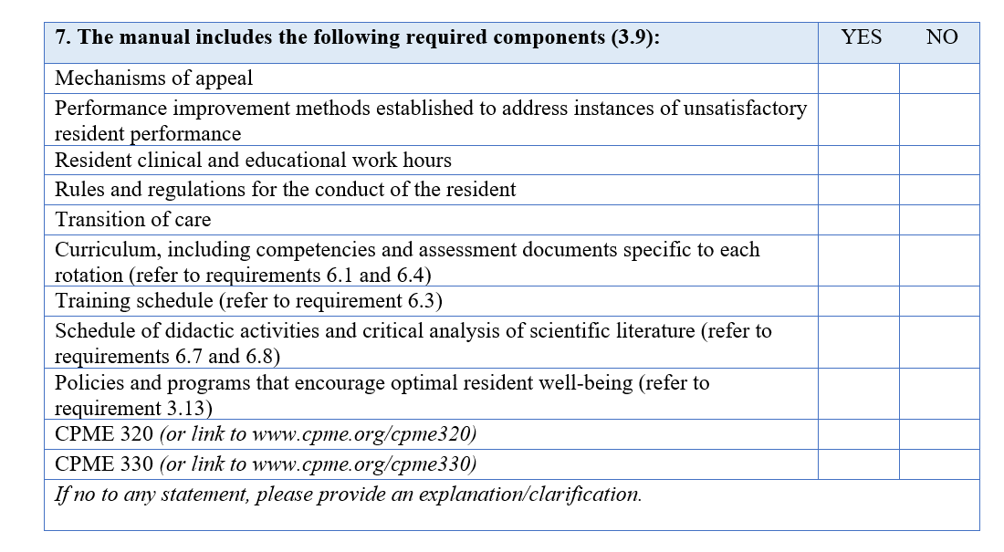
Checklist for Each Requirement
The 370 has a checklist for every requirement in CPME 320.

