Slide 1
Introduction to Logging, Common Errors, and Log Reports
These informal slides were intended to be delivered in a conversational format, with the presenter sharing practical examples relevant to each topic.

Slide 2
Logging Standards and Requirements
7.1 - The program director shall review, evaluate, and verify resident logs on a monthly basis.
  The program director (PD) must review the logs for accuracy to ensure that there is no duplication, miscategorization, and/or fragmentation. Procedure notes must support the selected experience.
  PD must monitor resident logs to ensure resident attainment of the Minimum Activity Volume (MAV) and diversity requirements prior to completion of training.

Slide 3
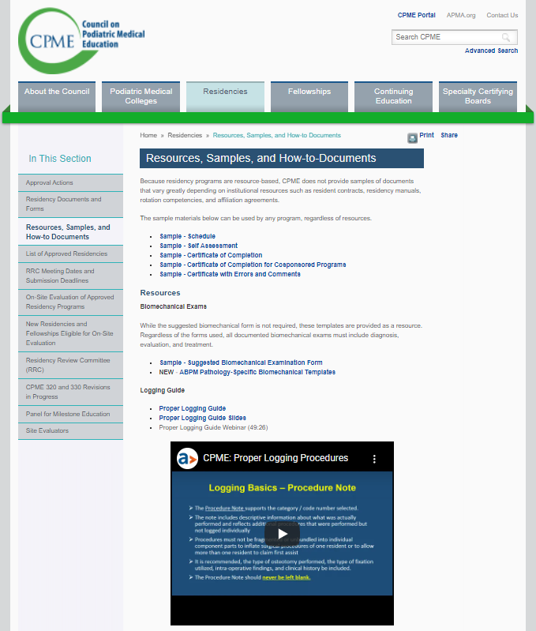
How do Residents Learn to Log?
Logging is not the same as billing
Sources:
  Proper logging links available through CPME, PRR, ABFAS
  Contact RRC chair through PRR website with specific logging questions
  Program Director / Faculty
  Recent graduates
  Senior residents
Notes:
In PRR under tutorials has links to proper logging
Learning to log correctly in PRR will help avoid logging errors in PLS when seeking ABFAS board certification

Slide 4
Appendix B
1 Digital Surgery (lesser toe or hallux)
  1.1 partial ostectomy/exostectomy
  1.1 phalangectomy
  1.2 arthroplasty (interphalangeal joint [IPJ])
  1.3 implant (IPJ) (silastic implant or spacer)
  1.4 diaphysectomy
  1.5 phalangeal osteotomy
  1.6 fusion (IPJ)
  1.7 amputation
  1.8 management of osseous tumor/neoplasm
  1.9 management of bone/joint infection
  1.10 open management of digital fracture/dislocation
  1.11 revision/repair of surgical outcome
  1.12 other osseous digital procedure not listed above
SURGICAL PROCEDURE CATEGORIES AND CODE NUMBERS

Slide 5
Utilizing PRR
Run MAV/Diversity report for each resident.
Run CLAD report. CLAD may show errors that are not truly errors. This is a guide, not an absolute.
Go to each resident’s individual logs, reviewing cases with multiple procedures for fragmentation.
Verify at least monthly and have residents log in a timely manner.
Make sure attendings and locations are present and correct.
  For example, resident logs chest pain as ED rotation performed under DPM
Ensure procedure descriptions are detailed to clearly demonstrate case rendered or procedure performed.
Ensure residents are logging core rotations, not just podiatric procedures. Check dates against training schedule.
Ensure residents are logging clinical encounters as well as surgical.
Ensure residents are logging didactic activities (i.e., lectures, M&Ms, journal club, workshops, etc.).

Slide 6
Logging Basics
ØLaterality (i.e., L/R) must be included for all surgical cases in the Location column – N/A is never acceptable except for biomechanical exams.
ØFor digits, metatarsal and interspace procedures, list the digital, metatarsal, or interspace number in the Location column (e.g., R4).
ØThe attending’s name and degree (DPM, MD, DO) is included for all cases (surgical or clinical).

Slide 7
Logging Basics
The Procedure Note supports the code selected.
Includes descriptive information about what was performed and reflects additional procedures that were performed but not logged individually.
Procedures must not be fragmented or unbundled into individual component parts to inflate surgical procedures of one resident or to allow more than one resident to claim first assist.
May include: type of osteotomy performed, fixation utilized, intra-operative findings, and pertinent clinical history.
The Procedure Note should never be left blank.
Procedure Note
Notes:
It cannot be stressed enough the Procedure Note is one of the most important parts of the logging entry. Anyone reviewing the logs can read the Procedure note and understand the justification for the surgical code that was utilized. It can also serve as a source of documentation establishing different types of osteotomies and fixation that the resident was afforded during their residency.

Slide 8
Miscategorization
Examples:
  A simple Haglund’s resection is incorrectly logged as 4.19 detachment/reattachment of Achilles tendon with partial ostectomy, when it should be logged as 4.1 partial ostectomy including foot, ankle, and leg
  Tarsometatarsal joint fusion classified as 5.2.4 midfoot, rearfoot, or ankle fusion when it should be logged as 4.15 tarsometatarsal fusion
Surgical procedure is misclassified into an incorrect procedure code.

Slide 9
Fragmentation
When a specific surgical procedure is unbundled or fragmented inappropriately into individual component parts.
  Separated into two or more procedures instead of one procedure.
  Fragmentation falsely elevates the resident’s procedure volume and diversity.

Slide 10
Fragmentation
  Examples:
  A bunionectomy that has been fragmented into an osseous procedure and an adjunctive soft tissue procedure
  Partial ray resection that has been fragmented into toe amputation and metatarsal head resection and management of management of bone/joint infection distal to the tarsometatarsal joints (with or without bone graft)
  A triple arthrodesis that has been fragmented into arthrodesis of the individual joints (STJ, TN, CC)
  A bi-malleolar fracture that has been fragmented into ORIF of the medial malleolus and ORIF of the lateral malleolus
  An ankle fracture repair that has been fragmented into repair of the malleolus and associated ligaments
Notes:
State the 4 examples listed. Then say: IN all of these examples, only one procedure would be appropriately logged. It is also unacceptable for one resident to log the STJ arthrodesis and another resident log the TN and CC arthrodesis. Again, a triple arthrodesis is logged as a single procedure with one resident taking First assist participation for the entire procedure.
Then for last bullet point about logging/billing: The procedures the resident logs may not always correspond to the exact procedures listed on the operative report. For example: The operative report may list a Radical bunionectomy with 1st metatarsal osteotomy. The resident would not log this, instead they would choose the appropriate Category 2 First Ray Hallux Valgus Procedure Codes between 2.1.1 through 2.1.9 as listed in Appendix B in CPME 320.

Slide 11
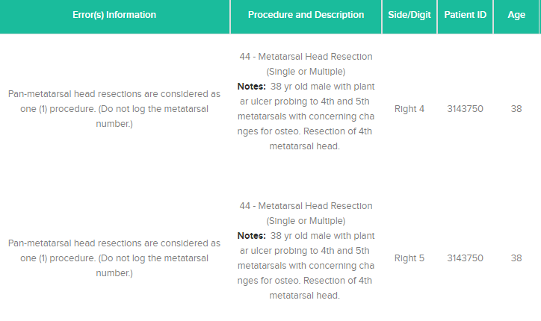

Slide 12
Duplication and Shared Cases
Duplication – a resident’s duplicate entry of the same case and procedure(s) on the same day of surgery.
Shared cases – when two or more residents or a fellow claim first assist for the same procedure on the same date on the same patient.
Be aware of a resident logging each procedure separately as a different case as this will artificially inflate case volume.
CLAD report should identify this error.
Notes:
In both of these instances, the PRR CLAD report would identify these errors.

Slide 13
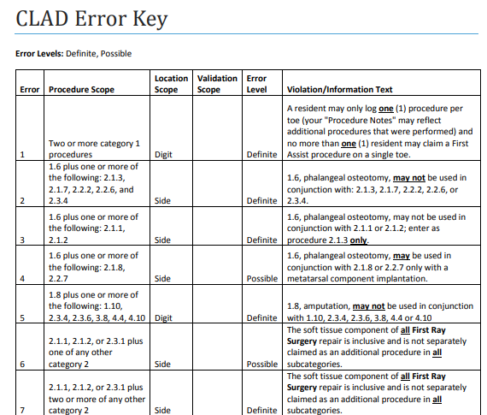

Slide 14
Category 1: Digital Surgery (Lesser Toe / Hallux)
General Guidelines:
A procedure performed at both the PIPJ and DIPJ can only be logged once. Include both procedures in the Procedure Note.
An Akin is logged as a Category 1 procedure when performed at the same time as a first ray procedure.
An amputation of a digit is included with the management of a bone/joint infection, incision and drainage, and/or a ray resection. These cannot be logged separately.
Percutaneous stab tenotomies, toenail procedures are category 6.
Notes:
It is important to realize that a resident may only log one procedure per toe (the Procedure Note may reflect additional
procedures performed) and no more than one resident may claim a first assistant on a single toe.
The Akin procedure is commonly mis-logged as it can be correctly logged under category 1 or 2 depending on the circumstances. If the Akin is performed along with a metatarsal osteotomy then it would be correctly logged under category 1: as 1.6 Phalangeal osteotomy. If the Akin is the primary procedure and not performed along with a metatarsal osteotomy, it would be appropriately logged as a category 2: 2.1.3 Bunionectomy with phalangeal osteotomy.
Another common error is the fragmentation a digital amputation with management of bone/joint infection, incision and drainage or ray resection. Other digital procedures such as percutaneous stab tenotomies and toenail procedures should be logged under category 6

Slide 15
Proper Logging Guidelines
1.6 Phalangeal Osteotomy
May not be used in conjunction with:
  2.1.1 bunionectomy (partial ostectomy/Silver procedure) – (use 2.1.3 bunionectomy with hallux osteotomy)
  2.1.3 bunionectomy with phalangeal osteotomy
  2.1.7 metatarsophalangeal joint (MPJ) fusion
  2.1.8 MPJ implant (with phalangeal implantation)
  2.2.1 cheilectomy
  2.2.2 joint salvage with phalangeal osteotomy (Kessel-Bonney, enclavement)
  2.2.6 MPJ fusion
  2.2.7 MPJ implant (with phalangeal implantation)
  2.3.4 amputation
Notes:
To reiterate, code 1.6 phalangeal osteotomy cannot be used with any of the following category 2 codes to avoid fragmentation.

Slide 16
Category 2: First Ray Surgery
General Guidelines:
Soft tissue component of all First Ray Surgery repair is inclusive and is not separately claimed as an additional procedure for all subcategories.
Only 1 resident may be 1st assistant and log one 2.2.1-2.3.10 procedure per foot.
Osteotomy (Akin) of the proximal phalanx 1.6 can be claimed separately with first metatarsal osteotomy.
Suture button constructs as the primary method to repair a bunion deformity should be logged as 2.1.1.
2.1.10 bunionectomy with double correction with osteotomy and/or arthrodesis “both involving first metatarsal” EXAMPLE: A 1st TMTJ arthrodesis and capital osteotomy.
Notes:
General guidelines when logging category 2 procedures: The soft tissue component of all First Ray Surgery repair is inclusive and cannot separately claimed as an additional procedure to avoid fragmentation. A resident may only log one category 2.2.1-2.3.10 procedure per foot and no more than one resident may claim a first assistant procedure for these categories per foot.
2.1.1 is limited to isolated soft tissue repair / partial ostectomy of the first MPJ when no other osteotomy or fusion procedure is completed on the first ray or if a suture button construct was the primary method to repair a bunion deformity.
2.1.10 can only be used when two separate osteotomies and/or arthrodesis are performed on the same first ray to correct the bunion deformity. EXAMPLE: A first tarsometatarsal arthrodesis and a head osteotomy on the same metatarsal should be logged as 2.1.10. Osteotomy (Akin) of the proximal phalanx 1.6 can be claimed separately or as 2.1.10 if combined with first metatarsal osteotomy / fusion for diversity

Slide 17
Category 3: Other Soft Tissue
3.1 Excision of Ossicle/Sesamoid
May not be used in conjunction with First Ray Surgery or tendon transfer/augmentation
  May not be used in conjunction with Other Osseous Foot Surgery
  EXAMPLES: os peroneum, os tibiale externum, os vesalianum
3.4 Plantar Fasciotomy
May include open or endoscopic approach
  TOPAZ and PRP injection are logged as 6.14
  Includes plantar heel spur/exostosis resection
  Includes local nerve (i.e., Baxter’s nerve) release or ablation
  May not be claimed as Reconstructive Rearfoot/Ankle Surgery
  May not be used in conjunction with: 3.9 plantar fasciectomy / fibroma resection
Notes:
When logging code 3.1, it is important for the resident to identify the specific ossicle/sesamoid removed in the Procedure Note section. This code is only logged if it is performed as an isolated procedure and cannot be used with 1st ray surgery, other osseous foot surgery or tendon transfer / augmentation to avoid fragmentaton
Code 3.4 plantar fasciotomy is logged whether the procedure is performed open or endoscopically : It also includes localized lipectomy or soft tissue excisions and a Baxter nerve release. These peripheral aspects of the surgery can be included in the Procedure Note for complete documentation. A resident may choose for MAV or diversity reasons to log the calcaneal ostectomy instead of the fasciotomy/fasciectomy. This is acceptable and correctly logged under 4.1 Partial ostectomy with the fasciotomy/fasciectomy listed in the Procedure Note. Be aware that procedures such as Topaz, Tenex and PRP injections for plantar fasciosis should be logged as 6.14.

Slide 18
Proper Logging Guidelines
3.8 Incision and Drainage/Wide Debridement of Soft Tissue Infection (includes foot, ankle, or leg)
Full documentation in the “Procedure Note” to justify use of procedure 3.8 with another procedure is required.
If an I&D is performed at a different site as an amputation, it can be logged separately.
    EXAMPLE: an I&D of a first interspace with a 5th digit amputation
If the I&D, amputation, and bone biopsy are all occurring at the same surgical site, only one of these procedures may be logged.
May not be used in conjunction with:
  1.8 amputation
  1.10 management of bone/joint infection
  2.3.4 amputation
  2.3.6 management of bone/joint infection (with or without bone graft)
  3.17 decompression of compartment syndrome (includes foot or leg)
  4.4 metatarsal head resection (single or multiple)
  4.10 amputation (lesser ray, transmetatarsal amputation)
  4.11 management of bone/joint infection distal to the tarsometatarsal joints (with or without bone graft)
  5.4.6 management of bone/joint infection (with or without bone graft)
  5.4.7 amputation proximal to the tarsometatarsal joints
Notes:
A common fragmentation error is code 3.8 - Full documentation in the “Procedure Note” to justify use of procedure 3.8 with another procedure is required. As discussed earlier, when an I&D is performed at a different site as an amputation or ray resection, it can be logged separately. An example of this would be an I&D of a first interspace with a 5th digit amputation. However, if the I&D, amputation, and bone biopsy are all occurring at the same surgical site, only one of these procedures may be logged to avoid fragmentation.

Slide 19
Not Category 3 – Soft Tissue Surgery
Excision of verrucae is Category 6: 6.2 excision or destruction of skin lesion (including skin biopsy and laser procedures).
Application of bioengineered skin substitutes / biologic dressings and amniotic membrane products, etc., are Category 11: 11.2 biological dressings.
TOPAZ, Tenex, PRP is a Category 6: 6.14 percutaneous procedures (i.e., coblation, cryosurgery, radiofrequency ablation, platelet-rich plasma).
Operating Room debridement of a superficial ulcer is Category 11.1.
Category 6 procedures may be performed in the OR, clinic, or bedside.
Notes:
Several procedures continue to be inappropriately logged as category 3 procedures. These are some of the most common errors identified by reviewers during on-site evaluation of the resident logs. Excision of verrucae is code 6.2 excision or destruction of skin lesion (including skin biopsy and laser procedures). Application of bioengineered skin substitutes / biologic dressings and amniotic membrane products should be logged as 11.2 biological dressings. TOPAZ, Tenex, PRP are appropriately logged as 6.14 percutaneous procedures (i.e., coblation, cryosurgery, radiofrequency ablation, platelet-rich plasma.) Operating Room debridement of a superficial ulcer is a Category 11.1.
All of these procedures are considered Category 6 regardless of whether the procedures were performed in the OR, clinic or bedside.

Slide 20
Category 4: Other Osseous
General: One procedure per metatarsal but there are exceptions.
4.1 Partial Ostectomy (includes foot, ankle, or leg)
  May include calcaneal ostectomies, i.e., simple Haglund’s excision, dorsal midfoot exostectomy and resection of os trigonum.
May not be used in conjunction with:
    3.4 plantar fasciotomy if associated with plantar calcaneal exostosis (see 3.4 above)
    3.9 plantar fasciectomy if associated with plantar calcaneal exostosis (see 3.9 above)
    4.2 lesser MPJ arthroplasty, if associated with the same metatarsal
    4.3 bunionectomy of the fifth metatarsal without osteotomy, if associated with the same metatarsal
    4.5 lesser MPJ implant, if associated with the same metatarsal
    4.6 central metatarsal osteotomy, if associated with the same metatarsal
    4.7 bunionectomy of the fifth metatarsal with osteotomy, if associated with the same metatarsal
Notes:
I will now review proper logging guidelines for category 4 procedures. In general, when it comes to the metatarsals, residents can only log one procedure per metatarsal and any exceptions to this rule will be highlighted.
Under code 4.1 – Partial ostectomy – this would include procedures such as calcaneal ostectomies, i.e. simple Haglund’s excision, retrocalcaneal exostectomy and resection of os trigonum. A resident could log either 3.4 plantar fasciotomy, 3.9 plantar fasciectomy or 4.1 partial ostectomy for a plantar fasciotomy with resection of a plantar calcaneal exostosis but they cannot log these together to avoid fragmentation.

Slide 21
Category 4: Other Osseous
4.4 Metatarsal Head Resection (single or multiple)
Single, multiple, or adjoining metatarsal head resections are considered as one procedure.
Non-adjoining metatarsal head resections can be counted as two procedures with procedure note documentation.
        EXAMPLE: 1st and 5th metatarsal head resection
        Adjoining metatarsal head resections are considered as one procedure
Notes:
Code 4.4 Metatarsal Head Resection is another frequent logging error as it includes single and multiple resections. Single, multiple such as a pan metatarsal head resection procedure, or adjoining metatarsal head resections are considered as one procedure. Non-adjoining metatarsal head resections such as isolated 1st and 5th metatarsal head resections can be counted as two procedures with procedure note documentation in PRR.
As noted previously, code 4.6 central metatarsal osteotomy may be used in conjunction with 3.7, plantar plate repair, if performed at the same location

Slide 22
Category 4: Other Osseous
4.8 Open Management of Lesser Metatarsal Fracture(s)
  Repair of multiple metatarsal fractures is logged as individual procedures
4.10 Amputation (lesser ray, transmetatarsal amputation)
  Transmetatarsal amputation is considered as one procedure.
  Amputation of adjoining metatarsals or rays is considered one procedure.
  Non-adjoining metatarsal ray amputations can be counted as two procedures.
        EXAMPLE: 1st and 5th ray amputations
  Watch for fragmentation of lesser ray amputation into metatarsal head resection and toe amputation. Includes the incision and drainage.
Notes:
Code 4.8 Open Management of Lesser Metatarsal Fracture(s) – The repair of multiple metatarsal fractures may be logged as individual procedures
Under code 4.10 ampulation of a lesser ray or transmetatarsal amputation. Transmetatarsal amputation as well as amputation of adjoining metatarsals or rays are considered one procedure. Non-adjoining metatarsal ray amputations such as 1st and 5th ray amputatons can be counted as two procedures.
Lesser ray amputation includes the amputation of the toe(s) and metatarsal(s) segment(s)
As with other amputations, incision and drainage is included as a component of the procedure and cannot be fragmented unless remote to the amputation.

Slide 23
Proper Logging Guidelines
4.13 Open Management of Tarsometatarsal Fracture/dislocation
  Claimed as one procedure for repair of the metatarsal cuneiform and cuboid joints.
      Cannot be logged with 3.7 Open Management of Dislocation (MPJ/tarsometatarsal) or 4.15 Tarsometatarsal fusion.
4.14 Multiple Metatarsal Osteotomy Management of Metatarsus Adductus
  One procedure for the correction of metatarsus adductus (independent of the number of osteotomies performed).
Notes:
Code 4.11 - Management of Bone/joint Infection Distal to the Tarsometatarsal Joints (with or without bone graft) can only be combined with other similar procedures if performed in a separate anatomic location with justification and documentation in the procedure note in PRR.
Code 4.13 - Open Management of Tarsometatarsal Fracture/dislocation is logged as one procedure for repair of the metatarsal cuneiform and cuboid joints. Also inclusive of the first metatarsal cuneiform joint
Code 4.14 - Multiple Metatarsal Osteotomy Management of Metatarsus Adductus is correctly logged as one procedure for the correction of metatarsus adductus (independent of the number of osteotomies performed)

Slide 24
Proper Logging Guidelines
4.15 Tarsometatarsal Fusion
  Fusion of the tarsometatarsal joints (complete or partial) is one procedure.
  This code is to be used in cases of Lisfranc joint fracture / dislocation primary arthrodesis or osteoarthritis.
  This code is not to be used for bunion correction (use 2.1.6 or 2.2.5 or 2.3.3).
  Cannot be logged with 3.7 Open Management of Dislocation (MPJ / tarsometatarsal) or 4.13 Open Management of Tarsometatarsal Fracture / dislocation.
4.19 Detachment/reattachment of Achilles Tendon with Partial Ostectomy
  May not be used in conjunction with:
        4.1 partial ostectomy (includes foot, ankle, or leg)
        5.3.1 repair of acute tendon injury
Notes:
Code 4.15 - Tarsometatarsal Fusion is used for the partial or complete arthrodesis of the tarsometatarsal joints and is considered one procedure. This code is to be used in cases of Lisfranc joint fracture / dislocation primary arthrodesis or in cases of Lisfranc arthrodesis for osteoarthritis. This code is not to be used for bunion correction (use 2.1.6 - Lapidus or 2.2.5 joint salvage with 1st MCJ arthodesis or 2.3.3 joint salvage with 1st MCJ arthrodesis for other than hallux valgus or hallux rigidus)
Code 4.17 - Revision/repair of Surgical Outcome in the Forefoot may be used in conjunction with other procedures with
full documentation in the “Procedure Note” to avoid concerns for fragmentation.
Code 4.19 Detachment/reattachment of Achilles Tendon with Partial Ostectomy is another code that is often fragmented.
It may not be used in conjunction with: 4.1 partial ostectomy (includes foot, ankle or leg) or 5.3.1 repair of acute tendon injury

Slide 25
Category 5: Logging Guidelines
General Guidelines:
  Any reference in the proper logging guide document to “midfoot” entails any osseous or soft tissue procedure that is performed proximal to, but not including the tarsometatarsal/Lisfranc joint.
  The rule of thumb to follow when logging ankle procedures is, “an ankle is an ankle.” All procedures performed within a single case must be logged as a single procedure, even if one could log multiple procedures if they were performed at different times. Exceptions are noted below.
Notes:
I will now discuss Category 5 – Reconstructive Rearfoot and Ankle logging general guidelines. “midfoot” entails any osseous or soft tissue procedure that is performed proximal to, but not including the tarsometatarsal/Lisfranc joint.
The rule of thumb to follow when logging ankle procedures is, “an ankle is an ankle.” This means that all procedures performed within a single case must be logged as a single procedure, even if one could log multiple procedures if they were performed at different times. Exceptions to this will be noted in the slides to follow.

Slide 26
Category 5: Elective Osseous
5.2.1 Operative arthroscopy without removal of loose body or other osteochondral debridement
  Cannot be counted separately if converted into an open ankle procedure
  Can be logged with a lateral ankle stabilization as long as the lateral ankle stabilization was not performed through the scope
  May not be claimed if the arthroscopy results in an “open” procedure.
  May not be claimed in conjunction with:
      5.1.7 open synovectomy of the rearfoot/ankle
      5.2.7 open management of talar dome lesion (with or without osteotomy)
      5.2.8 ankle arthrotomy / arthroscopy with removal of loose body or other osteochondral debridement
      5.2.11 other elective reconstructive rearfoot/ankle osseous surgery not listed above (i.e.,subchondroplasty)
Notes:
Code 5.2.1 Operative Arthroscopy cannot be counted separately if converted into an open ankle procedure. It can be logged with a lateral ankle stabilization as long as the lateral ankle stabilization was not performed through the scope.
This code may not be claimed as a diagnostic arthroscopy. It may not be claimed in conjunction with:
5.1.7 open synovectomy of the rearfoot/ankle
5.2.7 open management of talar dome lesion (with or without osteotomy)
5.2.8 ankle arthrotomy / arthroscopy with removal of loose body or other osteochondral debridement
5.2.11 other elective reconstructive rearfoot/ankle osseous surgery not listed above (i.e.subchondroplasty)

Slide 27
Category 5: Elective Osseous
5.2.4 Midfoot, Rearfoot, or Ankle Fusion
  Multiple procedures count as one procedure.
  “Midfoot” entails any osseous procedure that is performed proximal to but not including the TMTJ.
  EXAMPLES: double arthrodesis, triple arthrodesis, pan talar arthrodesis, talonavicular with a calcaneocuboid arthrodesis are all logged as one procedure.
  NOTE: 5.2.4 can be claimed in conjunction with 5.2.5, 5.2.7, and 5.2.9 when an osteotomy was done to correct RRA deformity.
5.2.5 Midfoot, Rearfoot or Tibial Osteotomy
  May not be claimed with the following procedures if the osteotomy was performed to access pathology:
      5.2.4 midfoot, rearfoot or ankle fusion
      5.2.7 open management of talar dome lesion (with or without osteotomy)
      5.2.9 ankle implant
  May be used if two separate osteotomies - i.e., Evans and Cotton or Evans and medial calcaneal osteotomy.
Notes:
Code 5.2.4 - Midfoot, Rearfoot, or Ankle Fusion. For the next 2 codes remember as noted previously “Midfoot” entails any osseous or soft tissue procedure that is performed proximal to, but not including the tarsometatarsal/Lisfranc joint. Also, as previously discussed, multiple midfoot, rearfoot or ankle fusions count as one procedure and cannot be broken up into component parts. For example: double arthrodesis, triple arthrodesis, pan talar arthrodesis, talonavicular with a calcaneocuboid arthrodesis are all logged as one procedure
Code 5.2.5 - Midfoot, Rearfoot or Tibial Osteotomy may not be claimed in conjunction with the following procedures if the osteotomy was performed to access pathology such as for a 5.2.4 midfoot, rearfoot or ankle fusion, 5.2.7 open management of talar dome lesion or 5.2.9 ankle implant
NOTE: 5.2.5 can be claimed in conjunction with 5.2.4 midfoot, rearfoot or ankle arthrodesis, 5.2.7 and 5.2.9 when an osteotomy was done to correct RRA deformity and if two separate osteotomies such as an Evans and Cotton or Evans and medial calcaneal osteotomy are performed.

Slide 28
Category 5: Elective Osseous
5.2.8 Ankle arthrotomy/arthroscopy with removal of loose body or other osteochondral debridement
  May not be used in conjunction with:
        5.2.4 midfoot, rearfoot, or ankle fusion (may be used other than with ankle fusion)
        5.2.5 malleolar osteotomy
        5.2.9 ankle implant
        5.2.11 other elective reconstructive rearfoot/ankle osseous surgery not listed above (i.e., subchondroplasty)
5.2.9 Ankle implant
May not be used in conjunction with:
        5.1.5 primary or secondary repair of ligamentous structures
        5.1.7 open synovectomy of rearfoot / ankle
        5.2.1 operative arthroscopy without removal of loose body or other osteochondral debridement
        5.2.7 open management of talar dome lesion (with or without osteotomy)
        5.2.8 ankle arthrotomy
        5.3.2 repair of acute ligament injury
        5.4.3 open repair of acute ankle fracture
Notes:
Code 5.2.8 - Ankle Arthrotomy / arthroscopy with Removal of Loose Body or Other Osteochondral Debridement
may not be used in conjunction with
5.2.4 midfoot, rearfoot, or ankle fusion if an ankle fusion is performed
5.2.5 malleolar osteotomy or 5.2.11 other elective RRA such as subchondroplasty as they are considered as potential parts of the index procedure

Slide 29
Category 5: Non-elective – Soft Tissue
5.3.2 Repair of Acute Ligament Injury
May not be used in conjunction with fracture repair or ankle implant
    5.2.9 ankle implant
    5.3.6 open repair of dislocation (proximal to tarsometatarsal joints)
    5.4.1 open repair of adult midfoot fracture
    5.4.2 open repair of adult rearfoot fracture
    5.4.3 open repair of adult ankle fracture
    5.4.4 open repair of pediatric rearfoot/ankle fractures or dislocations
Claim only one procedure per foot/ankle even if multiple ligaments are repaired.
Notes:
Code 5.3.2 - Repair of Acute Ligament Injury may not be used in conjunction with fracture repair
5.2.9 ankle implant
5.3.6 open repair of dislocation (proximal to tarsometatarsal joints)
5.4.1 open repair of adult midfoot fracture
5.4.2 open repair of adult rearfoot fracture
5.4.3 open repair of adult ankle fracture
5.4.4 open repair of pediatric rearfoot/ankle fractures or dislocations
The resident can claim only one of these procedures per foot/ankle

Slide 30
Category 5: Non-elective Osseous
5.4.1 Open Repair of Adult Midfoot Fracture
Claim only one procedure per foot.
5.4.2 Open Repair of Adult Rearfoot Fracture
Claim only one procedure per foot.
Notes:
For codes 5.4.1, 5.4.2 and 5.4.3 the resident can log only one procedure per foot. To reiterate under code 5.4.3 Open Repair of adult Ankle Fracture, the repair of ankle ligaments and syndesmosis is included in the repair and
Uni/Bi/Tri malleolar fracture repairs are considered one procedure

Slide 31
Category 5: Non-elective Osseous
5.4.3 Open Repair of Adult Ankle Fracture
  Repair of ligaments is included in the repair.
  Repair of syndesmosis is included in the repair.
  Uni/Bi/Tri malleolar fracture repairs are considered one procedure.
  Claim only one procedure per ankle.
5.4.4 Open Repair of Pediatric Rearfoot / Ankle Fracture or Dislocation
  Claim only one procedure per foot / ankle.
Notes:
The same criteria goes for 5.4.4 Open Repair of Pediatric Rearfoot/ankle Fracture or Dislocation as the resident can log only one procedure per foot/ankle
Code 5.4.9 Application of Multiplanar External Fixation Midfoot, Rearfoot, and Ankle does not include application of a monorail, mini-rail, or purely static frame. It is to be used for cases requiring deformity correction or manipulation and
may not be used with codes 4.8, 4.13, 5.4.1, 5.4.2, 5.4.3, and 5.4.4

Slide 32
Category 6: Other Podiatric Procedures
May be performed in the OR, clinic, or bedside (unless otherwise noted)
6.1 – Procedure code number no longer used
6.2 – Excision or destruction of skin lesion (including skin biopsy and laser procedures). Used for verrucae.
6.3 – Nail avulsion (partial or complete)
6.4 – Matrixectomy (partial or complete, by any means). Use this for procedures performed in the clinic or OR.
6.5 – Removal of hardware. Includes external fixator removal
6.6 – Repair of simple laceration (no neurovascular, tendon, or bone/joint involvement); includes simple delayed wound closure
Notes:
I previously touched upon some category 6 procedures that are often miscategorized. Other category 6 procedures include … Read examples above ….

Slide 33
Category 6: Other Podiatric Procedures
6.7 – procedure code number no longer used
6.8 – extracorporeal shock wave therapy
6.9 – taping/padding/splinting/casting (limited to the foot and ankle)
6.10 – orthotics/prosthetics (limited to the foot and ankle casting/scanning/
impressions for foot and/or ankle orthosis)
6.11 – procedure code number no longer used
6.12 – procedure code number no longer used
6.13 – procedure code number no longer used
Notes:
Read examples. ….Category 6 procedures cannot be counted toward the minimum procedure requirements. Regardless, it is very important for the resident to continue to log the category 6 procedures in order to fully document their r
residency experiences.
Entries under Category 6, Other Procedures, do not require the name of the attending. If the name is not provided, the Faculty/Degree column must state N/A.

Slide 34
Category 6: Other Podiatric Procedures
  6.14 – percutaneous procedures (i.e., coblation, cryosurgery, radiofrequency ablation, platelet-rich plasma, digital tenotomy, percutaneous bone biopsy, bone marrow aspiration)
  6.15 – foot care (nail debridement, callus paring)
  6.16 – therapeutic/diagnostic injections (without sedation)
  6.17 – incision and drainage (performed outside of the operating room)
  6.18 – closed reduction of fracture or dislocation
  6.19 – removal of foreign body (not in the operating room)
  6.20 – application of external fixation
Notes:
Surgical cases performed outside of the United States may be logged as category 6, other procedures (6.13).
These procedures cannot be counted toward the minimum procedure requirements, but will allow residents to have these procedures in their logs for possible future reference.

Slide 35
Category 7: Biomechanics
A biomechanical case should be performed in a variety of settings (surgical and non-surgical) and should include diverse pathology and treatment methods. They should be a representation of the learning experiences of the resident.
    Evaluation – includes static and dynamic exam of the area of chief complaint.
    Diagnosis
    Treatment
The biomechanical exam must be comprehensive relative to the diagnosis, be consistent with the clinical findings, and be signed by the resident and attending physician.
Notes:
To be counted in a resident log as a biomechanical case, it must include the following components: Evaluation which includes a comprehensive biomechanical exam and gait analysis on ambulatory patients, diagnosis as well as
Treatment.
The examination must be signed by the resident and attending physician.

Slide 36
Category 7: Biomechanics
Patient encounters such as taping and padding, orthotics, prosthetics, and other biomechanical experiences that do not include a biomechanical examination and gait analysis are not counted as biomechanical cases but can be logged under the appropriate Category 6 procedures.
Gait analysis may range from basic visual gait analysis to complex computerized gait analysis. An interpretation of the gait analysis must be documented.
Treatment plans must be justified and supported by findings of the biomechanical exam.
The treatment plan must address the identified pathology.
A biomechanical case is identified as procedure code 7.1 and cannot be broken up into left / right when logged.
Notes:
Encounters such as taping and padding and orthotics that do not include a biomechanical examination and gait analysis do not count as biomechanical cases but can be logged under the appropriate category 6 procedures.
Treatment plans must be supported by the findings of the biomechanical exam and address the identified pathology.

Slide 37
Category 7: Biomechanical Logging
No need to copy and paste entire biomechanical exam.
Procedure Note must include:
  Diagnosis / Differential diagnosis
  Simple description of treatment plan
Example:
  Diagnosis: Right plantar fasciitis, gastrocnemius equinus
  Plan: Achilles stretching, orthotics, corticosteroid injection, physical therapy
BME diagnosis must have an appropriate pathology
  Tinea pedis, onychomycosis, acute trauma are not appropriate.

Slide 38
Comprehensive Problem-focused
Past medical history, past surgery history, family history, social history, medications, allergies, review of systems
Vital signs
Physical exam: Head, eyes, ears, nose, throat, neck, chest/breast, lungs, abdomen, GU, rectal, upper extremity, and neurological
Problem-focused history
Problem focused exam: vascular, dermatological, neurological, and musculoskeletal exam
Biomechanical examination
Gait analysis.
Admission, preoperative, and outpatient H&Ps may be used as acceptable forms of a comprehensive H&P, 25 of which must be performed during non-podiatric rotations. A problem-focused history and physical examination does not fulfill this requirement.
Notes:
Admission, preoperative, and outpatient medical H&Ps may be used as acceptable forms of a comprehensive H&P. A focused history and physical examination does not fulfill this requirement. Complete H&P’s must be obtained from both podiatric and non-podiatric rotations to insure diverse medical encounters and pathology managed by the resident.

Slide 39
Categories 9 & 10: Med / Surg Specialties
Medical and Surgical Specialty experiences must be logged to substantiate these experiences in non-podiatric rotations
Logging examples:
  Orthopedic surgery rotation 9.2
    Dx: Left radius fracture
    Treatment: Closed reduction, splint
  Neurology rotation 10.12
    LS radiculopathy vs. tarsal tunnel
    EMG / NCV

Slide 40
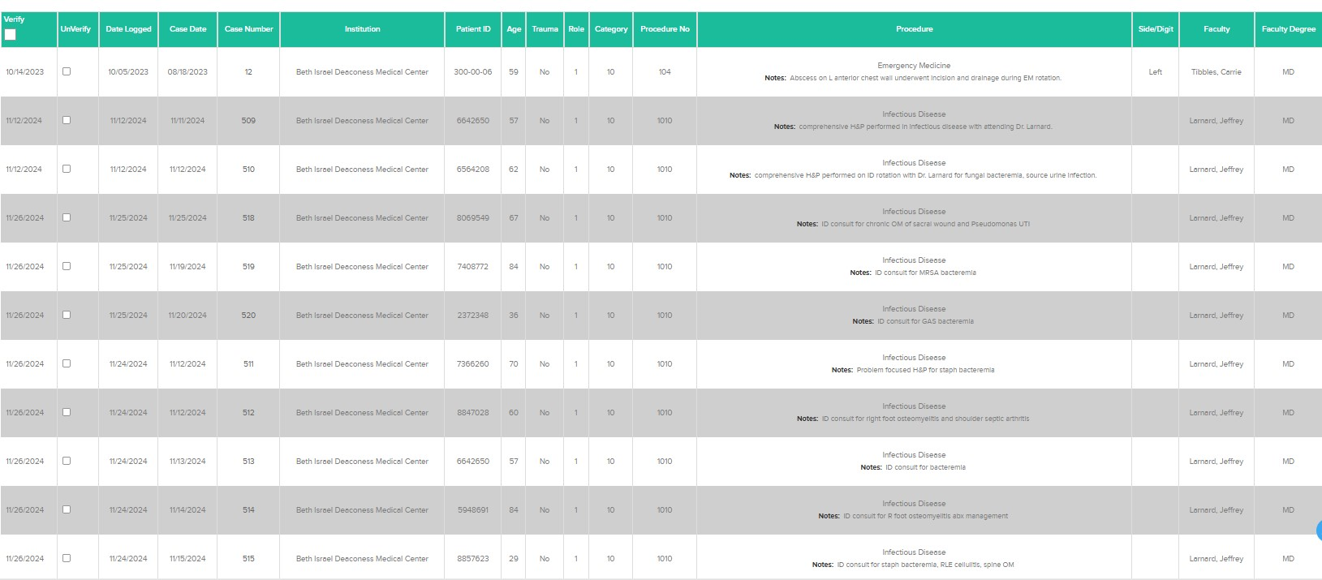
Categories 9 & 10: Med / Surg Specialties

Slide 41
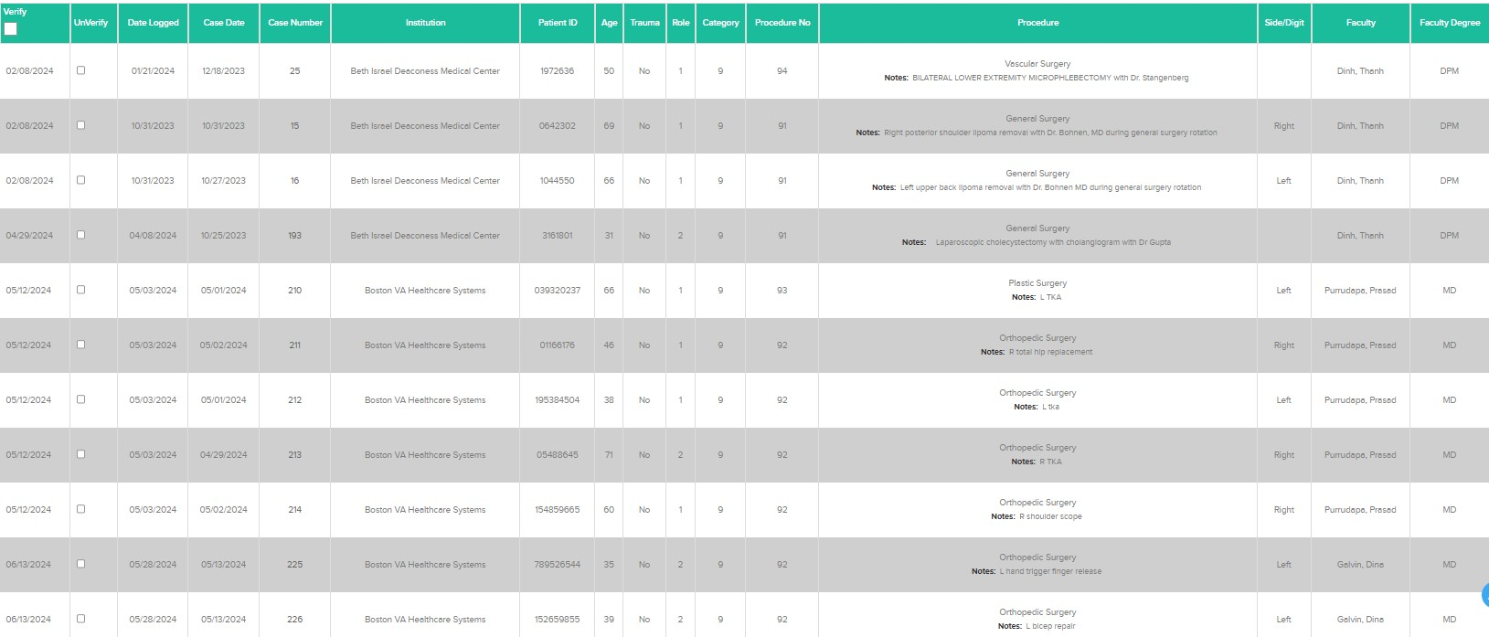
Categories 9 & 10: Med / Surg Specialties

Slide 42
Category 11: Lower Extremity Wound Care
11.1 – excisional debridement of ulcer or wound (e.g., neuropathic, arterial, traumatic, venous, thermal)
11.2 – advanced wound care modalities (e.g., negative pressure wound therapy, cellular and/or tissue-based product, total contact casting, multi-layer compression therapy/Unna boot)
11.3 – hyperbaric oxygen therapy
Notes:
A minimum activity volume of at least 50 diverse lower extremity wound care experiences must be logged

Slide 43
Category 11: Lower Extremity Wound Care
Procedure note should include:
  Type of wound (if known)
  Location including laterality
  Level of debridement
Debridement in OR that includes deeper structures might best be categorized in surgical categories.
Only log one wound care category per case regardless if there is more than one wound care procedure.
Notes:
A minimum activity volume of at least 50 diverse lower extremity wound care experiences must be logged

Slide 44
Logging Category 11
Should be used no matter where lower extremity wound care service is provided (e.g., OR, outpatient/clinic, ED, floors)
ANY sharp debridement of an ulcer or wound of any type is category 11.1 and should not be miscategorized as category 3.8 I+D. RRC includes hydrostatic debridement such as Versajet and Misonix-type debridement in this category, although they are traditionally referred to as "non-excisional debridement."
If a procedure note states "debridement of ulcer" or "debridement of wound," then it is miscategorized if it is 3.8; it should be logged as 11.1.

Slide 45
Logging Category 11
If a wound is debrided and a biologic dressing is placed, the debridement is inclusive with the biologic being placed and should only be categorized as 11.2 without a separate debridement code.
If a wound is debrided and a split thickness skin graft is applied, it should only be categorized as 3.12 Plastic Surgery Techniques (Including Skin Graft, Skin Plasty, Flaps, Syndactylization, Desyndactylization, and Debulking Procedures Limited to The Forefoot) or 5.1.1 for the midfoot, rearfoot, ankle / leg; the debridement is inclusive.
If a wound is debrided and a wound VAC is placed, the debridement is inclusive, and the procedure should only be categorized as 11.2 (without a separate debridement code).
If a wound is debrided and then hyperbaric oxygen treatment is utilized, it should only be logged as an 11.3.

Slide 46
When is 3.8 Properly Used?
3.8 is for an I&D/wide debridement of soft tissue infection (includes foot, ankle, or leg) and is intended for an incision and drainage (I+D) of an infection such as plantar space infection, necrotizing fasciitis, gas gangrene, etc. It is NOT used for excisional debridement of non-infected tissue.
In cases where a foot/ankle remains infected after an initial I+D and the patient returns for another washout, then 3.8 is still appropriate.
If an infected case is left open and the patient returns to the OR for light debridement and delayed wound closure (because infection has resolved), then it is properly categorized as 6.6 repair of simple laceration (no neurovascular, tendon, or bone/joint involvement); includes simple delayed wound closure.
An incision and drainage performed away from the OR, no matter how extensive, is properly logged as 6.17 incision and drainage (performed outside of the operating room) and not a 3.8.

Slide 47
Trauma Cases
This activity includes resident participation in the clinical evaluation and management and/or surgical management of patients who present within six weeks of a traumatic episode.
    One resident can log initial clinical / ED evaluation / management of trauma
    Another resident can log surgical management of trauma on same patient
At least 25 of the 50 required trauma cases must be foot and/or ankle trauma.
Notes:
After reading first bullet point, say: The trauma MAV is not just surgical trauma.

Slide 48
Podopediatric Cases
Residents must participate in the evaluation and/or management of patients less than 18 years of age.
Encounters must include the evaluation and/or management of lower limb pathology and can be clinical or surgical experiences.
The resident must log these encounters under categories 1-7, not under category 10.15. Category 10.15 is not considered a podopediatric experience.
Notes:
Podopediatric experiences involve resident participation in the evaluation and /or management of lower limb pathology patients less than 18 years of age and be medical or surgical in nature
For pediatric foot and ankle medical and surgical care – log the procedure under categories 1-7 – not under category 10 as it will not be reflected in PRR as a podopediatric experience.

Slide 49
Category 13: Other Clinical Experiences
13.1 – Other clinical experiences
  Mission trips
  Procedures performed outside the United States

Slide 50
Log Verification / Correcting Errors
Program Directors must review and verify logs monthly; therefore, residents must log experiences on a timely basis – date of resident logging and Program Director verification are displayed in PRR.
The Clinical Log Audit Detail (CLAD) Report is used to audit residents’ logs to ensure attainment of required surgical MAV numbers.
  Definite errors: Logging two Category 2 procedures on the same patient
  Possible errors: infection cases, tenotomies
    The Program Director must review these logs:
      clear the inquiry if appropriate
      un-verify and correct the logging error or refer the logging error back to the resident to correct
Notes:
The CLAD report is readily viewable within PRR, Podiatry Residency Resource under Program Reports, Clinical Section. PRR provides detailed information for using the CLAD report under Resources section by choosing the Help Wiki link. A PDF and a tutorial video can be viewed for further CLAD report information.

Slide 51
Minimum Activity Volume (MAV)
Procedure Activities:
First and second assistant procedures (total): 400
First assistant procedures, including:
Digital: 80
First Ray: 60
Other Soft Tissue Foot Surgery: 45
Other Osseous Foot Surgery: 40
Reconstructive Rearfoot/Ankle (added credential only): 50
Elective and non-elective soft tissue RRA may be substituted in the Other Soft Tissue Foot Surgery category whenever there are deficiencies.
Elective and non-elective osseous RRA may be substituted for Other Osseous Foot Surgery category whenever there are deficiencies.
Notes:
From Appendix A in CPME 320. Residents in a PMSR program can use cases logged in Category 5 to make up deficits in the MAV’s needed in Categories 3 and 4.

Slide 52
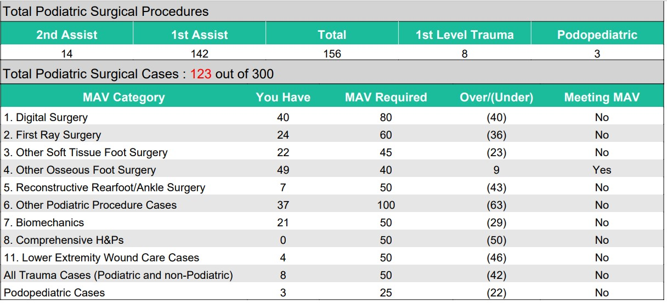
MAV Report

Slide 53
Assuring Diversity of Surgical Procedures
At least 33% of the procedure codes within each category and subcategory must be represented with first assistant procedures.
For example, in the Other Osseous Foot Surgery category:
    At least 6 of the 18 different procedure codes must have at least one activity as first assistant.

Slide 54
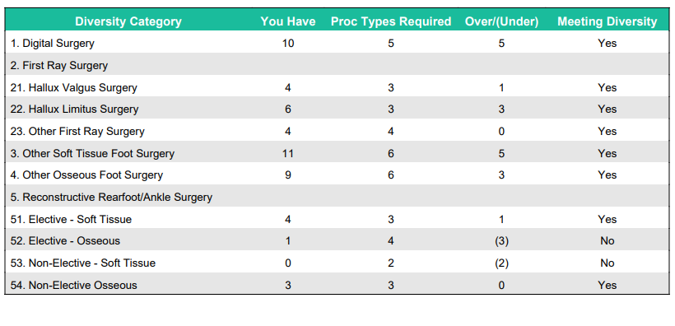
Diversity Report

Slide 55
Activity Logs
Requirement 6.7 - Didactic activities that complement and supplement the curriculum shall be available.
  Residents must be afforded protected time for weekly didactic activities. Didactic activities must be provided in a variety of formats. These formats may include lectures, case discussions, clinical pathology conferences, morbidity and mortality conferences, cadaver dissections, tumor conferences, informal lectures, teaching rounds, and/or continuing education.
  The majority of didactic activities must include participation by at least one faculty member.

Slide 56
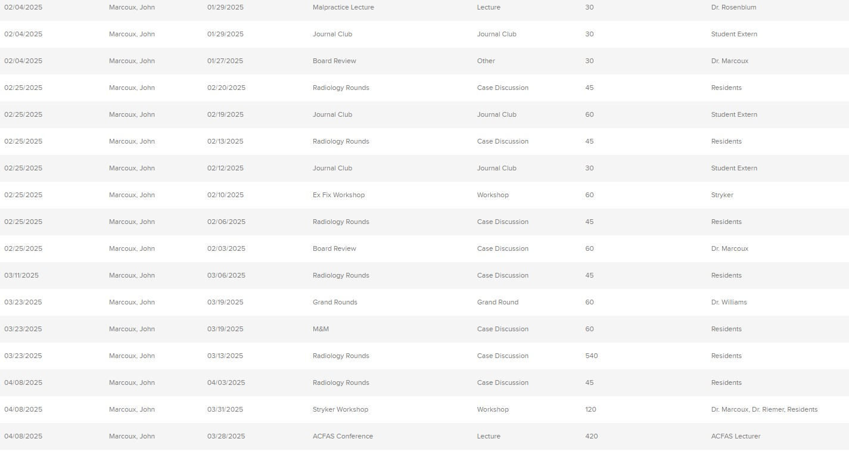
Activity Logs

Slide 57
Chart Requests
  ABFAS and ABPM chart requests are forwarded to the Program Director at least four weeks in advance of an on-site visit.
  Upload redacted documents to CPME in the format requested
Notes:
Develop at least 15–20 cases.
Keep a copy of the list

