Slide 1


Required Rotations & Lengths
These informal slides were intended to be delivered in a conversational format, with the presenter sharing practical examples and emphasizing the key elements that contribute to a successful on-site evaluation.

Slide 2

Requirement 6.4
CPME 320, July 2023
  Pages 23-24
https://www.cp me.org/wp-content/uploads/2023/12/320-Council-Approved-October-2022-April-2023-edits.pdf
www.cpme.org/cpme320

Slide 3
To-Do List for Rotations
The residency program SHALL provide rotations to achieve competencies identified by the CPME and any additional by the program.
  SHALL include both podiatric medicine and surgery as well as non-podiatric rotations.
  SHALL provide resident patient experiences in both inpatient and outpatient settings.
Notes:
Competencies to be discussed later on with Dr. Vyce.

Slide 4
More for the To-Do List!
  The program director MUST, in collaboration with appropriate individuals, construct the curriculum based on available resources.
  The program director MUST consult with faculty to identify resources available to enable resident achievement of the curricular competencies.
  Members of the administrative staff and GME may be involved in the development of the curriculum.

Slide 5
Rotation Requirements
Each rotation MUST be a minimum of two weeks of training
  Block or sequential format only
  Case-by-case is NOT acceptable

Slide 6
Required Rotations
Podiatric medicine and surgery
Anesthesiology
Behavioral medicine
Emergency medicine (minimum of four weeks)
Medical imaging

Slide 7
Required Rotations
Surgical specialties MUST equal a minimum of eight cumulative weeks.
  MUST include:
    Endovascular/vascular surgery = minimum of two weeks
  MUST include at least one of the following:
    Cardiothoracic surgery, general surgery, hand surgery, orthopedic surgery, neurosurgery, orthopedic/surgical oncology, pediatric orthopedic surgery, plastic surgery, surgical intensive care unit (SICU), or trauma team/surgery

Slide 8
Required Rotations
Medical Specialties MUST equal a minimum of 12 cumulative weeks.
  MUST include:
    Internal medicibe/Family medicine = minimum of four weeks
    Infectious disease
  MUST include at least two of the following:
    Burn unit, dermatology, endocrinology, geriatrics, intensive/critical care unit, neurology, pain management, pediatrics, physical medicine and rehabilitation, rheumatology, wound care, and vascular medicine

Slide 9
Curriculum (6.4)
Medical Specialties
Medical Specialties
Training must include rotations in:
  Internal medicine/Family medicine
  Infectious disease
Training must also include at least two of the following rotations:
    Burn unit
    Dermatology
    Endocrinology
    Geriatrics
    Intensive/critical care unit
    Neurology
    Pain management
    Pediatrics
    Physical medicine and rehabilitation (not physical therapy)
    Rheumatology
    Wound care
    Vascular medicine
In addition to the required rotations, the residency curriculum must include rotations in at least two medical specialties. There is a minimum of 12 cumulative weeks of training in medical specialties.
Required Rotations
Required Medical Specialty Rotations
At least two medical specialties from list above

Slide 10
Curriculum (6.4)
Surgical Specialties
Surgical Specialties
Training must include a minimum of two weeks in endovascular/vascular surgery and at least one of the following rotations:
    Cardiothoracic
    General surgery
    Hand surgery
    Orthopedic surgery
    Neurosurgery
    Orthopedic/surgical oncology
    Pediatric orthopedic surgery
    Plastic surgery
    Surgical intensive care unit (SICU)
    Trauma team/surgery
In addition to the required rotations, and medical specialties, there is a minimum requirement of 8 cumulative weeks of training in surgical specialties. Training must include at least two surgical rotations, with a minimum of two weeks in endovascular/vascular surgery.
Endovascular/ Vascular
At least one other specialty

Slide 11
Wound Care Medical Specialty Rotations
To qualify as a “medical specialty,” the following MUST occur:
  Involve training AND assessments by non-DPMs
Wound care rotations that involve training only by DPMs do NOT qualify as one of the two required “medical specialty” rotations.

Slide 12
Keep in Mind
Typical training week involves five working days.
  Holidays may shorten a work week.
Program should be structured so that:
  Each rotation is a minimum of the required length of time
  The resident is allowed to successfully achieve the rotation competencies.
Individual resident schedules may vary due to faculty schedules, holidays, or other unforeseen circumstances; however, the intent is the program affords residents the necessary time required in each rotation.

Slide 13
Resources
CPME 320
CPME 310 checklist
CPME 370

Slide 14
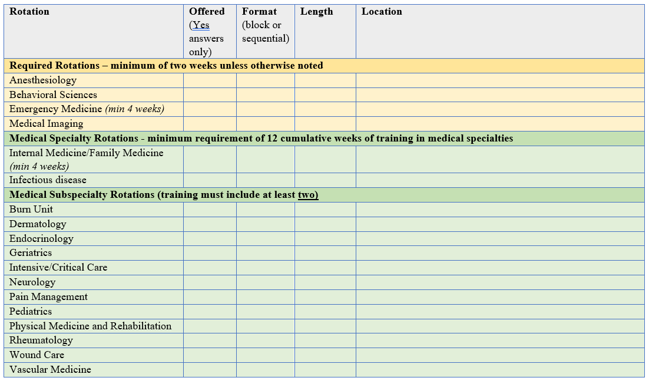
Rotations

Slide 15
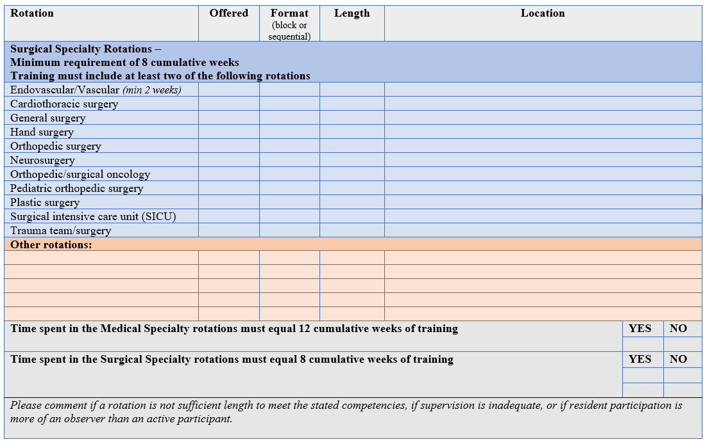
Rotations

Slide 16
