Slide 1
Miscellaneous Topics
These informal slides were intended to be delivered in a conversational format, with the presenter sharing practical examples and emphasizing the key elements that contribute to a successful on-site evaluation.

Slide 2
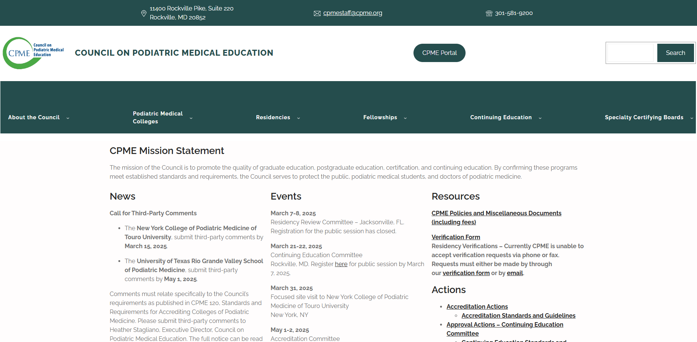
Updated Website @ https://www.CPME.org

Slide 3
Logging in Categories 9 and 10
6.2 The sponsoring institution shall require that the resident maintain web-based logs documenting clinical and didactic experiences related to the residency.
    Residents MUST log experiences to substantiate their rotations.
    Residents MUST log experiences in all non-DPM rotations
        Category 9 – Surgical Specialties
        Category 10 – Medical Specialties

Slide 4
Proof of Completion of a Rotation: Four Things the On-site Team Looks For
  Competencies that meet criteria set forth in the CPME 320
  Properly completed evaluations for the rotation
    Lists dates of rotation
    Signed by evaluator, whose name and degree are printed legibly
    Signed by trainee and program director
    Acceptable levels checked off on evaluations (not all "n/a")
  3. Experiences logged for the non-DPM rotations
  4. Absence of large-scale podiatric logs during the scheduled time of the rotation

