Slide 1
Competency and Assessment Documents
These informal slides were intended to be delivered in a conversational format, with the presenter sharing practical examples and emphasizing the key elements that contribute to a successful on-site evaluation.

Slide 2

What is the entire point of residency?
Training Residents to become
Practicing Podiatrists
COMPETENT

Slide 3
Curriculum (6.1)
The Competencies (6.1) - Standard and Requirements
6.1 The curriculum shall be clearly defined and oriented to assure that the resident achieves the competencies identified by the Council.
The curriculum must provide the resident a sufficient volume and diversity of
experiences in the supervised diagnosis and management of patients with a variety
of diseases, disorders, and injuries through achievement of the competencies listed below.

Slide 4
Curriculum (6.1)
The Competencies (6.1) - 7 Core Competencies
Each of the 7 Core Competencies needs to be addressed in the Competencies and Assessment Documents of the program. Each of the 7 is further outlined in the CPME 320.
The 7 Core Competencies:
  Prevent, diagnose, and medically and surgically manage diseases, disorders, and injuries of the lower extremity.
  Assess and manage the patient’s general medical and surgical status.
  Practice with professionalism, compassion, and concern in a legal, ethical, and moral fashion.
  Communicate effectively and function in a multi-disciplinary setting.
  Manage individuals and populations in a variety of socioeconomic and health-care settings.
  Understand podiatric practice management in a multitude of health-care delivery settings.
  Be professionally inquisitive, life-long learners and teachers utilizing research, scholarly activity, and information technologies to enhance professional knowledge and evidence-based practice.

Slide 5
Podiatric Competencies
They MAY be copied word-for-word from the CPME 320.
But they DO NOT NEED TO BE copied word-for-word, as long as they have similar meaning.
Broad latitude is given in podiatric competencies and assessments, given the breadth of the material.
It is understood that assessments cannot exhaustively list every possible procedure and scenario.

Slide 6
Podiatric Competencies
Need to make sure ALL of podiatric care is addressed in your competencies.
Cannot simply focus on certain aspects of care, such as surgery or office procedures, etc.
Competencies can be split among different evaluations of podiatry, if different rotations cover different areas:
    In other words, an office rotation versus inpatient rotation versus outpatient surgery rotation may all have different evaluations, as long as cumulatively they cover all areas of podiatric competencies.
Need to include professionalism in addition to medical acumen and knowledge.

Slide 7
Competencies and Assessments for Non-podiatric Rotations
These competencies need to developed while paying strict attention to the CPME 320.
They must be specific to the rotation.
  It is okay to have general competencies and assessment questions.
  But programs must have competencies that are specific to that specialty:
      e.g., skin-related competencies for a Dermatology rotation, not just generic H+P competencies
Some rotations have specific competencies listed in the CPME 320.
These need to be included in assessment and competencies.

Slide 8
Competencies and Assessments
– Non-podiatric
Requirement 6.1 B 9 states:
Participate actively in an infectious disease rotation that includes, but is not limited to, the following training experiences:
Recognizing and diagnosing common infective organisms.
Using appropriate antimicrobial therapy.
Interpreting laboratory data including blood cultures, gram stains, microbiological studies, and antibiosis monitoring.
Managing patients with local and systemic infections.
These specific points need to be in the competency and assessment documents.

Slide 9
Competencies and Assessments
– Non-podiatric
Requirement 6.1 B 12 states:
Participate actively in a vascular/endovascular surgery rotation that incorporates the evaluation and management of patients with peripheral arterial disease including, but not limited to, the following training experiences:
Evaluating and interpreting various vascular studies.
Understanding the indications for various vascular/endovascular revascularization procedures
These specific points need to be in the competency and assessment documents.

Slide 10
Assessments – CPME 320 Standards and Requirements
7.2 The faculty and program director shall assess and validate, on an ongoing basis, the extent to which the resident has achieved the competencies.
Assessment forms must be completed for all rotations identified in the curriculum.
The document must specify the dates covered, the name of the resident, and the name of the faculty member.
The document must assess competencies specific to each rotation including communication skills, professional behavior, attitudes, and initiative.

Slide 11
Assessments - Must Be Signed
The assessment must be signed and/or electronically acknowledged and dated by the faculty member, the resident, and the program director.
Intent and Background: Electronic or written acknowledgement of receipt and review of the assessment by the resident and program director is acceptable.
This documentation must be producible upon the request of the site team and/or RRC/CPME.

Slide 12
Assessments – CPME 320 Standards and Requirements
7.2 (Continued)
The timing of the assessment for each competency must allow sufficient opportunity for performance improvement.
Assessment must be documented at least once for every three months of uninterrupted training in podiatric medicine and/or podiatric surgery service and must include assessment of resident outpatient podiatric experiences (clinic and/or private practice offices).

Slide 13
Develop and Review Competencies and Assessment Documents with Rotation Directors
-Competencies for every rotation must be developed in concert with the rotation director.
  They know what happens in the rotation!
-Competencies should be reviewed annually with the rotation director to make sure the rotation is supplying the needed training for resident to meet the competencies.
  The review can be in writing (such as an annual email asking them to review).
  The review can be verbal (but the rotation director will be asked during the site visit!).

Slide 14
Assessments
Need to be able to evaluate how well the resident is meeting the competencies.
Essentially, assessment can consist of the competencies directly copied over, with a scale added to assess how well the trainee meets the competency.
For example:
Competency states:
  Demonstrate appropriate skills in soft tissue handling and repair
Assessment may be worded:
  Trainee demonstrates appropriate skills in soft tissue handling and repair
  [Response options are] Poor / Below Average/ Average / Above Average / Superior / N/A

Slide 15
Assessments
Competencies do not need to be copied directly.
For example:
The competency states:
  Demonstrate appropriate skills in soft tissue handling and repair
The assessment may be worded:
  Trainee manages soft tissue envelope and incisions with appropriate tension and instrumentation 1/2/3/4/5 N/A
  Trainee is able to suture capsule and subcutaneous tissue appropriately 1/2/3/4/5 N/A
  Trainee is able to perform a variety of skin suturing techniques 1/2/3/4/5 N/A

Slide 16
Getting Good Assessments
Keep them short and sweet -- fewer than 15 questions per evaluation, otherwise you may not get valid information (beware the dreaded “straight line through one set of bubbles”).
A program may have different sets of evaluations delivered at different times, as long as cumulatively they meet the criteria:
May have one 10-15 question evaluation on clinical aspects of practice and a separate 5-10 question evaluation on professionalism and a separate one on surgical skills or biomechanics.
May have a quarterly professionalism and overall review of clinical aspects of practice.
Alternatively, may have one long assessment for podiatric medicine and surgery, encompassing all aspects including professionalism.

Slide 17
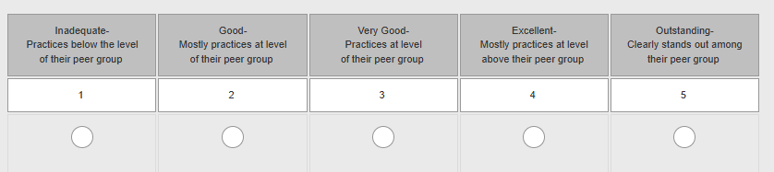
Getting Good Assessments
It is better to have descriptors for multi-choice columns, than simply a number:

Slide 18
Getting Good Assessments
Consider “on-the-fly” short evaluations.
  These are 1-5 question evaluations attendings can fill out after a day in the OR with a resident or a day in the office.
  Consider 360-degree evaluations
    Nursing evaluations
    Peer-to-peer evaluations

Slide 19
Assessment Documents
For the rotation to be valid, the resident must participate and “pass” the competencies! Should this count as a valid rotation?
1. Participates in Rheumatology clinic appropriately 3 2 1 N/A
2. Participates in Rheumatology conferences appropriately 3 2 1 N/A
3. Develops an understanding of the various rheumatologic diseases and their associated 3 2 1 N/A
signs and symptoms.
4. Develops an understanding of the various laboratory and related diagnostic studies available 3 2 1 N/A
to diagnose and monitor the various rheumatologic diseases.
5. Develops an understanding of the various medications used to treat rheumatologic diseases 3 2 1 N/A
and their indications for use
6. Overall rating for Resident in Rheumatology Rotation? 3 2 1 N/A

Slide 20
Putting it All Together
How does a program determine competence of a resident?
Have various mechanisms for assessing whether residents are developing as doctors and surgeons.

Slide 21
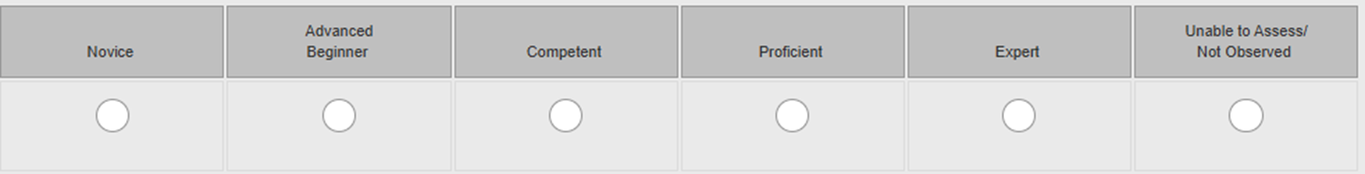
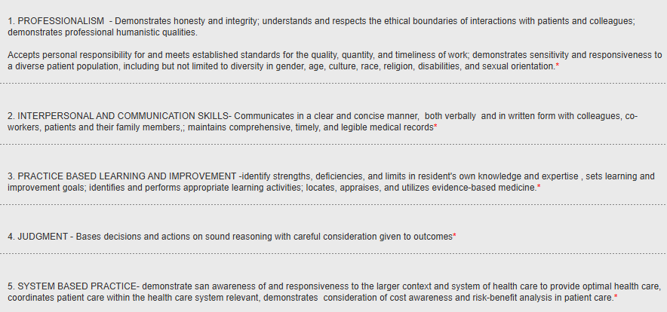
Faculty Must Help Determine Competence--Not Only Program Director’s Job!

Slide 22
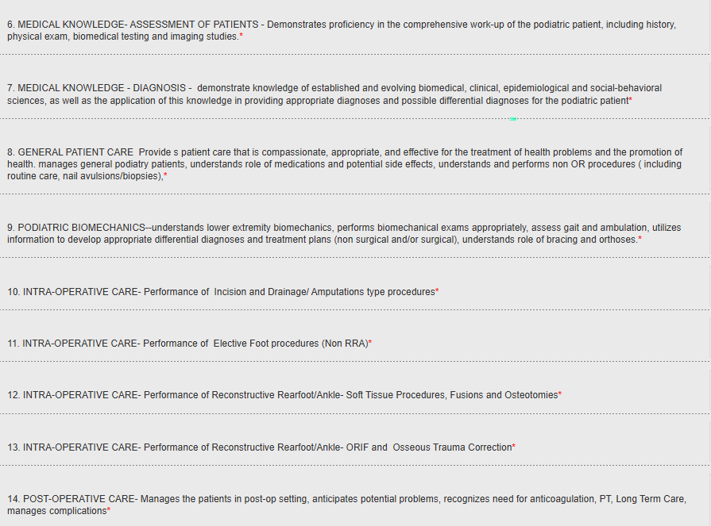
Getting Good Assessments

Slide 23
Proof of Completion of a Rotation: Four Things the On-site Team Looks For
  Competencies that meet criteria set forth in the CPME 320
  Properly completed evaluations for the rotation
    Lists dates of rotation
    Signed by evaluator, whose name and degree are printed legibly
    Signed by trainee and program director
    Acceptable levels checked off on evaluations (not all "n/a")
  3. Experiences logged for the non-DPM rotations
  4. Absence of large-scale podiatric logs during the scheduled time of the rotation

Slide 24
Assessment Documents
Review:
All rotation assessment documents must:
  List dates and name of rotation
  List name of trainee
  Legibly list evaluator's name and degree/title
  Be signed by evaluator
  Be signed (or digitally reviewed) by program director and trainee

