Slide 1
Semi-annual Resident Review
These informal slides were intended to be delivered in a conversational format, with the presenter sharing practical examples and emphasizing the key elements that contribute to a successful on-site evaluation.

Slide 2
Semi-annual Assessment of Resident
7.2 The faculty and program director shall assess and validate, on an ongoing basis, the extent to which the resident has achieved the competencies.
  a. Faculty assessment of the resident
  b. Program director semi-annual assessment of the resident
  c. Program director final assessment of the resident
      Intent and Background: The final assessment of the resident is to be conducted in lieu of the semi-annual assessment. This assessment must be conducted within the resident’s final two months of training.

Slide 3
7.2a. Faculty Assessment of the Resident
Assessment forms for all rotations in the curriculum.
  Dates of rotation, resident, and faculty member.
  Signed and/or electronically acknowledged and dated by faculty member, resident, and program director.
  Competencies specific to rotation. communication skills, professional behavior, attitudes, and initiative.
  Timing must allow sufficient opportunity for performance improvement.
Assessment at least once for every three months of uninterrupted training in podiatric medicine/surgery and must include outpatient podiatric experiences (clinic and/or private practice offices).
Intent and Background: Podiatric medicine/surgery assessment forms may be combined or separate documents.
Electronic or written acknowledgement of receipt and review of the assessment by the resident and program director is acceptable.

Slide 4
Semi-annual Assessment of Resident
7.2b. Program Director Semi-Annual Assessment of the Resident
  The program director must conduct and document a semi-annual meeting with each resident on an individual basis. The semi-annual assessment must be signed and dated by the program director and the resident. This review must include the following:
        Review of completed rotation assessments (see requirement 7.2a).
        In-training examinations.
        Projected attainment of MAVs.

Slide 5
Semi-annual Review: Data
All rotation evaluations since prior review*
  Consider 360-degree assessments or milestones assessment data
In-training exam results*
  Can direct areas that need improvement
Projected attainment of MAVs*
  Review of clinical / surgical logs / diversity / volume
Research requirements – methodology per CPME plus other per program
Required didactic activities – weekly and annual

Slide 6
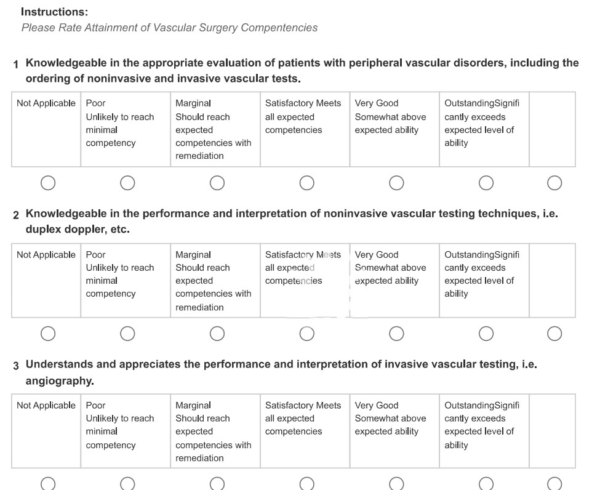
Review Evaluations – If You Use Milestones

Slide 7
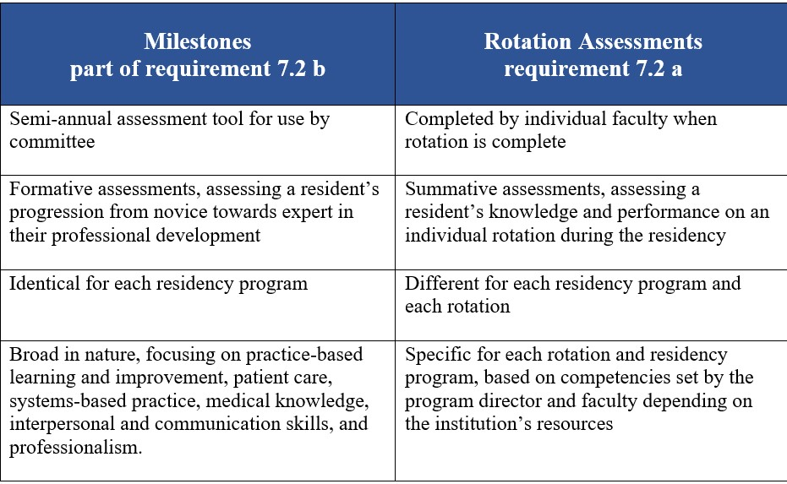
Milestones

Slide 8
Review Evaluations – If You Use 360-Degree Assessment
Performance evaluation method
Gathers input from multiple perspectives / sources including:
  Fellow residents, nurses, OR / clinic staff, patients
Provides an unbiased, comprehensive view of performance strengths, weaknesses, and areas of improvement

Slide 9
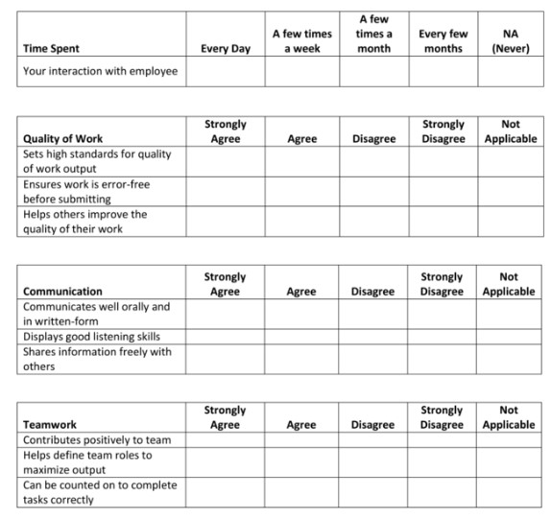
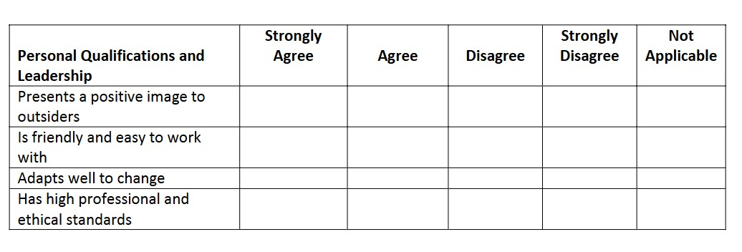
360-Degree Assessment
Evaluate various competencies:
Work performance
Communication skills
Teamwork / Attitude
Professionalism / Leadership

Slide 10
In-training Examinations
7.3 The program shall require that all residents take at least one in-training examination during each academic year, as offered by SBRC-recognized specialty boards.
  The sponsoring institution must pay any fees associated with the examinations.
  The program must require that residents take one exam from each SBRC-recognized specialty board at least once during their time in residency training.
  Examination results are used as a guide for resident performance improvement and as part of the annual self-assessment of the program.

Slide 11
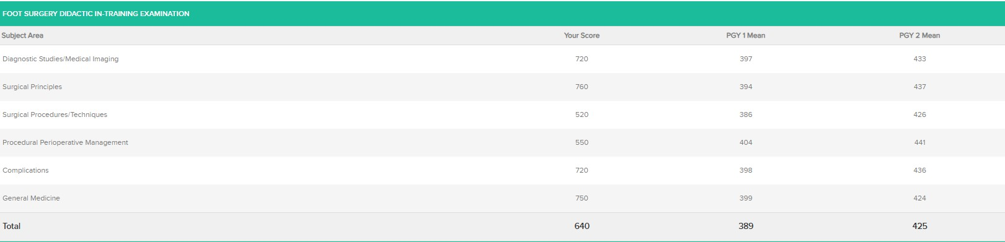
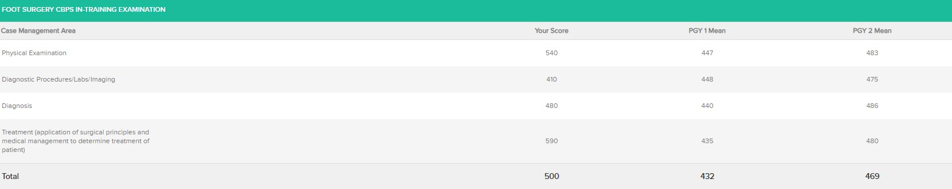
ABFAS In-training Examination - Foot

Slide 12
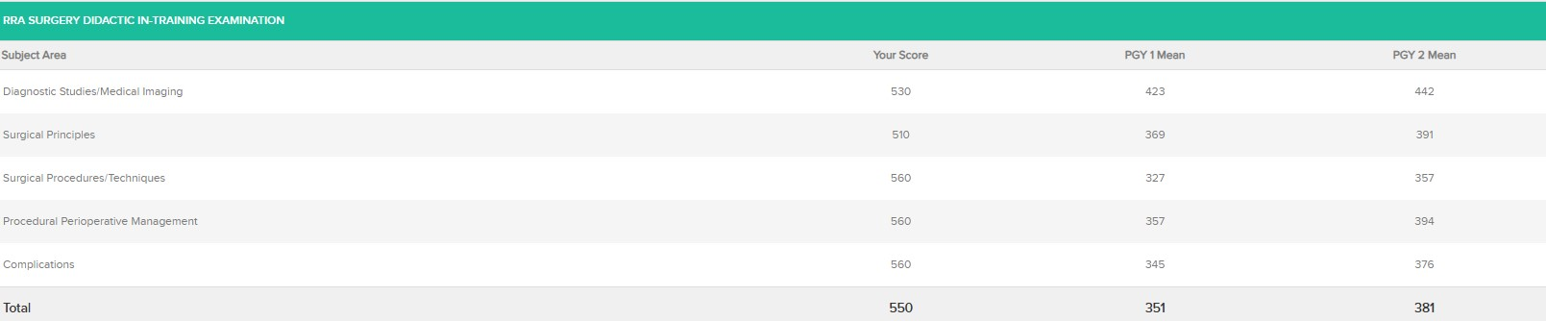
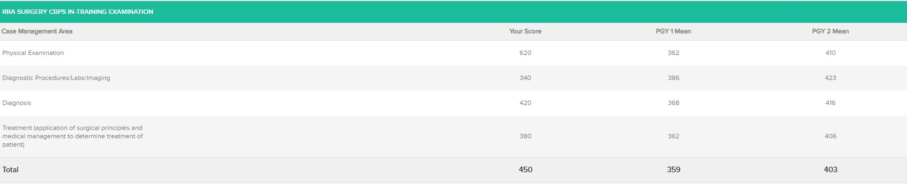
ABFAS In-training Examination - RRA

Slide 13
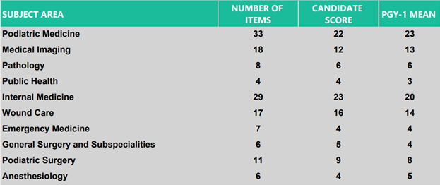
ABPM In-training Examination

Slide 14
Minimum Activity Volume (MAV)
Procedure Activities:
First and second assistant procedures (total): 400
First assistant procedures, including:
Digital: 80
First Ray: 60
Other Soft Tissue Foot Surgery: 45
Other Osseous Foot Surgery: 40
Reconstructive Rearfoot/Ankle (added credential only): 50
Elective & non-elective soft tissue RRA may be substituted for Other Soft Tissue Foot Surgery category if there are deficiencies.
Elective & non-elective osseous RRA may be substituted for Other Osseous Foot Surgery category if there are deficiencies.
Notes:
From Appendix A in CPME 320. Residents in a PMSR program can use cases logged in Category 5 to make up deficits in the MAV’s needed in Categories 3 and 4.

Slide 15
Minimum Activity Volume (MAV)
Case Activities
Podiatric surgical cases: 250 for PMSR
Podiatric surgical cases: 300 for PMSR/RRA
Trauma cases: 50
Podopediatric cases: 25
Biomechanical cases: 50
Comprehensive history and physicals: 50
Other podiatric procedures: 100
Lower extremity wound care: 50
Notes:
MAVs are patient care activity requirements that assure that the resident has been exposed to adequate diversity and volume of patient care. MAVs are not minimum repetitions to achieve competence. For some residents, the minimum repetitions may be higher or lower than the MAVs. It is incumbent upon the program director and the faculty to assure that the resident has achieved a competency, regardless of the number of repetitions. The MAV’s listed in CPME 320 were derived from the appropriate specialty boards.
A case is defined as an encounter with a patient that includes resident activity in one or more areas of podiatric or non-podiatric evaluation or management. Multiple procedures or activities performed on the same patient by a resident at the same time would constitute one case. An individual patient can be counted towards fulfillment of more than one activity.
Podiatric surgical cases: This activity includes participation of the resident in performing foot and ankle surgery (and their governing and related structures) during a single patient encounter. In the logs, only categories 1-5 would count towards the surgical case MAV. PMSR programs require 150 surgical cases and the PMSR with RRA require a total of 300 surgical cases.
Trauma: 50 cases
25 Podopediatric cases are required. This activity includes resident participation in the evaluation and/or management of lower extremity pathology in patients who are less than 18 years of age.
75 Biomechanical cases and 50 comprehensive H&P’s

Slide 16
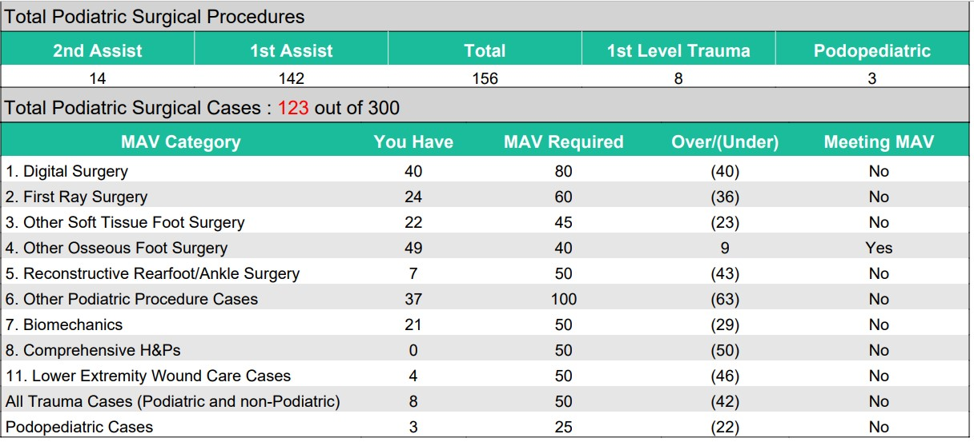
MAV Report

Slide 17
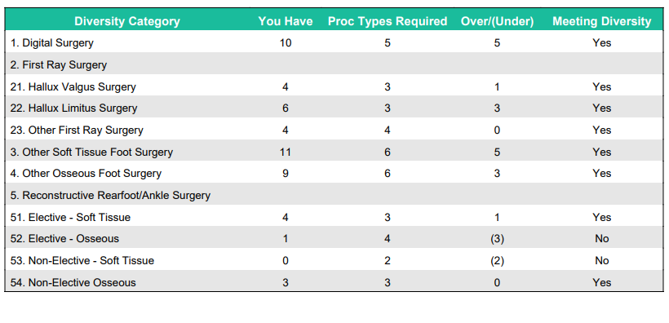
Diversity Report

Slide 18
Research Requirement
6.7 - Didactic activities that complement and supplement the curriculum shall be available.
  Training in research methodology must be provided at least once during residency training (e.g., web-based training, formal lectures, or a dedicated research rotation).

Slide 19
Yearly Required Didactic Activities
Training in the following must be provided to the resident at least once per year of training:
Falls prevention.
Resident well-being (e.g., substance abuse, fatigue mitigation, suicide prevention, self-harm, and physician burnout).
Pain management (i.e., multi-modal approach to chronic and acute pain) and opioid addiction.
Workplace harassment and discrimination awareness and prevention.
Foundation of and importance of coding and medical documentation.
The annual instruction may be provided during resident orientation, focused activities, and through web-based programs.

Slide 20
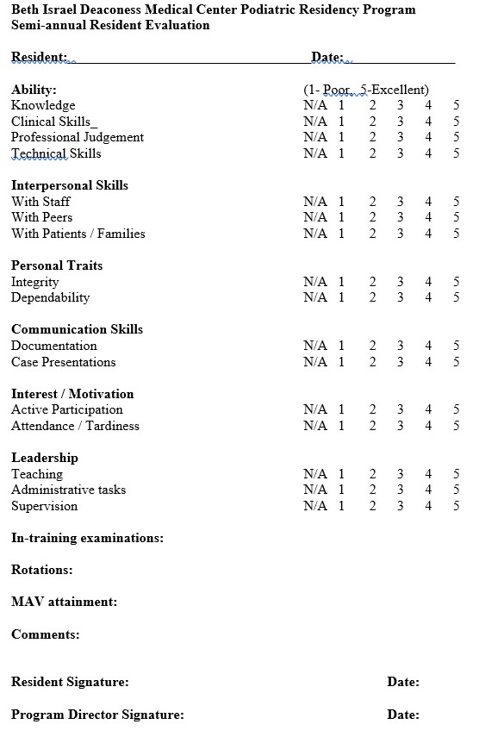
Semi-annual Review Documentation
Clinical / surgical competency
Communication skills
Professional behavior
Attitude, initiative, leadership
Rotations / evaluations completed
MAV attainment
In-training examination scores

Slide 21
Final Assessment of Resident
7.2c - Program Director Final Assessment of the Resident
The Program Director must conduct a final meeting with each resident upon completion of the program. A final assessment must be provided in a written format and include the date and signatures of the Program Director and the resident. The final assessment must:
  become part of the resident’s permanent record maintained by the institution, and must be accessible for review by the resident in accordance with institutional policy
  verify that the resident has achieved the competencies of the residency program and ensure attainment of MAVs in all categories.

Slide 22
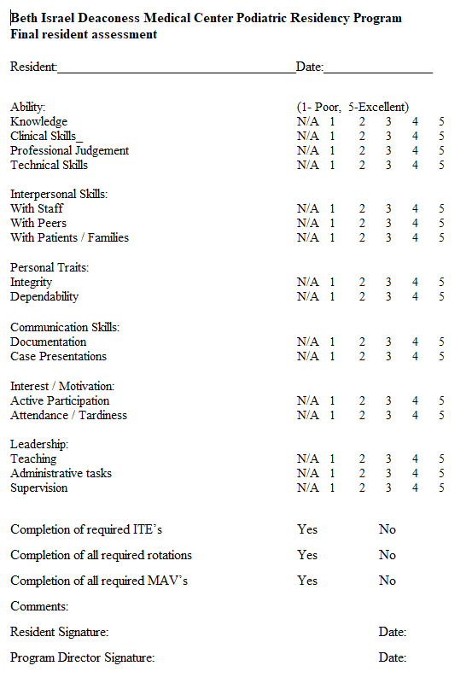
Final Assessment of Resident
Ensure completion of all requirements prior to graduation
In-training examinations
Required rotations including lengths of the rotations
All required MAVs and diversity
Competency
Professionalism

