Slide 1
Annual Program Self Assessment
These informal slides were intended to be delivered in a conversational format, with the presenter sharing practical examples and emphasizing the key elements that contribute to a successful on-site evaluation.

Slide 2
7.4 Program Self Assessment
Standard and Requirements
7.4 The program director, faculty, and resident(s) shall conduct a formal, written annual self-assessment of the program’s resources and curriculum. Information resulting from this review shall be used in improving the program.
The review must include the following:
  a. Identification of individuals involved
  b. Performance data utilized
  c. Measures of program outcomes utilized
  d. Results of the review

Slide 3

Who Must be Involved?
7.4 states: The program director, faculty, and resident(s) shall …
Can be involved in one meeting or can be involved in separate meetings/reviews (maybe one for faculty, one for residents, etc.)
Should incorporate survey data from all parties listed in the requirement, including:
              All residents
              DPM faculty with significant involvement
              (Clinical Competency Committee perhaps?)
              Non-DPM faculty with significant involvement and rotation directors
Must have record of those involved

Slide 4
7.4b - Performance Data
Evaluation of the program’s compliance with the standards and requirements of the Council:
  Many programs use a standard Excel file listing the 320 standards and requirements, and HOW they meet them, and then they review it annually.

Slide 5
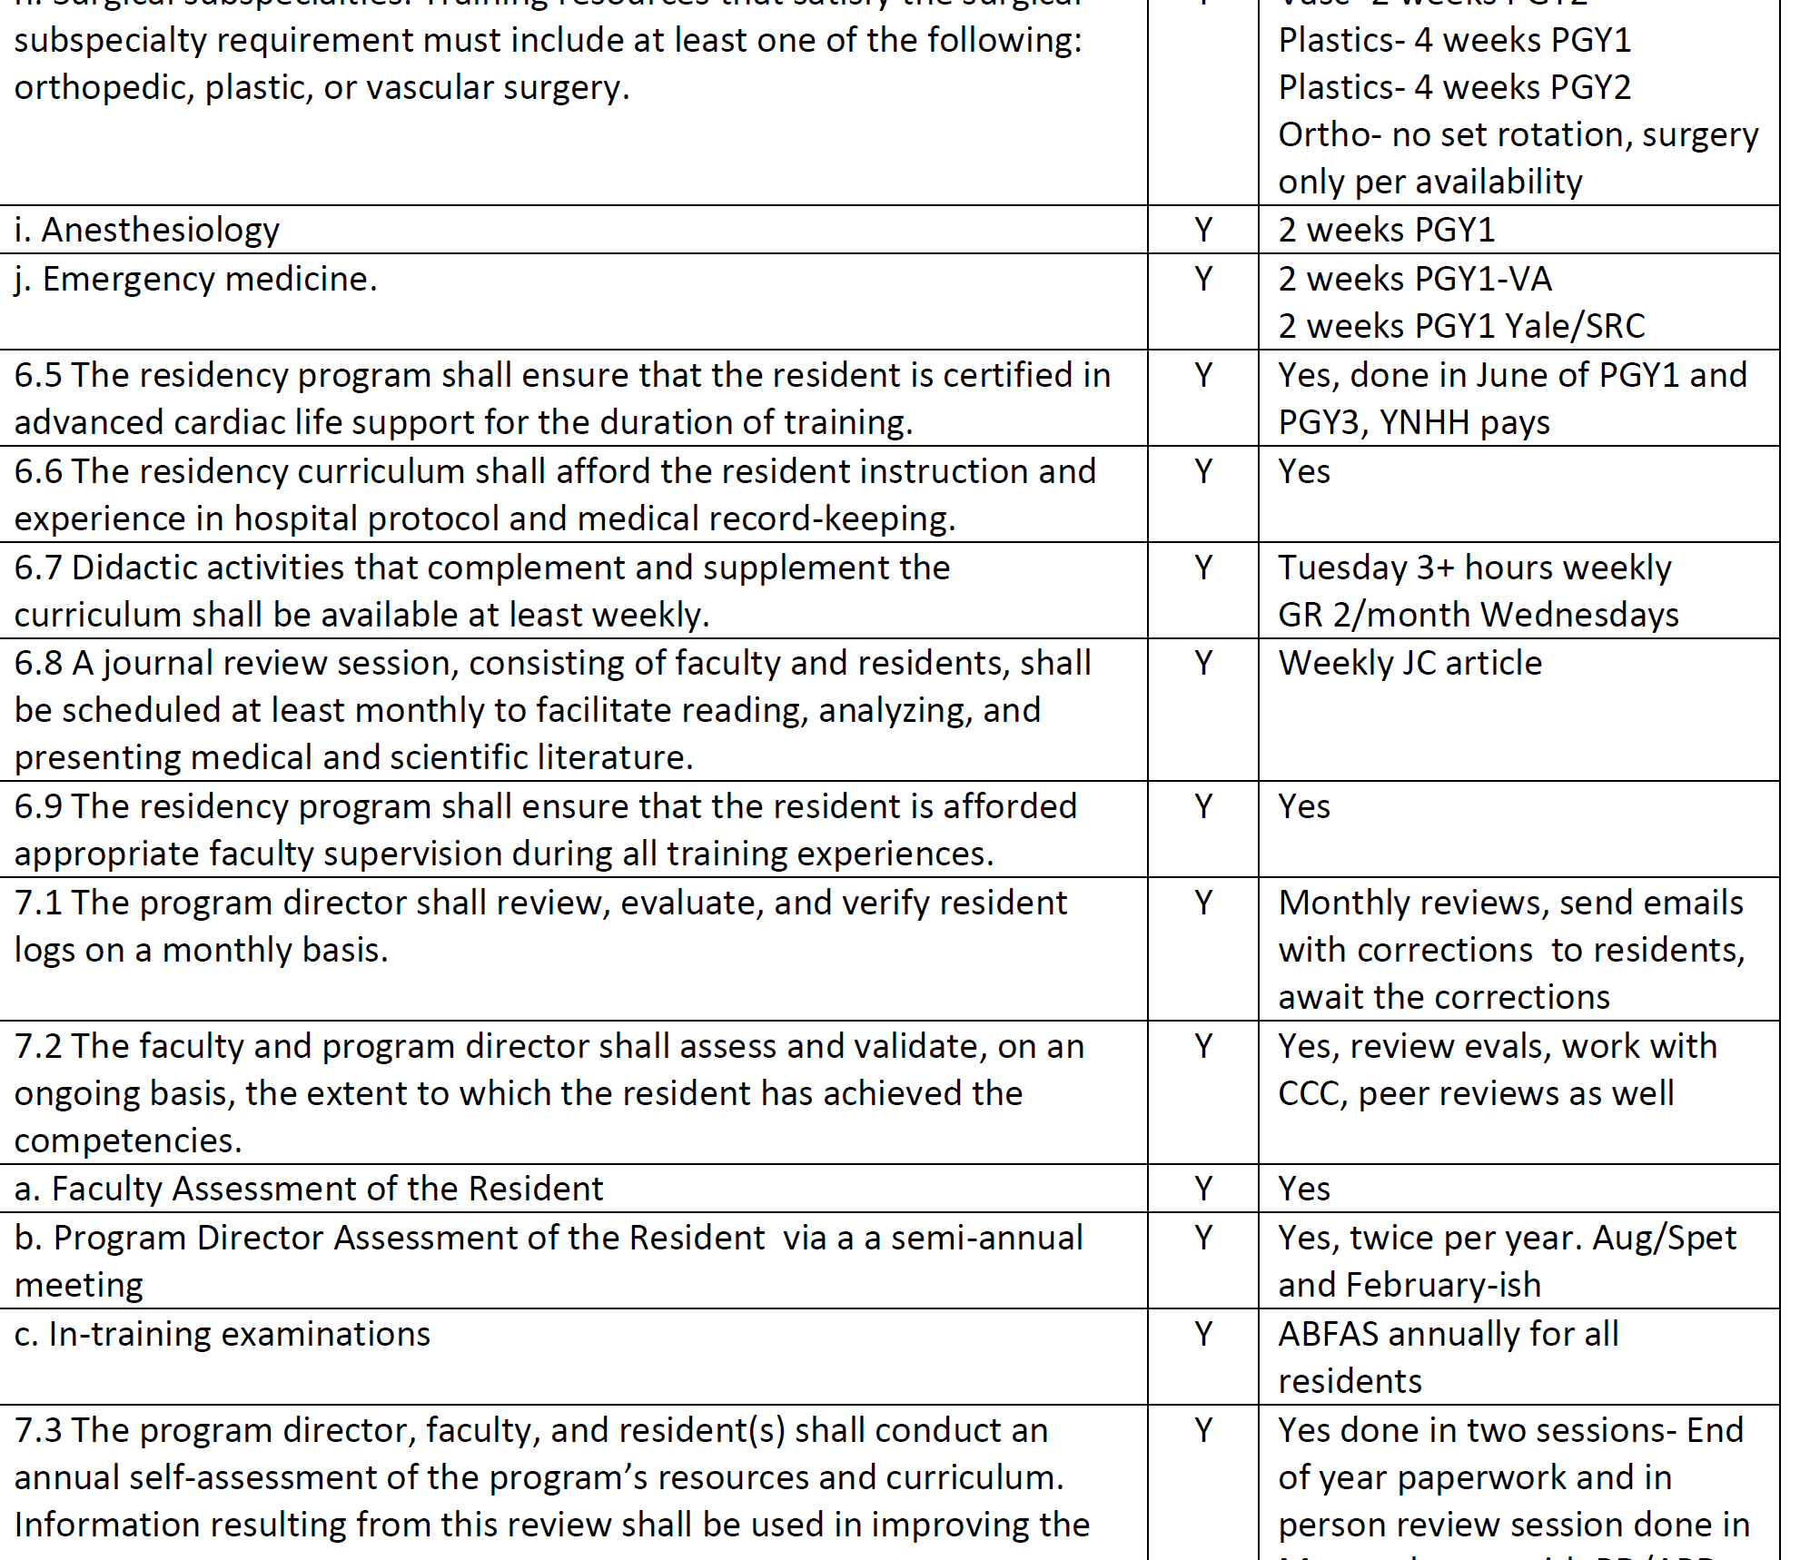

Slide 6
Performance Data - Evaluations
Residents' proficiency, efficiency and competency (via their evaluations)
By PGY class (possibly compare to prior years)
In entirety (all residents) (possibly compare to prior years)
Professionalism of residents
Aggregate evaluation data
Good time to discuss outliers with a group of faculty (Clinical Competency Committee?)

Slide 7
Performance Data
Trend Institution Volume by Academic Year
 |  | 2017-18 |  | 2018-19 | 2019-20 | 2020-21 | 2021-22 | 2022-23
The Best Hospital |  | 1059 |  | 1280 | 883 | 923 | 851 | 721
TBH Sx Center |  | 0 |  | 54 | 334 | 335 | 413 | 337
North Surg |  | Counted in total, but not tracked |  |  |  | 25 | 5 | 0
St Ralphies |  |  |  |  |  | 23 | 43 | 0
Community Hospital |  | 795 |  | 880 | 702 | 1031 | 1136 | 1159
Central Hospital |  | 438 |  | 233 | 184 | 216 | 235 | 157
VA |  | 184 |  | 208 | 176 | 272 | 342 | 280
Old Main |  | 522 |  | 1 | 0 | 0 | 0 | 0
Pinetree |  | 275 |  | 194 | 78 | 150 | 94 | 71
Surg Center Alpa |  | 360 |  | 555 | 379 | 427 | 308 | 330
TOTALS | 3935 |  | 3792 |  | 3005 | 3650 | 3789 | 3642
Allows you to keep track of where cases are coming from and if you need to reallocate residents
Track ONLY 1st assists (as 2nd assist can be redundant cases)

Slide 8
Performance Data - MAVs
Review MAVS of past graduates and current residents
  Confirm MAVs are being met
  Compare trends in MAVs
  Compare MAVs to in-training examinations in aggregate

Slide 9
Average 1st Assists for a Single Resident in a Graduating Class (Towards MAVs)
 | 2018 | 2019 | 2020 | 2021 | 2022 | 2023 | 2024 |  | AVG
Cat 1 | 297 | 301 | 223 | 251 | 285 | 295 | 285 |  | 277
Cat 2 | 163 | 171 | 142 | 160 | 171 | 169 | 173 |  | 164
Cat 3 | 173 | 181 | 131 | 154 | 168 | 159 | 164 |  | 161
Cat 4 | 194 | 185 | 161 | 174 | 190 | 186 | 179 |  | 181
Cat 5 | 221 | 213 | 187 | 194 | 251 | 238 | 241 |  | 221
Total | 1048 | 1051 | 844 | 933 | 1065 | 1047 | 1042 |  | 1004

Slide 10
Outcomes Measures - ITE
Review in-training examination results in aggregate, reported per PGY class
Compare :
Program’s PGY class mean versus national PGY class mean
Program’s PGY class each successive year as they progress in program
Identify trends and areas didactic training or clinical training needs improvement

Slide 11
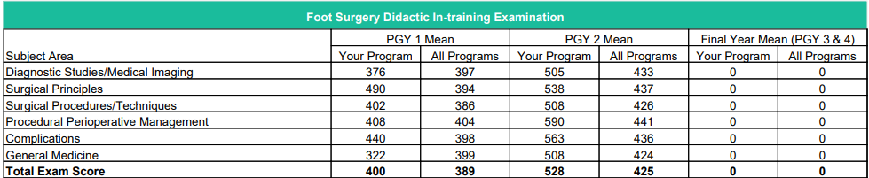
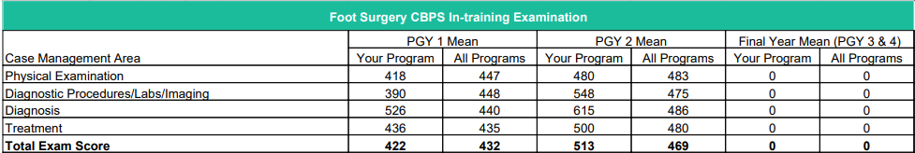




















2024 ABFAS ITE Scores
Key:
More than 10 points above national mean
Within 10 points above or below national mean
More than 10 points below national mean
PGY1 represents knowledge from school, PGY2 plus is knowledge added from residency

Slide 12
Outcomes Measures - Board Qual/Cert
Example Report from ABFAS
Shows how many graduates are qualified or certified, per class year.
Percentage calculated, giving few years leeway for collecting cases for certification
2007-2017
Foot Qual - 50/50 (100%)
Foot Cert - 43/50 grads (86%)
RRA Qual 50/50 Grads (100%)
RRA Cert 27/50 Grads (55%)
Class Year | Foot Qual | Foot Cert | RRA Qual | RRA Cert
2007 1 4 1 3
2008 2 3 4 1
2009 5 2 3
2010 1 4 2 3
2011 1 4 2 3
2012 1 4 4 1
2013 5 1 4
2014 0 5 1 4
2015 2 3 2 1
2016 2 3 2 3
2017 2 3 4 1
2018 4 1 4 2
2019 4 1 4 1
2020 5 0 4 0

Slide 13
Resident Evaluation of the Program
Send anonymous survey to all residents
Ask questions about each rotation or site
Ask about workload (too much, not enough)
Ask about surgical training, office-based training, biomechanics training, etc.

Slide 14
Anonymous Resident Survey Examples
How would you rate | N/A | Too little | Appropriate | Too much
the workload at TBTH podiatric rotation |  |  | 63.64% | 36.36%
the workload at RNC podiatric rotation | 36.36% |  | 63.64%
the workload at VA podiatric rotation |  | 9.09% | 81.82% | 9.09%
the workload at Comm Hosp podiatric rotation |  |  | 100%
the amount of night/weekend call responsibilities you had this past year? |  | 9.09% | 72.73% | 18.18%

Slide 15
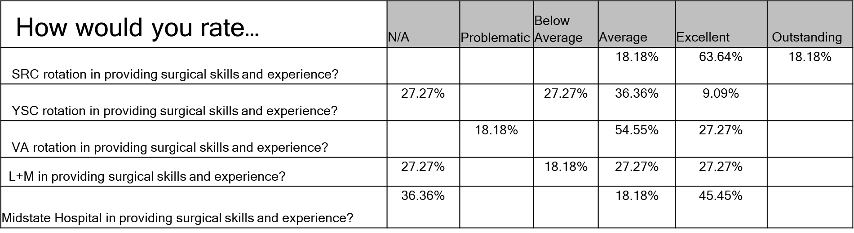
Anonymous Resident Survey Examples
How would you rate… | N/A | Problematic | Below Average | Average | Excellent | Outstanding
SRC rotation in providing valuable inpatient and ED experiences? |  |  |  |  | 90.91% | 9.09%
YSC rotation in providing valuable inpatient and ED experiences? | 9.09% |  | 9.09% | 36.36% | 36.36% | 9.09%
VA rotation in providing valuable inpatient and ED experiences? |  |  | 36.36% | 36.36% | 18.18% | 9.09%

Slide 16
Anonymous Resident Survey Examples
 | Problematic | Below Average | Average | Excellent | Outstanding
Evaluate PROFESSIONALISM of the Podiatric attendings (Demonstrates compassion, respect, and honesty; models responsibility and acknowledges errors; considers needs of patients/families/colleagues/ appreciates ethical and legal aspects of medical care)* |  |  | 63.64% | 36.36%
Evaluate PROFESSIONALISM of the podiatric residents (Demonstrates compassion, respect, and honesty; models responsibility and acknowledges errors; considers needs of patients/families/ colleagues/appreciates ethical and legal aspects of medical care)* |  |  | 54.55% | 45.45%
 | No | Yes
Did you feel unnecessary harassment by attendings at TBTH Hospital this past year ? If so, please put info in "final comments" question at end of survey.* | 81.82% | 18.18%

Slide 17
Outcomes Measures: Alumni Survey
Ask serious questions
Can the survey be anonymous as people don’t wish to share $$ data
Ask
  Income ranges
  Hospital/surgical center privileging
  State licensure issues
  Happiness questions
  What additional training in residency would have helped them

Slide 18
Anonymous Resident Survey
Review comments made by residents
Some typical (want more trauma, want more TARS, want less call, want less clinic)
Some more helpful - “suggest we do a arthroscopy lab at beginning of year rather than end of year, so PGYs can use knowledge gained all year”

Slide 19
Use Info Gained to Make Changes
Make tweaks or major changes and document the changes made.
Make your program utilize resources in the best way possible:
  Alter where residents are assigned
  Alter non-podiatric rotation lengths; cancel or change rotations
  Alter call schedule
  Alter didactics
  Add / remove attendings and teachers

