Slide 1
Introduction to CPME 320, Standards and Requirements for Approval of Podiatric Medicine and Surgery Residencies
These informal slides were intended to be delivered in a conversational format, with the presenter sharing practical examples relevant to each topic.
Notes:
We will pull up the 320 on a separate screen for this portion of the training.

Slide 2
Podiatric Residencies
Podiatric residency programs are based on the resource-based, competency-driven, assessment-validated model of training.
Resource-based
Competency-driven
Assessment-validated

Slide 3
Podiatric residency programs are based on the resource-based, competency-driven, assessment–validated model of training.
Definitions
RESOURCE-BASED
Resource-based implies that the program director constructs the residency program based upon the resources available. While the Council recognizes that available resources may differ among institutions, the program director is responsible for determining how the unique resources of the particular residency program will be organized to assure the resident opportunity to achieve the competencies identified by the Council.
Podiatric residency programs
are based on the
resource-based,
competency-driven,
assessment–validated
model of training.

Slide 4
Podiatric residency programs are based on the resource-based, competency-driven, assessment–validated model of training.
Definitions
COMPETENCY-DRIVEN
Competency-driven implies the program director assures that the resident achieves the competencies identified by the Council for successful completion of the residency. Each of these specific competencies must be achieved by every resident identified by the sponsoring institution as having successfully completed the residency program.
Podiatric residency programs
are based on the
resource-based,
competency-driven,
assessment–validated
model of training.

Slide 5
Podiatric residency programs are based on the resource-based, competency-driven, assessment–validated model of training.
Definitions
ASSESSMENT-VALIDATED
Assessment-validated implies the serial acquisition and final achievement of the competencies are validated by assessments of the resident’s knowledge, attitudes, and skills. To provide the most effective validation, assessment is conducted both internally (within the program) and externally (by outside organizations).
Podiatric residency programs
are based on the
resource-based,
competency-driven,
assessment–validated
model of training.

Slide 6
Verbs
VERBS IN CPME 320
“Shall,“ must,” and “is” indicate how a requirement is to be interpreted, without fail. The approval status of a residency program is at risk if noncompliance with a “must” or an “is” is identified.
“Should” indicates a desirable, but not mandatory, condition.
“May” is used to express freedom or liberty to follow an alternative.

Slide 7
Document Organization
STANDARDS
Requirements
GUIDELINES
Broad statements that embrace area of expected performance on the part of the sponsoring institution and the residency program
Provide an indication of whether the broader standard has been satisfied
Explanatory materials for the requirements used to indicate how the requirements either must be interpreted or may be interpreted to allow for flexibility, yet remain within a consistent framework

Slide 8
Standards and Requirements
Standards
Requirements
Explanatory materials for the requirement
Indicate how the requirement may be interpreted
Broad statements related to expected performance
The basis for evaluating the quality of education
Specific to each standard
Mandatory
Satisfaction of requirements determines extent of compliance with a standard
Guidelines

Slide 9
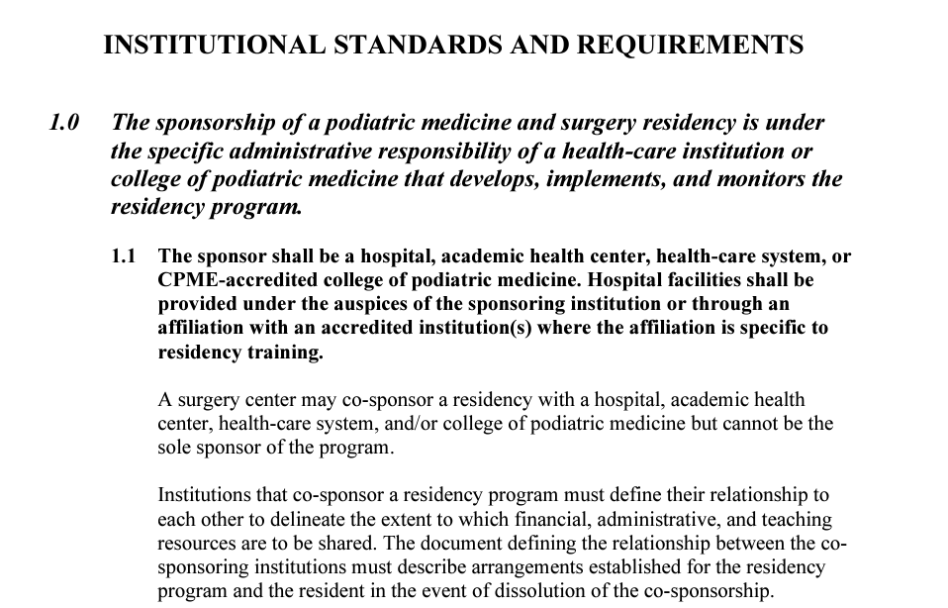
Standard
Requirement
Guideline

Slide 10
Two Types of Standards
INSTITUTIONAL STANDARDS
PROGRAM STANDARDS
Standards 1 – 4
All programs must be exact
Standards 5 – 7
Generally more flexibility due to resources of the sponsoring institution

Slide 11
Institutional and Program Requirements
7 Standards
Institutional Standards
1 – Institution (s)
2 – Facilities and Resources
3 – The Resident
4 – Reporting to the Council
Program Standards
5 – Program Director and Faculty
6 – The Curriculum
7 – Assessment

Slide 12
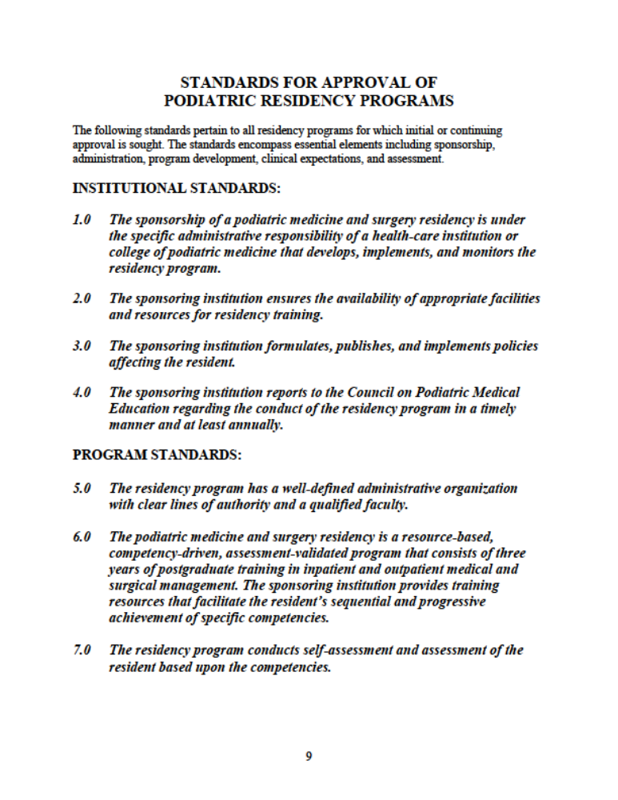

Slide 13
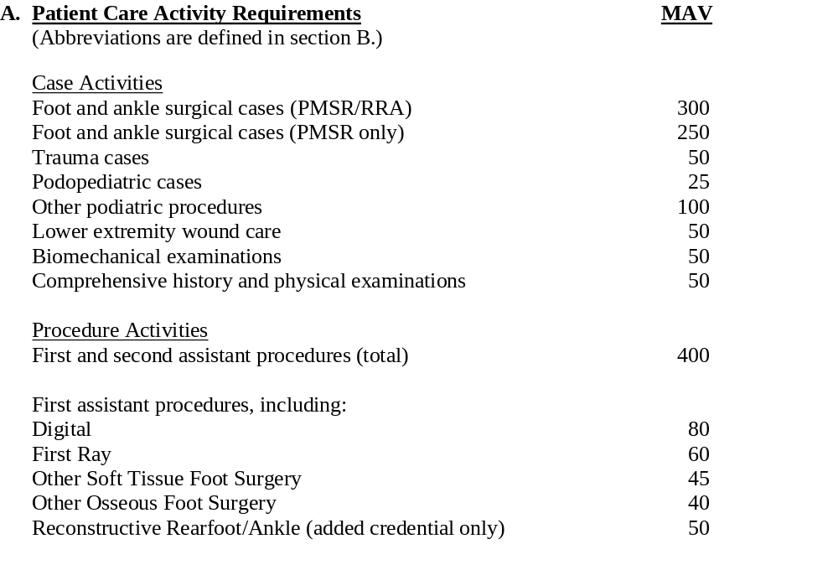
Appendix A
Volume and Diversity Requirements

Slide 14
Appendix A
Category 1: Digital Surgery (1.1–1.13)
Category 2: First Ray Surgery
  Hallux Valgus (2.1.1 – 2.1.9)
  Hallux Limitus (2.2.1 – 2.2.8)
  Other First Ray Surgery (2.3.1 – 2.3.10)
Category 3: Other Soft Tissue Foot Surgery (3.1–1.16)
Category 4: Other Osseous Foot Surgery 1–1.19)
Category 5: Reconstructive Rearfoot/Ankle Surgery
  Elective – Soft Tissue (5.1.1 – 5.1.9)
  Elective Osseous (5.2.1 – 5.2.11)
  Non–Elective – Soft Tissue (5.3.1 – 5.3.8)
  Non–Elective Osseous (5.4.1 – 5.4.8)
Volume and Diversity Requirements
Notes:
Remember that 5.3.5 is no longer used

Slide 15
Appendix A
Definition for Lower Extremity Wound Care
  Lower Extremity Wound Care. Management of lower extremity wounds, including debridement of ulcers or wounds (e.g., neuropathic, arterial, traumatic, venous, thermal), advanced wound modalities (e.g., negative pressure wound therapy, cellular and/or tissue-based product, total contact casting, multi-layer compression/therapy Unna boot), and/or hyperbaric oxygen therapy. Does not include 6.6, repair of simple laceration or simple delayed wound closure in Appendix B. Non-podiatric wound care should be logged as category 10.20.
Intent and background for biomechanical cases
  Intent and Background: Biomechanical cases should be performed in a variety of settings (surgical and non-surgical) and should include diverse pathology and treatment methods. Biomechanical exams should be a representation of the learning experience of the residents.
Volume and Diversity Requirements

Slide 16
Appendix B
Category 6: Other Podiatric Procedures (6.1–6.20)
Category 7: Biomechanics (7.1)
Category 8: History and Physical Examination
Category 9: Surgery and Surgical Subspecialties (9.1 – 9.12))
Category 10: Medicine and Medical Subspecialty Experiences (10.1 – 10.25)
Surgical Procedure Categories and Code Numbers

Slide 17
Appendix B
Category 6 – updated and expanded to include practice-based procedures that may be applied to meet the 100 MAV requirement
6 Other Podiatric Procedures
  6.5 removal of hardware (internal or external fixation)
  6.6 repair of simple laceration (no neurovascular, tendon, or bone/joint involvement); includes simple delayed wound closure
  6.8 extracorporeal shock wave therapy
  6.10 orthotics/prosthetics (limited to the foot and ankle casting/scanning/impressions for foot and/or ankle orthosis)
  6.14 percutaneous procedures (i.e., coblation, cryosurgery, radiofrequency ablation, platelet-rich plasma, digital tenotomy)
  6.15 foot care (nail debridement, callus paring)
  6.16 therapeutic/diagnostic injections (without sedation)
  6.17 incision and drainage (performed outside of the operating room)
  6.18 closed reduction of fracture or dislocation
  6.19 removal of foreign body (not in the operating room)
  6.20 application of external fixation
Surgical Procedure Categories and Code Numbers

Slide 18
Appendix B
Wound Care is Category 11
11 Lower Extremity Wound Care
11.1 excisional debridement of ulcer or wound (e.g., neuropathic, arterial, traumatic, venous, thermal)
11.2 advanced wound care modalities (e.g., negative pressure wound therapy, cellular and/or tissue-based product, total contact casting, multi-layer compression therapy/Unna boot)
11.3 hyperbaric oxygen therapy
Surgical Procedure Categories and Code Numbers

