Slide 1
After the On-site Evaluation
These informal slides were intended to be delivered in a conversational format, with the presenter sharing practical examples and emphasizing the key elements that contribute to a successful on-site evaluation.

Slide 2

Take a Deep Breath and Relax
  Relax and regroup
  The tough part is over

Slide 3

Consider the Summation Review
The summation review in-person meeting will have provided you insight into how the program did.
The summation review presents the site team's findings:
Commendations
Recommendations
Potential areas of noncompliance

Slide 4
Review Any
Potential Areas of
Noncompli-ance
Potential areas of noncompliance (PANC) are areas the site team identified where the program:
  May not be meeting standards or requirements
  May not have presented evidence that it is meeting standards or requirements
Listed as “potential” because CPME makes the final decision, not the site team.
You can work on obtaining proof, or correcting and providing proof of correction regarding any PANCs.

Slide 5
What Happens to the Team Report?
Site team completes
the 370- the team report
CPME liaison reviews the 370-
the team report
Submitted to CPME office
Sent to
program
Program reviews the 370 - the team report
Usually sent 4-6 weeks after the site visit

Slide 6
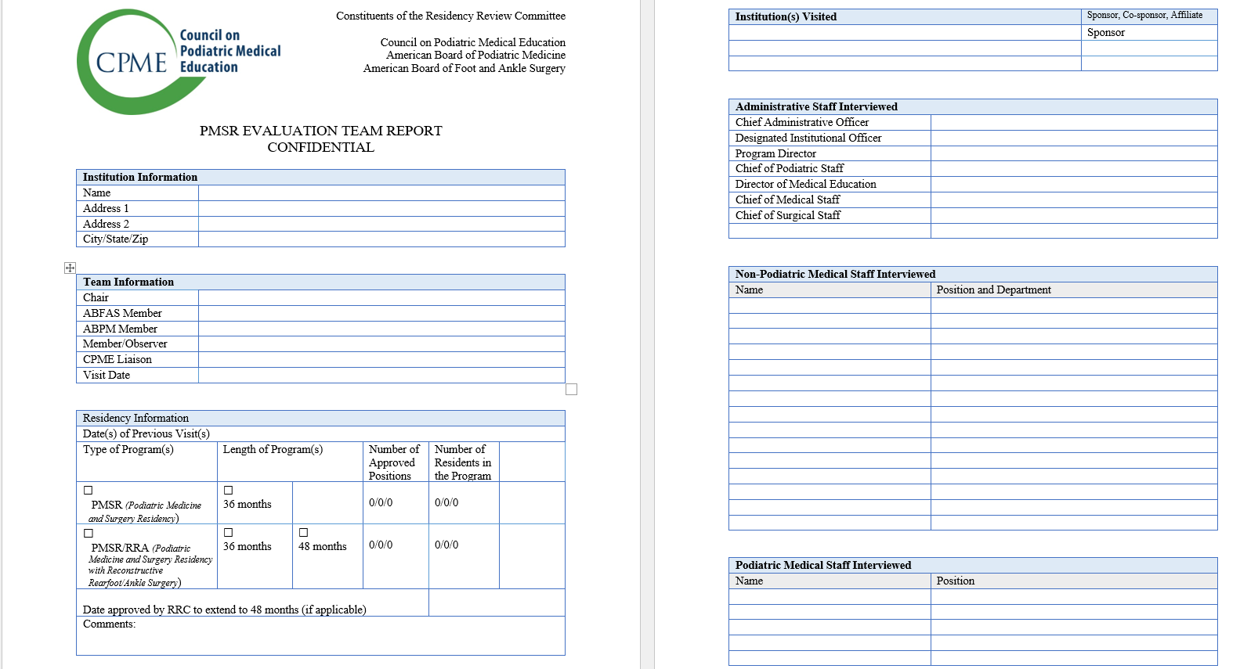
The CPME 370 - Team Report

Slide 7
The CPME 370 - Team Report
Program should first review to make sure all information is FACTUALLY CORRECT in the report:
  Incorrect names/titles of people
  Incorrect people interviewed
  Incorrect rotation names or times
  Any other incorrect info
  Put these FACTUAL errors in a well-organized letter to the CPME.

Slide 8
Response to Team Report and Potential Areas of Noncompliance (PANC)
The response is also the program's chance to present proof of corrective actions already taken to correct these PANCs.
For example:
Provide copies of missing:
  Fully executed affiliations agreements
  Signed contracts
  ACLS cards

Slide 9
Program Response to Team Report
In a well-organized letter, provide a list of the items that are factually incorrect, along with the substantive documentation demonstrating that each cited PANC has been corrected.
Provide a bookmarked PDF with each item of proof you are providing as documentation.

Slide 10
CPME Liaison Reviews the Program's Response
Your CPME Staff Liaison will review your reply and the documents submitted.
They might:
  Ask for clarification
  Ask for a Rotation Schedule (if your PANC involves evaluations/rotations)
  Suggest additional documents for you to submit
  Suggest you obtain required dates and/or signatures if not already there

Slide 11
RRC Meeting
The Residency Review Committee meets twice a year in the spring and fall.
The RRC reviews:
  Team reports completed in prior half of year
        Fall meeting reviews spring on-sites
        Spring meeting reviews fall on-sites
  Program responses to the team report, and associated materials submitted
  Logs in PRR if needed

Slide 12
RRC Meeting
Based on its review, the RRC:
  Determines if “Potential Areas of Noncompliance” are actually “Areas of Noncompliance” or not
  Determines if OTHER areas of noncompliance should be added

Slide 13
RRC Recommends an Accreditation Action to the Council
Accreditation
Accreditation with Report
Probationary Accreditation (with or without the ability to take new residents)
Withdrawal of Accreditation
All materials and a summary are provided to CPME for review and final decision. CPME also meets twice annually, usually a month after the RRC meeting.

Slide 14
CPME Accreditation Action
CPME reviews information and RRC recommendations.
CPME decides on final program status and sends a report to the program.
Accreditation
Accreditation with Report
Probationary Accreditation (with or without ability to take new residents)
Withdrawal of Accreditation

Slide 15
Progress Reports
If there are areas of noncompliance, the program will need to work to correct them and provide documentation of correction.
The program will have a chance to provide a progress report to RRC/CPME prior to their next meetings.
Link: RRC Meeting Dates and Submission Deadlines – CPME
The progress report should include a well-organized letter and bookmarked PDF with any supplemental materials.

