Slide 1
On-site Evaluation Process Overview
These informal slides were intended to be delivered in a conversational format, with the presenter sharing practical examples and emphasizing the key elements that contribute to a successful on-site evaluation.

Slide 2

Notification of on-site
Congratulations!
You’ve received an email from CPME notifying you that your program is scheduled for a re-evaluation.
This is your opportunity to shine!
It’s also an amazing opportunity for you to receive feedback on what’s going great and ways to improve the program.

Slide 3

Organization, planning, and preparation will lead to success.
It’s never too late to develop habits or new routines to improve outcomes.

Slide 4
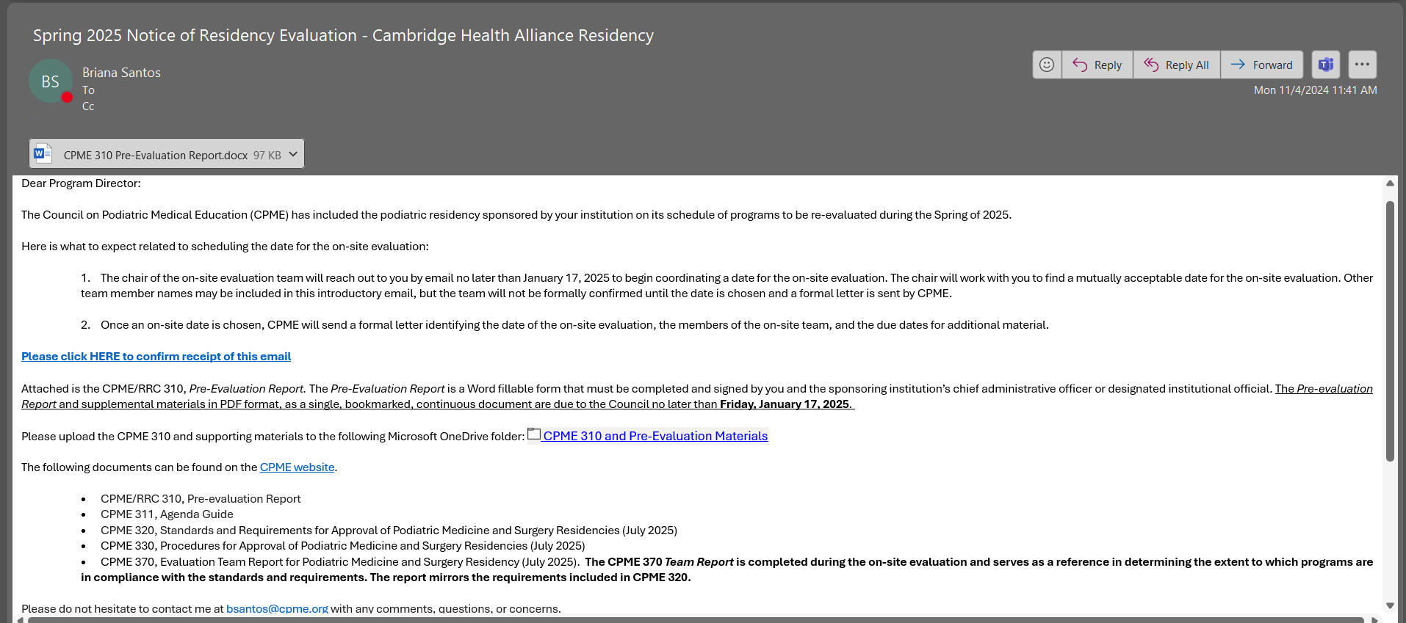
Notice of Evaluation Email
Sent to: Program Director, DIO, Program Coordinator, CPME Staff Liaison
310 DEADLINE 2 months away

Slide 5
CONFIRM and review the resources!

Slide 6

The chair contacts the program director, and both agree to a date for
the on-site evaluation.

Slide 7
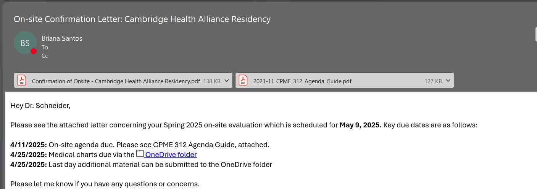
On-site Evaluation Confirmation Email
Sent to: Program Director, Program Coordinator, Evaluation Team, CPME Staff Liaison
NOTE the DEADLINES!
Attached: Agenda Guide & Confirmation Letter

Slide 8
On-site Team
The on-site evaluation is a process of collecting facts/data about a program by an objective team of reviewers who document findings and prepare a report for the RRC and CPME to review.
Minimum of two team members (ABFAS, ABPM, observers)
Known conflicts of interest (COI)are identified ahead of time
  Institutions can reject a member if COI identified and reported to CPME within 15 days of receiving on-site confirmation letter.

Slide 9
Goal of
On-site Evaluation
Conducted to assess:
  the general quality of the residency
  the institution’s ability to establish a curriculum that assures each resident achieves the competencies identified by the Council
  the institution’s plans for continued improvement.

Slide 10
Team Expectations - Volunteers
On-site review team members
  Do not act as consultants to the residency or the sponsoring institution.
  Serve in their primary role as fact-finders and observers to provide the RRC an assessment of the sponsor’s potential compliance with the Council’s standards and requirements.
  Assist the institution to understand more completely its role as related to the residency.
  May include in the report non-binding recommendations for improvement of the program.

Slide 11
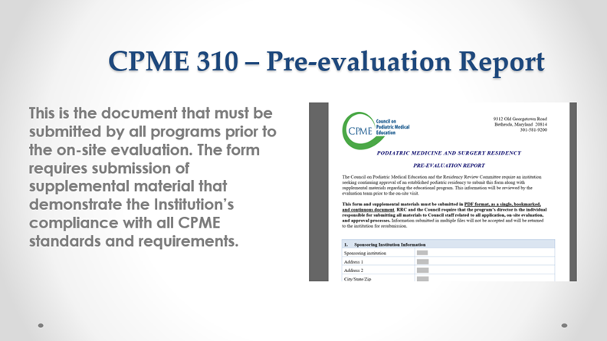
Programs submit report and materials in an orderly and organized fashion.

Slide 12
Date Set and Materials Received
Comprehensive review is initiated by the on-site team
The on-site team has access to resident logs in PRR
ABFAS representative provides case selections to chair
ABPM representative provides case selections to chair
Chair presents requested case selections to program director
Program director collects and submits case documentation to CPME for review by the evaluation team

Slide 13
Sending Charts
Initial submission
  Redact or they’ll get returned without any review
  Complete – check for missing pages; all requests accounted for
  Legible case number info/signatures or add a signature block
  Biomechanical forms in addition to chart for that visit when possible

Slide 14
Chart Review by Team
Resident participation – signature and/or name in chart indicating activity
  Signature and date of supervising provider
Comprehensive versus focused H&P
  Mix of DPM and non-DPM
Biomechanical exams static/dynamic components
  Gait analysis/conservative treatment
Ordering/interpreting diagnostic studies – imaging/labs/pathology, etc.
Differential diagnoses/care plans/consults/complications addressed
Involvement in perioperative care/complications

Slide 15
Review of Resident Logs
MAV/diversity
  Meeting/exceeding/concern for not meeting
  1st and 2nd assist
  Equity in training
CLAD report
Accuracy -- discussing logging in depth
  Miscategorization/fragmentation/sharing/duplication
Core rotation and non-DPM experiences - Categories 9 and 10
  Options for every core rotation and surgical experiences outside DPM scope
Verification within 30 days

Slide 16
Log Review May Prompt Questions
Significant differences between residents in same years
Significant logging errors and CLAD report with significant alerts
Logging cases at locations with no affiliation agreement or incomplete affiliation agreement
Not logging experiences during core rotations
  Supposed to be full representation of training

Slide 17
Agenda – CPME 311 – 4 Weeks Before Visit
Guide on CPME.org – required – interview lengths suggested
Program Director
Chief Executive Officer(s)
Director of Medical Education – if department/position exists
Site Coordinators – if program director not active at that site
Chiefs of Medical and/or Surgical Staffs
Podiatric (active) staff
Medical/osteopathic staff - must represent each rotation provided
OR/Clinic Supervisors
Podiatric residents (grouped by training year)

Slide 18
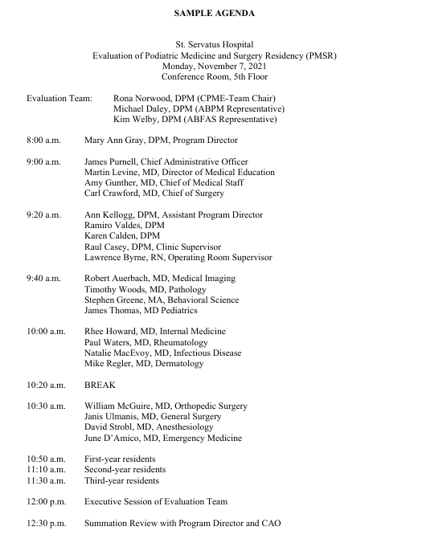
Key points:
Leadership group
DPM group
Core MD group
Core surgical group
Residents at the end

Slide 19
Resident Anonymous Survey
CPME 310 submission requirement
  Emails for current residents
Confidential resident survey sent before on-site
Results reviewed prior to the on-site
May prompt questions/requests for additional information

Slide 20
Resident Survey Questions
Available on CPME.org
What aspect of training would you like to see added to your program?
Is your schedule of training well defined throughout the year?
Are you removed from other services to cover podiatric surgery or clinic?
Do didactic activities occur at least weekly?
Does the journal club occur at least monthly?
Is research methodology part of your curriculum?
Were you provided formal instruction in logging with the web-based system used in your program?
If yes to the previous question, who instructed you in the use of web-based logging for your patient contacts?

Slide 21
Resident Survey Questions – continued
Is there a fellow at your institution or affiliate training sites and does their training affect resident training?
Do residents log cases in conjunction with a fellow, with both logging first assist?
Do you feel you receive adequate supervision from attendings in surgical and/or clinical training experiences?
Is your program director available to discuss resident concerns?
Are your clinical and educational work hours limited to no more than 80 hours per week, averaged over a four-week period? This is inclusive of all in-house clinical and educational activities and clinical work done from home.
Are you treated equitably with other residents in your facility?
Do you have any additional comments? If yes, please provide.

Slide 22
Final Communications Prior to On-site
Location logistics
  Airport/accommodations/on-site parking
  Where to meet on site
    Lobby/conference room/assistance with navigating the facility
Program director can designate an additional contact person such as program coordinator but is responsible/involved in all aspects of the visit.
Ideally, most if not all, omissions/questions addressed prior to visit.

Slide 23
Logistics for the Day of the Site Visit
If virtual—link arranged by CPME
In-person:
  Room with good lighting, confidentiality,
  sufficiently spacious
  Equipment for virtual interviews if indicated
  Wi-Fi access
  Outlets/strips for multiple PCs (typically 2-4)

Slide 24

Location on campus should be convenient for interviewees and either close to program offices or allow for staff to function nearby.
This Photo by Unknown Author is licensed under CC BY-SA

Slide 25
Day of the On-site
Review agenda with program director
  Changes/additions/deletions
    Coordinators required/substitutions
      Must be active in training and knowledgeable
Time changes
  Unavailability of scheduled participants
Availability of Program Director/Program Coordinator all day
Availability of leadership for summation review
No interviews are held prior to the official on-site date
Identify and possibly fix potential areas of noncompliance during the visit
  Volume/content of material may preclude review on day of on-site

Slide 26
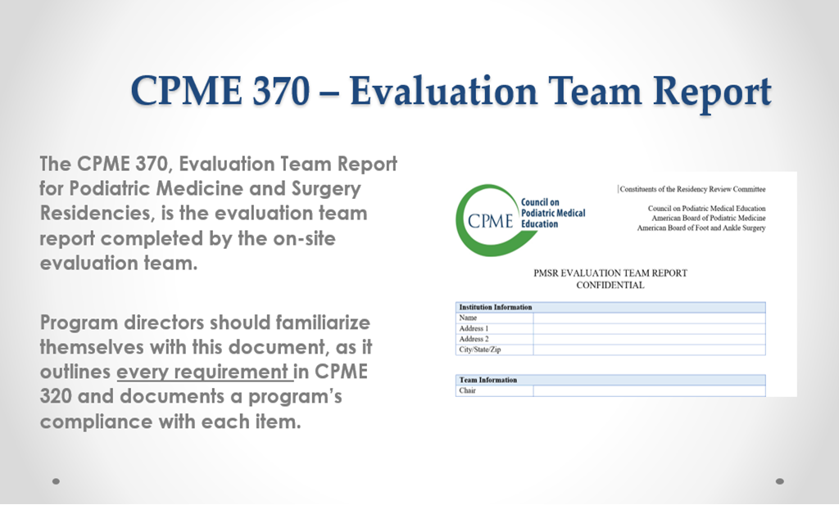

The evaluation team begins filling out the CPME 370 prior to the on-site according to findings in the submitted materials and completes the form after interviews from the day of the on-site. The CPME 370 is available on CPME.org.
Open Book Exam!

Slide 27
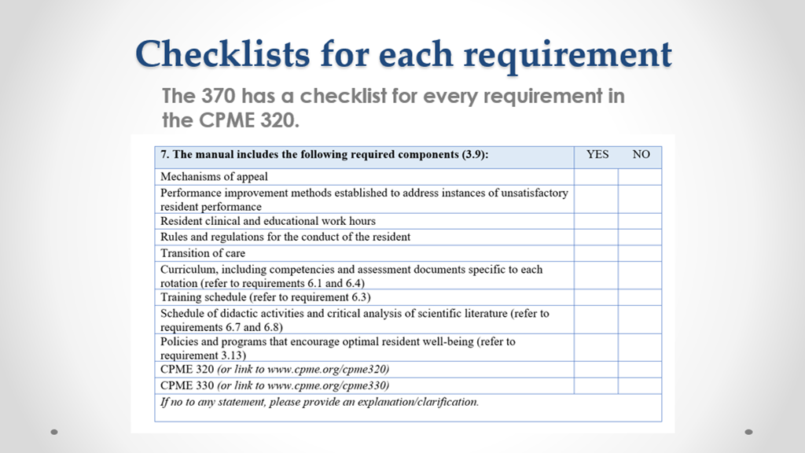
The 370 follows the 320. The Program director is highly advised to review the 370 prior to the on-site. It provides checklists covering required components.

Slide 28
Interviews
Introduce team members and their organizations
Purpose of the on-site evaluation is explained
Confidentiality policy is explained
Chair typically leads the interviews
Staying on schedule is paramount

Slide 29
Program Director Interview
Generally, questions follow the CPME 370.
Collect info for filling out summary portions of report.
Addresses omissions from CPME 310 materials:
  Address/clarify questions from the pre-evaluation review.
  Address concerns/questions from resident survey.
Future Plans
  Number of positions, affiliations, major changes to curriculum.

Slide 30
Program Director Interview, continued
Strengths/weaknesses/areas of improvement
Who instructs residents on logging?
Interview and selection process for residents
Self-assessment – who is involved
Where residents obtain their H&Ps/biomechanicals
Use of remediation policy
Hours and compensation
Faculty development requirement

Slide 31
Leadership/Administration Interview
Institution background/history/future plans
Collect data/demographics/accreditation/beds/ER volume/census
Determine interaction with program director/knowledge of program
Awareness of program director/program accolades/concerns
Anticipated positive/negative program impacts
Other residency programs
Integration of podiatry residents and equity in training
Support for clinical operations
Institutional financial support
Identification of quality assurance programs in place to review outcomes

Slide 32
GME Director Interview
Determine interaction with program director/knowledge of program
Presence of GME committee and program director membership/attendance
Awareness of program director/program accolades/concerns
Affiliate changes
Resources available for faculty development/resident education
Anticipated positive/negative program impacts
Other residency programs/Integration of podiatry residents and equity in training
Research resources
Resident mental/physical health support during residency

Slide 33

  During the on-site, a tour of the facility is conducted to confirm resources exist.
  The team may visit the ER, designated resident space, dining area, wards, library, OR, and clinic.

Slide 34
Core Medicine Rotation Interviews
Confirm interviewed rotation coordinator/provider is involved in training
Outline design of rotation – days/hours/length/location of rotation
  Hands-on versus observational and inpatient and/or outpatient
Confirm annual receipt of training schedule
Confirm knowledge of competencies – residents meet expectations
Complete assessment documents and ensure that they line up with competencies
Confirm rotation is of sufficient length/design to achieve competencies
Other trainees present at the same time and assuring equity
Residents getting pulled from rotation
Availability of didactic experiences
Final questions/comments/suggestions they may have for the program

Slide 35
Core Surgery Rotations
Confirm interviewed rotation coordinator/provider is involved in training
Outline design of rotation – days/hours/length/location of rotation
  Hands-on versus observational, and inpatient, outpatient and/or OR experiences
Confirm annual receipt of training schedule
Confirm knowledge of competencies – residents meeting expectations
Complete assessment documents and ensure that they line up with competencies
Confirm rotation is of sufficient length/design to achieve competencies
Other trainees present at the same time and assuring equity
  Who gets 1st assist and how it is determined especially when scope is podiatric
Residents getting pulled from rotation
Availability of didactic experiences
Final questions/comments/suggestions they may have for the program

Slide 36
Orthopedic Rotation Interview
May include additional questions delineating
  Presence of orthopedic residency or fellowship programs
  Number and type of trainees present during cases
  Determination of 1st assist
  Documenting podiatric resident involvement - OP reports/charts
  Extent of overall involvement in surgical/ortho cases
  Extent of involvement in ER/inpatient/outpatient evaluation of patients
  Determine protocol for 1st call to ER for lower extremity trauma cases

Slide 37
Anesthesiology and Emergency Medicine Interviews
Anesthesiology
  Observation of resident/attending interactions/environment
  Case coverage and involvement
Emergency Medicine
  Residents on consult/On-call activities
  If both orthopedic and podiatry presence, how are cases distributed?

Slide 38

Lunch is typically a working lunch and sometimes includes the DPMs involved in the program.

Slide 39
DPM Interviews
Confirm involvement in training and extent of resident interaction
  Design/OR/inpatient/outpatient/private practice locations
Call schedule and supervision of residents for rounds/OR
Confirm knowledge/completion of competencies/assessments
Resources sufficient to achieve MAVs/competencies
Other trainees present/double scrubbing/assuring equity
Case coverage and knowledge of residents getting pulled from core rotations
Residents meeting expectations
Presence of orthopedic service/residents/fellows – working environment

Slide 40
DPM Interviews, continued
Receipt of annual training schedule
Didactics availability and involvement
Involvement in annual self-assessment of the program/curriculum
Quality assurance for outcomes/M&M/Indications conferences, etc.
Performance improvement plan and if used
Aware of any changes and assessment of positive/negative impact
Final questions/comments/suggestions they may have for the program

Slide 41
DPM Interviews Supplement the Summary of Findings in the CPME 370
In addition to the pre-evaluation materials, review of charts/X-rays and logs, interviews provide insight into the program that allows for description of:
  inpatient podiatric experiences
  outpatient podiatric experiences
  podiatric surgical experiences
  location and rotations that provide wound experiences
  location and rotations that provide experiences in biomechanics

Slide 42
Operating Room/Clinic Supervisors
Level of interaction with Program Director and/or residents
Number of ORs, block time, emergency case addition protocol
  Level of involvement, which services residents are scrubbing for cases
Number of clinic rooms, volume, support staff
  Sufficient time, rooms, and equipment
  Residents performing procedures/wound care/administrative tasks
Resident supervision/attending presence
Other trainees present
Knowledge of changes impacting positively/negatively

Slide 43
Resident Interviews
Assure confidentiality and that focus is on program rather than individuals
Have option of speaking with the on-site team one-on-one if desired
Questions about the program, institution, Program Director availability, support staff, daily activities, duty hours, time off, and mental health support
Questions regarding on-call structure, case coverage, rounds, and OR
  Cases/volume/scope/equity in training/relationship with orthopedics
Questions about assessment document review, semi-annual reviews, ITEs, rotations in general, changes they might have noticed or would like to see
Research, research methodology, support for publishing endeavors
Academics: structure, presence of faculty, content, and frequency
Education about and feedback for logging

Slide 44
Resident Interviews, continued
Strengths/weaknesses/areas of improvement
Presence of fellows or other podiatric residents
Who taught logging
Meeting with the Program Director for evaluation review, semi-annual meetings
Clarification of points discovered from pre-evaluation report or during interviews
Accolades/questions/concerns

Slide 45

Core rotation/key staff not available?
Determine why, if possible, document it, and move on.
Lack of key participants can jeopardize the visit or program and can lead to cancellation or rescheduling of on-site evaluation.
This Photo by Unknown Author is licensed under CC BY

Slide 46
Executive Session Near the End of the Day
Time allowed depends on need for the team to meet privately
Team discusses, finalizes, and documents its findings
Team may elect to meet with the program director prior to meeting with
leadership
It is beyond the scope of the on-site team to make recommendations about increasing numbers, pursuing RRA, and/or getting involved in politics/issues surrounding the podiatric community.
Remember that the team's findings are sent to the CPME office and then reviewed by the RRC, which makes recommendations to the CPME for final actions.

Slide 47
Summation Review
Exit interview to report findings of the team
The program director and designated administrator must be present
Additional people may be present as determined by the program director and team chair
Report findings—not the time to discuss or challenge findings
Commendations and recommendations
Potential areas of noncompliance
Overview of the sequence of events following the visit

Slide 48
Commendations
Commendations reflect special, positive attributes and strengths of the program that the team became aware of during the review.
They are specific to the program and are meant to showcase how the program is succeeding in providing residency training and meeting or exceeding requirements.

Slide 49
Recommendations
Recommendations are areas the program may want to utilize for improvement.
Recommendations do not rise to the level of areas of noncompliance.

Slide 50
Potential Areas of Noncompliance
Areas of noncompliance will need to be addressed by the program within a specified timeline provided by the Council.
It is advised that staff members who are present during the summation review take notes and begin preparing for the program's response to the CPME.

Slide 51
After the Summation Review
The institution and the on-site team have no contact.
After the on-site visit, the draft report is finalized and sent to CPME staff for review and editing. This draft will be sent to the program director for review and identification of any factual errors. The program director may share this draft with colleagues and then supply CPME with corrections and clarifications, if any.
The corrected draft report will be submitted to the RRC at its next meeting.
After the Committee’s review, the report will be forwarded to the Council for an accreditation action at its next scheduled meeting.

Slide 52
RRC/CPME Changes to the CPME 370 Report
The Residency Review Committee and CPME have the prerogative to make changes in the commendations, recommendations, and potential areas of noncompliance.
They may eliminate a commendation or recommendation, add a recommendation, eliminate an area of noncompliance, or convert a recommendation to an area of noncompliance after reading the narrative summaries in the report relating to each of the seven standards.
The Council will issue the final report to the program shortly after its next scheduled meeting following the on-site evaluation.

Slide 53
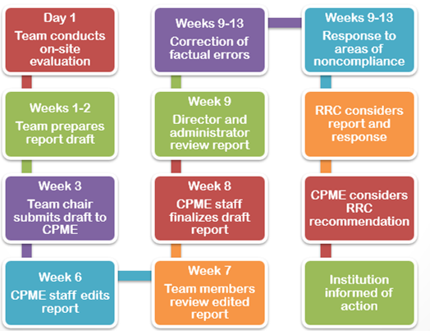
Accreditation timeline

Slide 54

A post-evaluation questionnaire allows the program to assess how well the evaluation team did. The completed questionnaire is reviewed by the Collaborative Residency Evaluator/Education Committee.
This Photo by Unknown Author is licensed under CC BY-SA-NC

